Slide 1
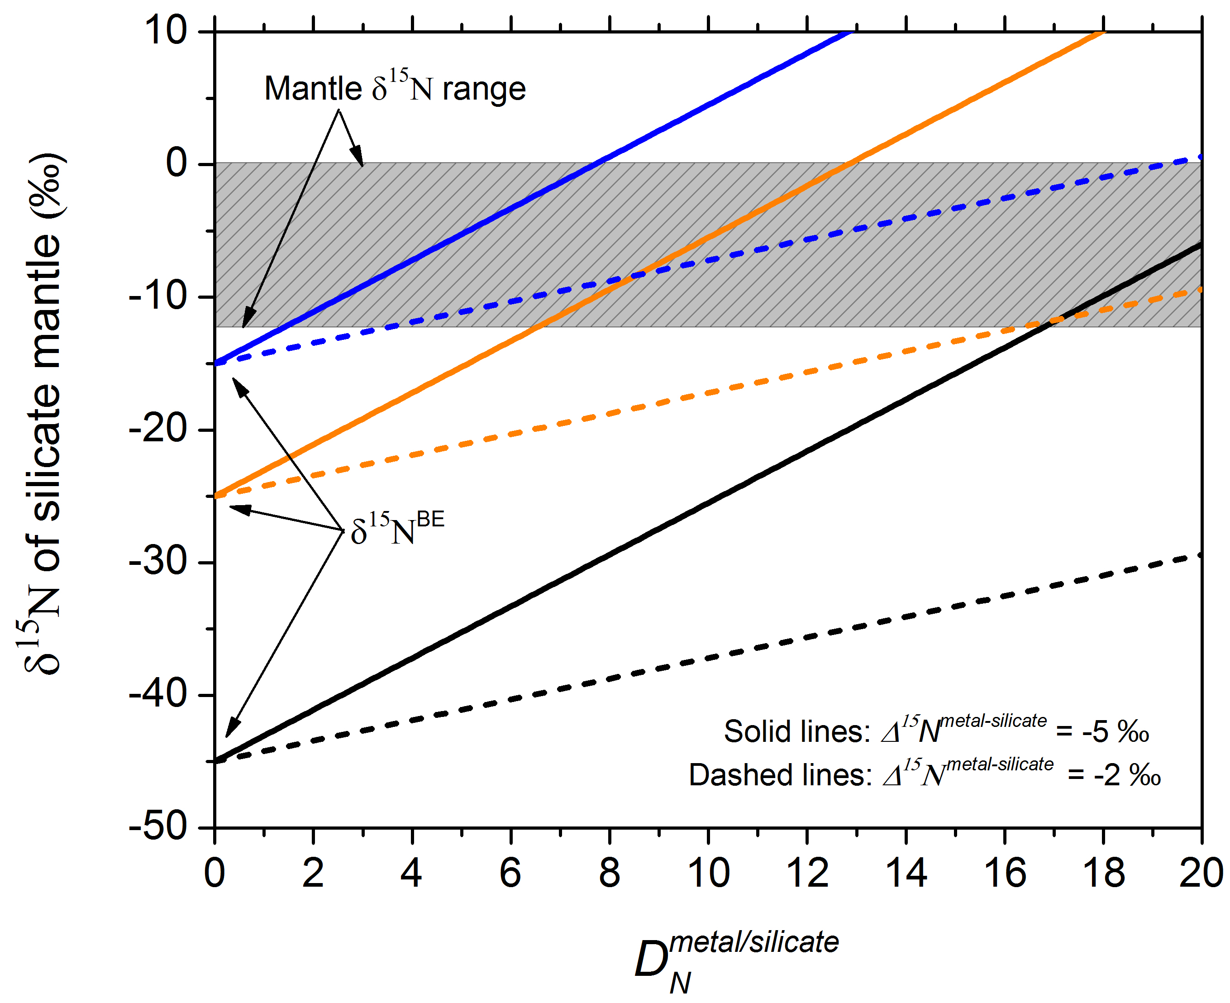
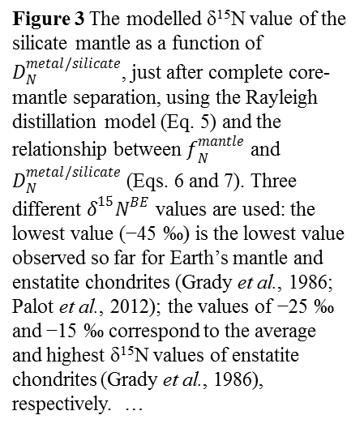
Li et al.
Nitrogen isotope fractionation during terrestrial core-mantle separation
Figure 3 The modelled δ¹⁵N value of the silicate mantle as a function of $D_{N}^{metal/silicate}$, just after complete core-mantle separation, using the Rayleigh distillation model (Eq. 5) and the relationship between $f_{N}^{mantle}$ and $D_{N}^{metal/silicate}$ (Eqs. 6 and 7). Three different $δ^{15}N^{BE}$ values are used: the lowest value (−45 ‰) is the lowest value observed so far for Earth’s mantle and enstatite chondrites (Grady et al., 1986; Palot et al., 2012); the values of −25 ‰ and −15 ‰ correspond to the average and highest δ¹⁵N values of enstatite chondrites (Grady et al., 1986), respectively. …
Li et al. (2016) Geochem. Persp. Let. 2, 138-147 | doi: 10.7185/geochemlet.1614
© 2016 European Association of Geochemistry
Notes:
Figure 3 The modelled δ¹⁵N value of the silicate mantle as a function of $D_{N}^{metal/silicate}$, just after complete core-mantle separation, using the Rayleigh distillation model (Eq. 5) and the relationship between $f_{N}^{mantle}$ and $D_{N}^{metal/silicate}$ (Eqs. 6 and 7). Three different $δ^{15}N^{BE}$ values are used: the lowest value (−45 ‰) is the lowest value observed so far for Earth’s mantle and enstatite chondrites (Grady et al., 1986; Palot et al., 2012); the values of −25 ‰ and −15 ‰ correspond to the average and highest δ¹⁵N values of enstatite chondrites (Grady et al., 1986), respectively. Two different $∆^{15}N^{metal−silicate}$ values of −2 ‰ and −5 ‰ are used for the dashed lines and solid lines, respectively. The gray box represents the main range of δ¹⁵N values observed for the silicate mantle (Marty and Dauphas, 2003; Palot et al., 2012; Cartigny and Marty, 2013), which may be produced from the average nitrogen isotopic composition of enstatite chondrites by core-mantle separation with $D_{N}^{metal/silicate}$ between 5 and 20.

