Slide 1
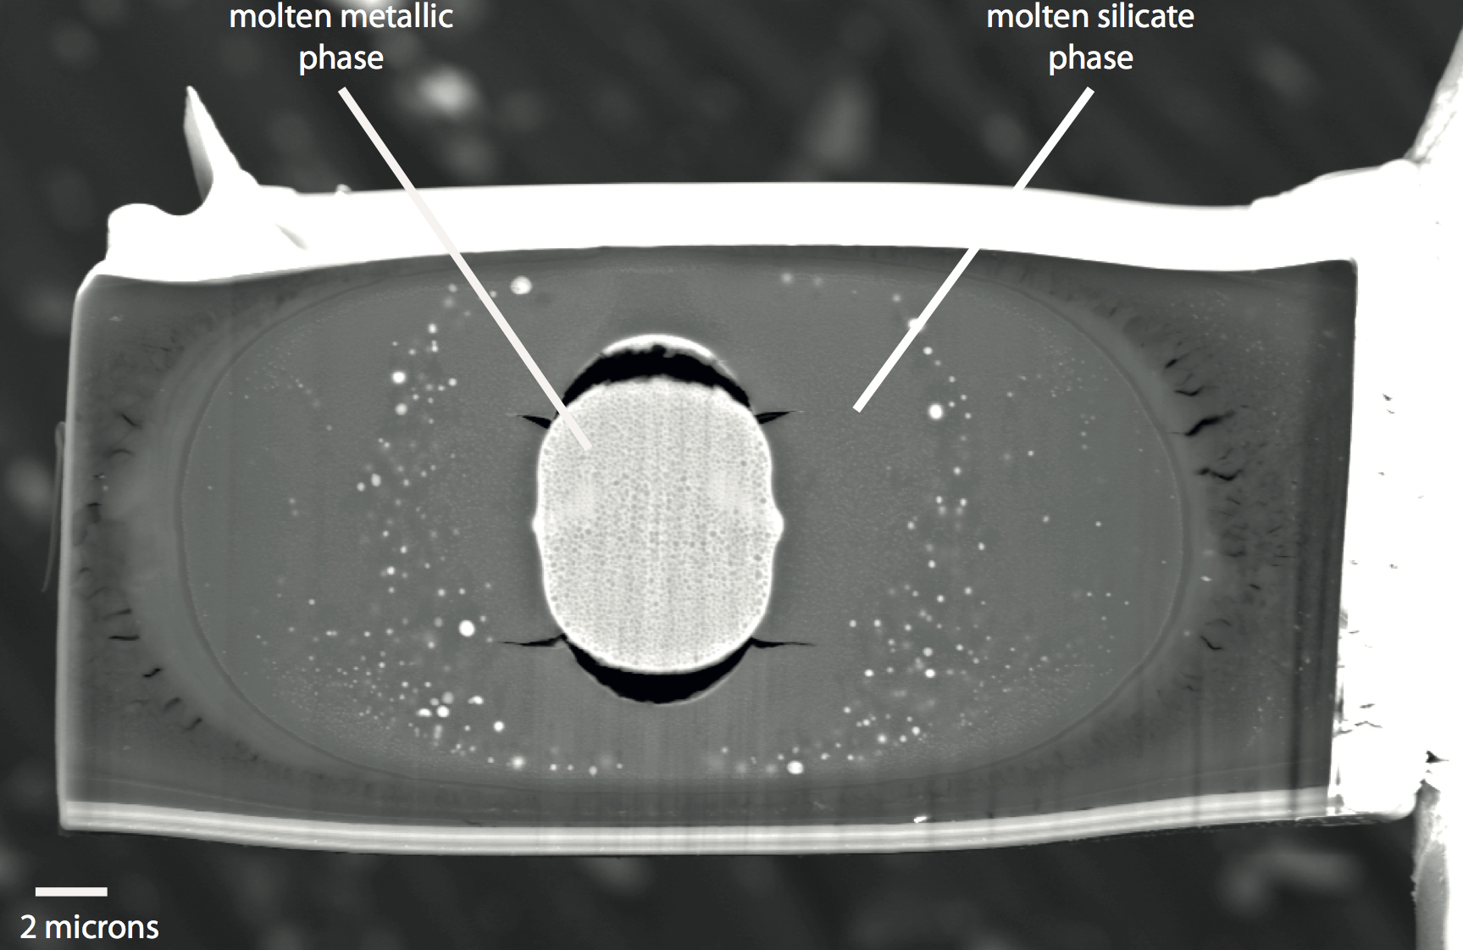
Blanchard et al.
The solubility of heat-producing elements in Earth’s core
Figure S-1 Backscattered scanning electron microscopy (FEG-SEM) image of a typical recovered sample. Samples are excavated from the melted region, thinned down to a thickness of ~3 microns, and welded to a TEM grid using a FIB instrument. The metal and silicate phases are analysed by electron microprobe analysis.
Blanchard et al. (2017) Geochem. Persp. Let. 5, 1-5 | doi: 10.7185/geochemlet.1737
© 2017 European Association of Geochemistry
Notes:
Figure S-1 Backscattered scanning electron microscopy (FEG-SEM) image of a typical recovered sample. Samples are excavated from the melted region, thinned down to a thickness of ~3 microns, and welded to a TEM grid using a FIB instrument. The metal and silicate phases are analysed by electron microprobe analysis.

