Slide 1
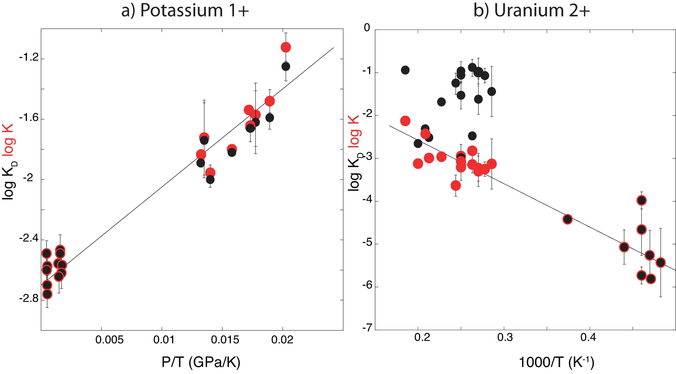
Blanchard et al.
The solubility of heat-producing elements in Earth’s core
Figure S-2 Comparison of equilibrium constant (log K) and the exchange coefficient (log K_{D}) for potassium (a) and uranium (b) metal-silicate exchange reactions. The difference between log(K) and log(K_{D}) is the activity coefficient ratio . While
activities are limited for potassium (a), because all interaction parameters are 0, they are obvious in uranium (b) because of a large interaction parameter between U and O in the metal.
Blanchard et al. (2017) Geochem. Persp. Let. 5, 1-5 | doi: 10.7185/geochemlet.1737
© 2017 European Association of Geochemistry
Notes:
Figure S-2 Comparison of equilibrium constant (log K) and the exchange coefficient (log K_{D}) for potassium (a) and uranium (b) metal-silicate exchange reactions. The difference between log(K) and log(K_{D}) is the activity coefficient ratio (see equation in caption above) . While activities are limited for potassium (a), because all interaction parameters are 0, they are obvious in uranium (b) because of a large interaction parameter between U and O in the metal.

