Slide 1
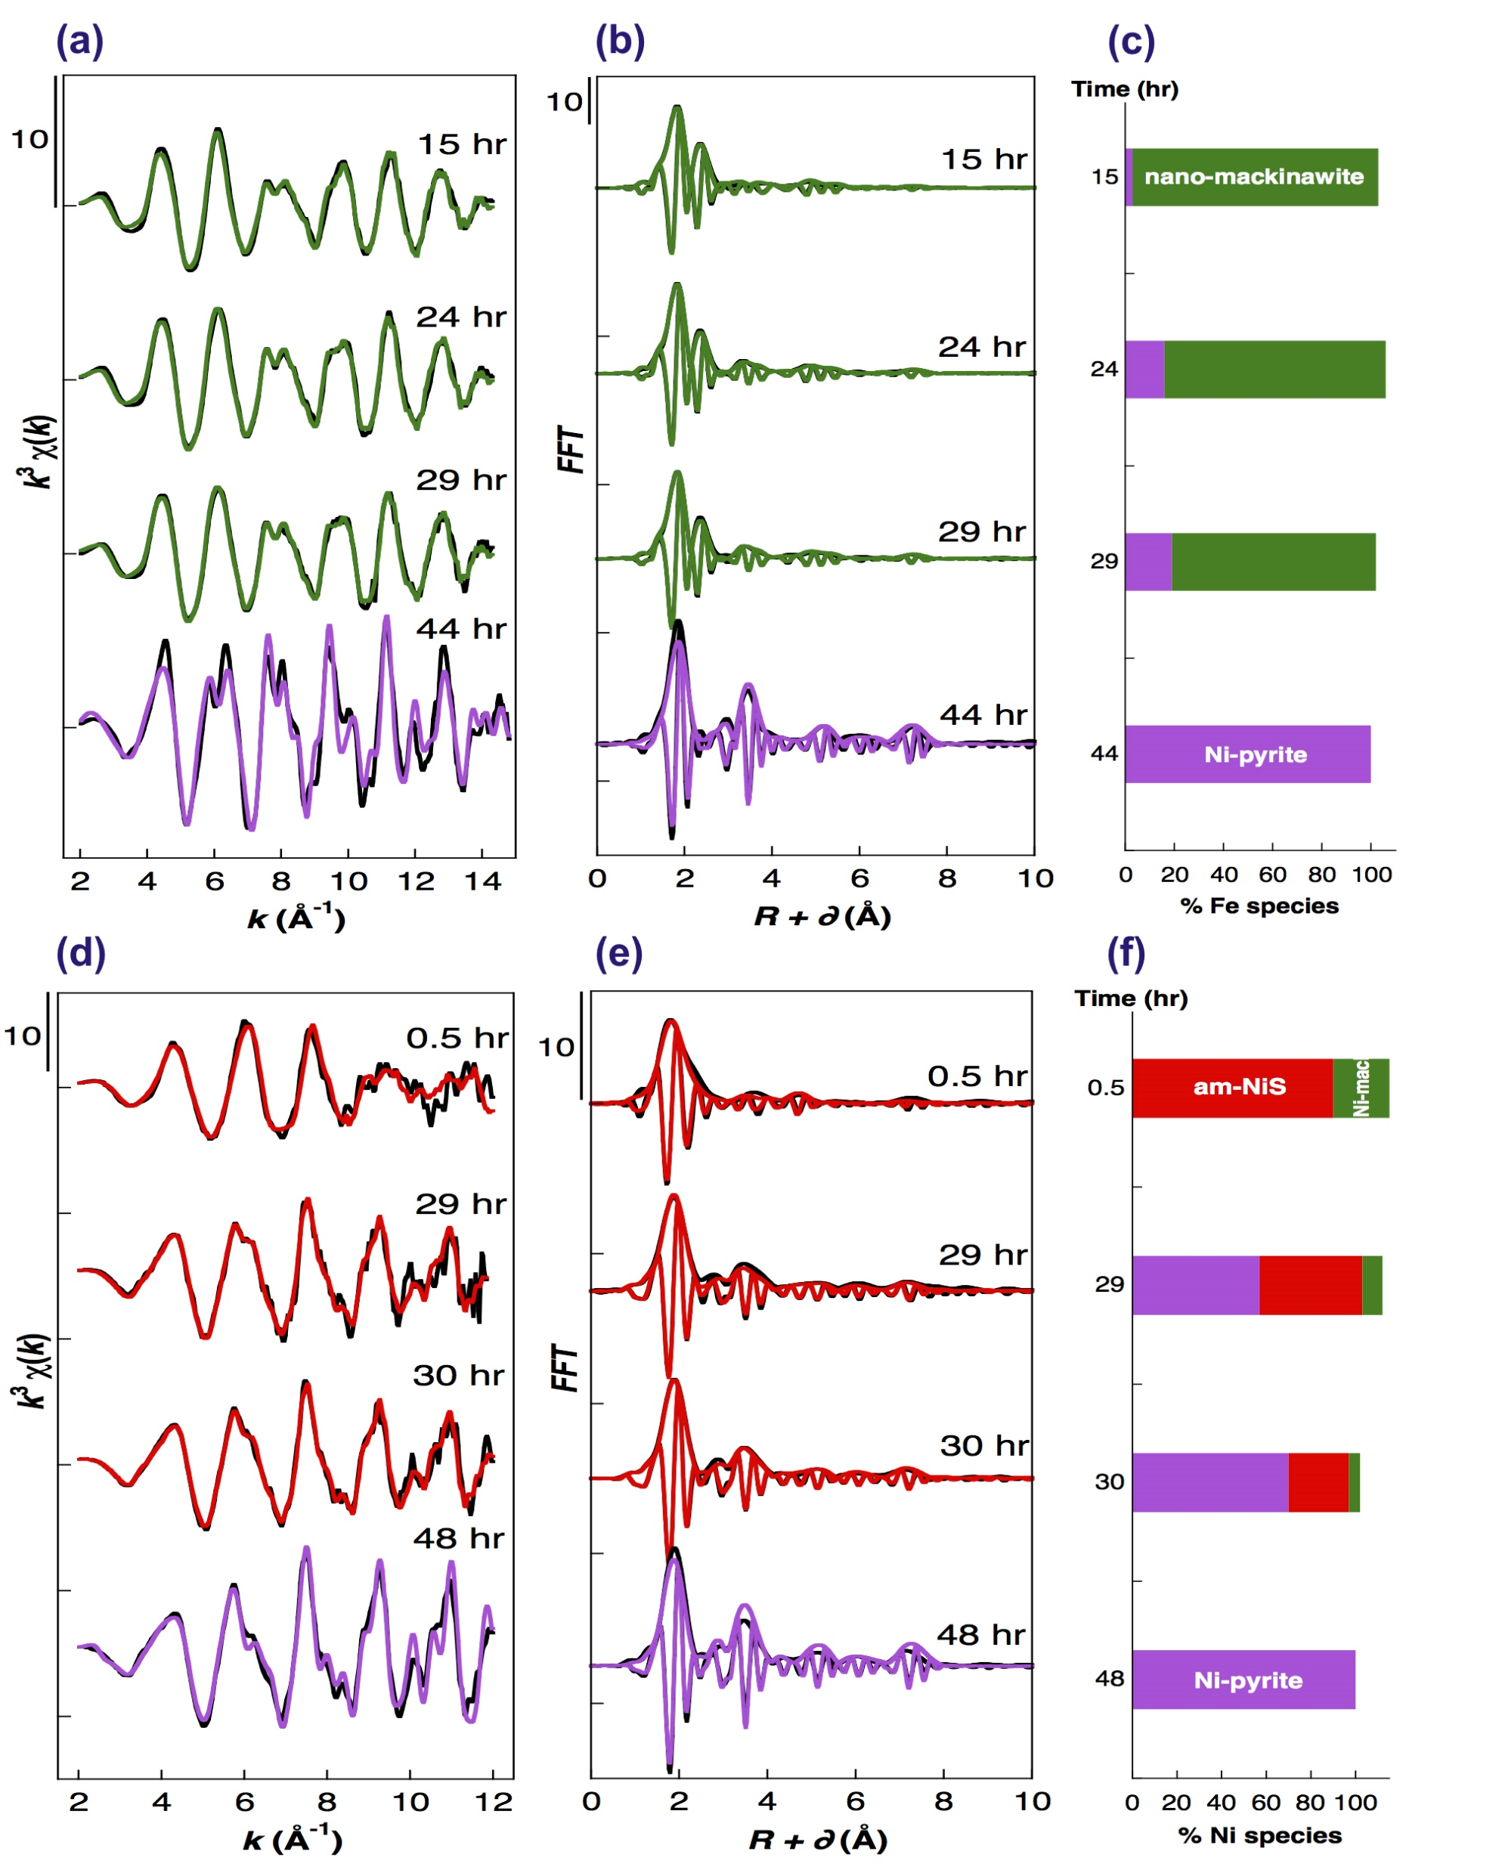
Morin et al.
Nickel accelerates pyrite nucleation at ambient temperature
Figure 2 Fe and Ni speciation in the solids formed during the synthesis of Ni-doped pyrite. Fe (a,b) and Ni (d,e) K-edge k³-weighted EXAFS spectra and corresponding Fast Fourier transforms. Experimental (black). Ab initio Feff8.1 calculation (purple) (Table S-3). LC-LS fits (green: Fe; red: Ni) (Table S-4). LC-LS fit components probing the local structure around Fe (c) and Ni (f) atoms include: Ni-pyrite (Fe_{1-x}Ni_{x}S₂), am-NiS (amorphous NiS) and Ni-mack (Fe_{1-x}Ni_{x}S) (Table S-4).
.
Morin et al. (2017) Geochem. Persp. Let. 5, 6-11 | doi: 10.7185/geochemlet.1738
© 2017 European Association of Geochemistry
Notes:
Figure 2 Fe and Ni speciation in the solids formed during the synthesis of Ni-doped pyrite. Fe (a,b) and Ni (d,e) K-edge k³-weighted EXAFS spectra and corresponding Fast Fourier transforms. Experimental (black). Ab initio Feff8.1 calculation (purple) (Table S-3). LC-LS fits (green: Fe; red: Ni) (Table S-4). LC-LS fit components probing the local structure around Fe (c) and Ni (f) atoms include: Ni-pyrite (Fe_{1-x}Ni_{x}S₂), am-NiS (amorphous NiS) and Ni-mack (Fe_{1-x}Ni_{x}S) (Table S-4).

