Slide 1
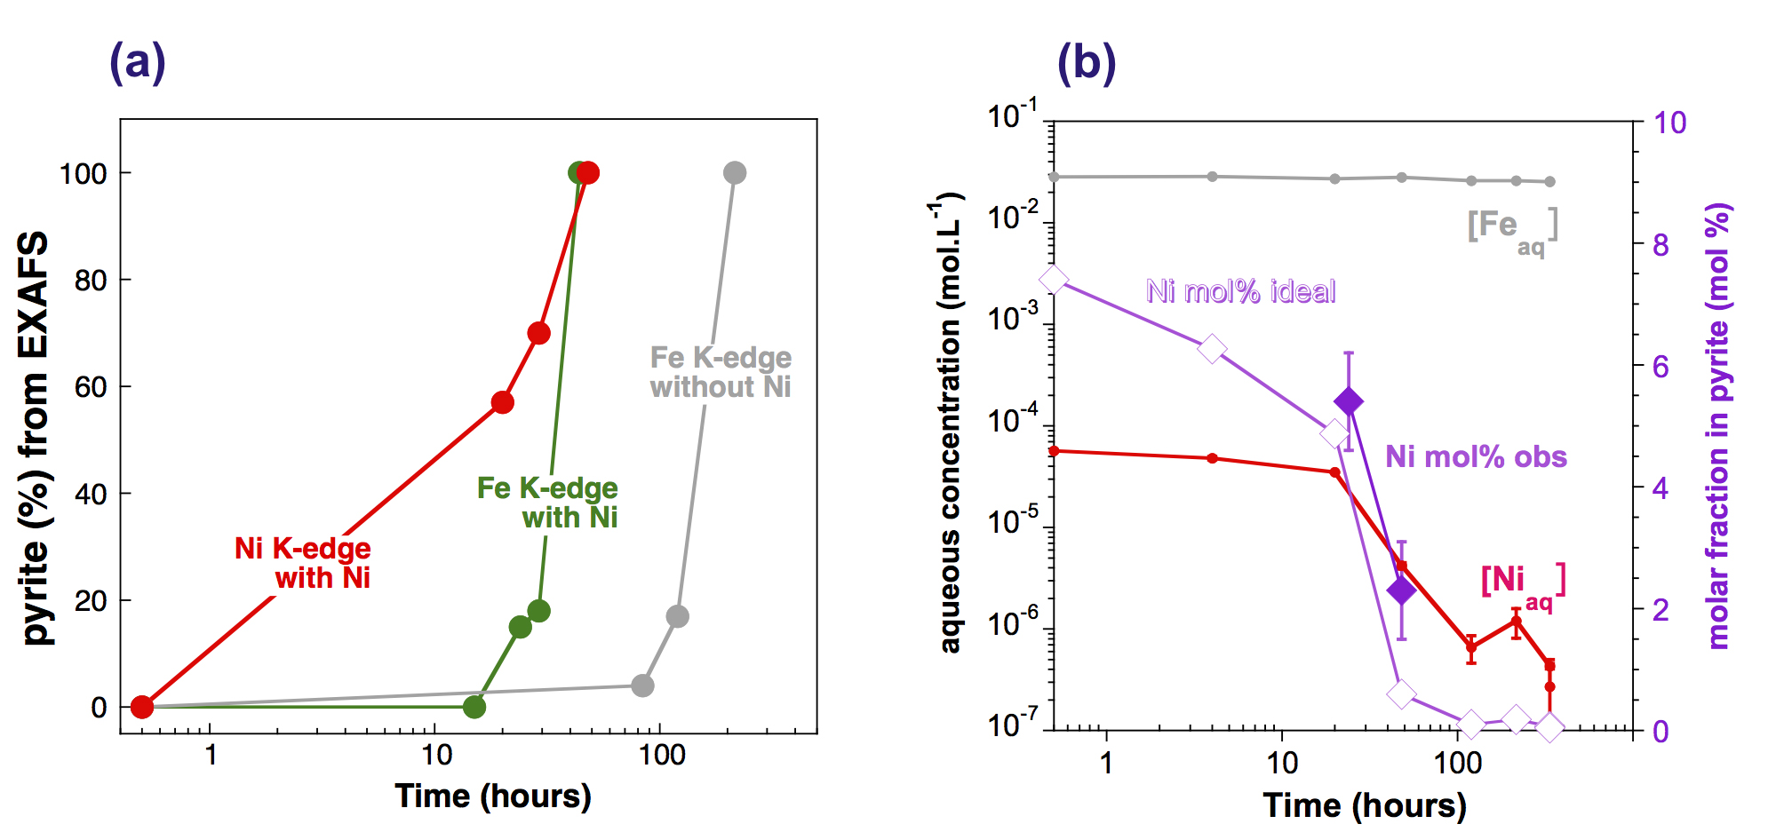
Morin et al.
Nickel accelerates pyrite nucleation at ambient temperature
Figure 4 Distribution of Ni and Fe in the solid and dissolved phases during the pyrite synthesis. (a) Proportion of initial Ni (red) and Fe (green and gray) incorporated in pyrite in the synthesis conducted with and without Ni impurity, as determined by LC-LS fits of EXAFS data (Figs. 2 and S-2). (b) Concentrations of aqueous Fe ([Fe_{aq}]) and Ni ([Ni_{aq}]) in the presence (with Ni) and absence (without Ni) of aqueous Ni impurity…
Morin et al. (2017) Geochem. Persp. Let. 5, 6-11 | doi: 10.7185/geochemlet.1738
© 2017 European Association of Geochemistry
Notes:
Figure 4 Distribution of Ni and Fe in the solid and dissolved phases during the pyrite synthesis. (a) Proportion of initial Ni (red) and Fe (green and gray) incorporated in pyrite in the synthesis conducted with and without Ni impurity, as determined by LC-LS fits of EXAFS data (Figs. 2 and S-2). (b) Concentrations of aqueous Fe ([Fe_{aq}]) and Ni ([Ni_{aq}]) in the presence (with Ni) and absence (without Ni) of aqueous Ni impurity. The molar fraction of Ni in pyrite estimated by combining chemical composition of the solution and EXAFS analysis of the solids (Ni mol. % obs; purple diamonds) is compared to the molar fraction of Ni in pyrite predicted by assuming saturation equilibrium with an ideal pyrite-vaesite solid solution (Ni mol. % ideal; white diamonds) (see text and Table S-5).

