Slide 1
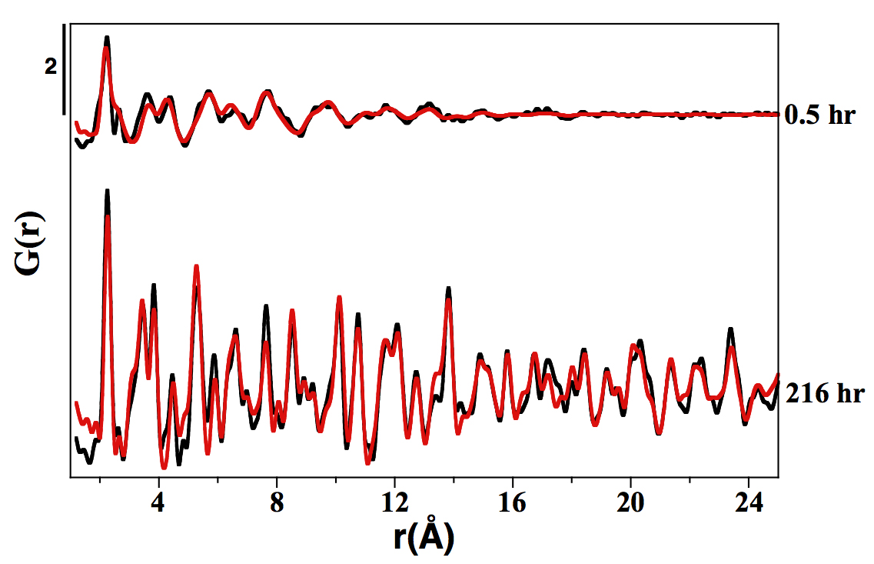
Morin et al.
Nickel accelerates pyrite nucleation at ambient temperature
Figure S-1 PDF analysis of the samples collected at 0.5 hr and 216 hr in the Ni-free synthesis experiment. For the 0.5 hr and 216 hr samples, the best fits were obtained from the refinement in real space of the mackinawite structure (Lennie et al., 1995) and the pyrite structure (Wyckoff et al., 1963) respectively (Table S-2). Experimental and calculated PDF curves are plotted in black and red colours, respectively.
Morin et al. (2017) Geochem. Persp. Let. 5, 6-11 | doi: 10.7185/geochemlet.1738
© 2017 European Association of Geochemistry
Notes:
Figure S-1 PDF analysis of the samples collected at 0.5 hr and 216 hr in the Ni-free synthesis experiment. For the 0.5 hr and 216 hr samples, the best fits were obtained from the refinement in real space of the mackinawite structure (Lennie et al., 1995) and the pyrite structure (Wyckoff et al., 1963) respectively (Table S-2). Experimental and calculated PDF curves are plotted in black and red colours, respectively.

