Slide 1
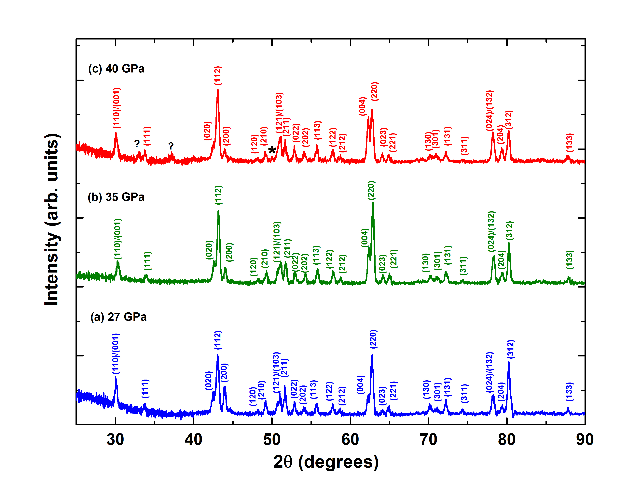
Liu et al.
Rapid decrease of MgAlO_{2.5} component in bridgmanite with pressure
Figure 1 XRD patterns of En₉₀Brm₁₀ subjected to (a) 27, (b) 35 and (c) 40 GPa and at 2000 ºK. Number in parentheses represents the index of bridgmanite. Question marks denote unidentified peaks. Asterisk denotes the probable (200) peak of periclase.
Liu et al. (2017) Geochem. Persp. Let. 5, 12-18 | doi: 10.7185/geochemlet.1739
© 2017 European Association of Geochemistry
Notes:
Figure 1 XRD patterns of En₉₀Brm₁₀ subjected to (a) 27, (b) 35 and (c) 40 GPa and at 2000 ºK. Number in parentheses represents the index of bridgmanite. Question marks denote unidentified peaks. Asterisk denotes the probable (200) peak of periclase.

