Slide 1
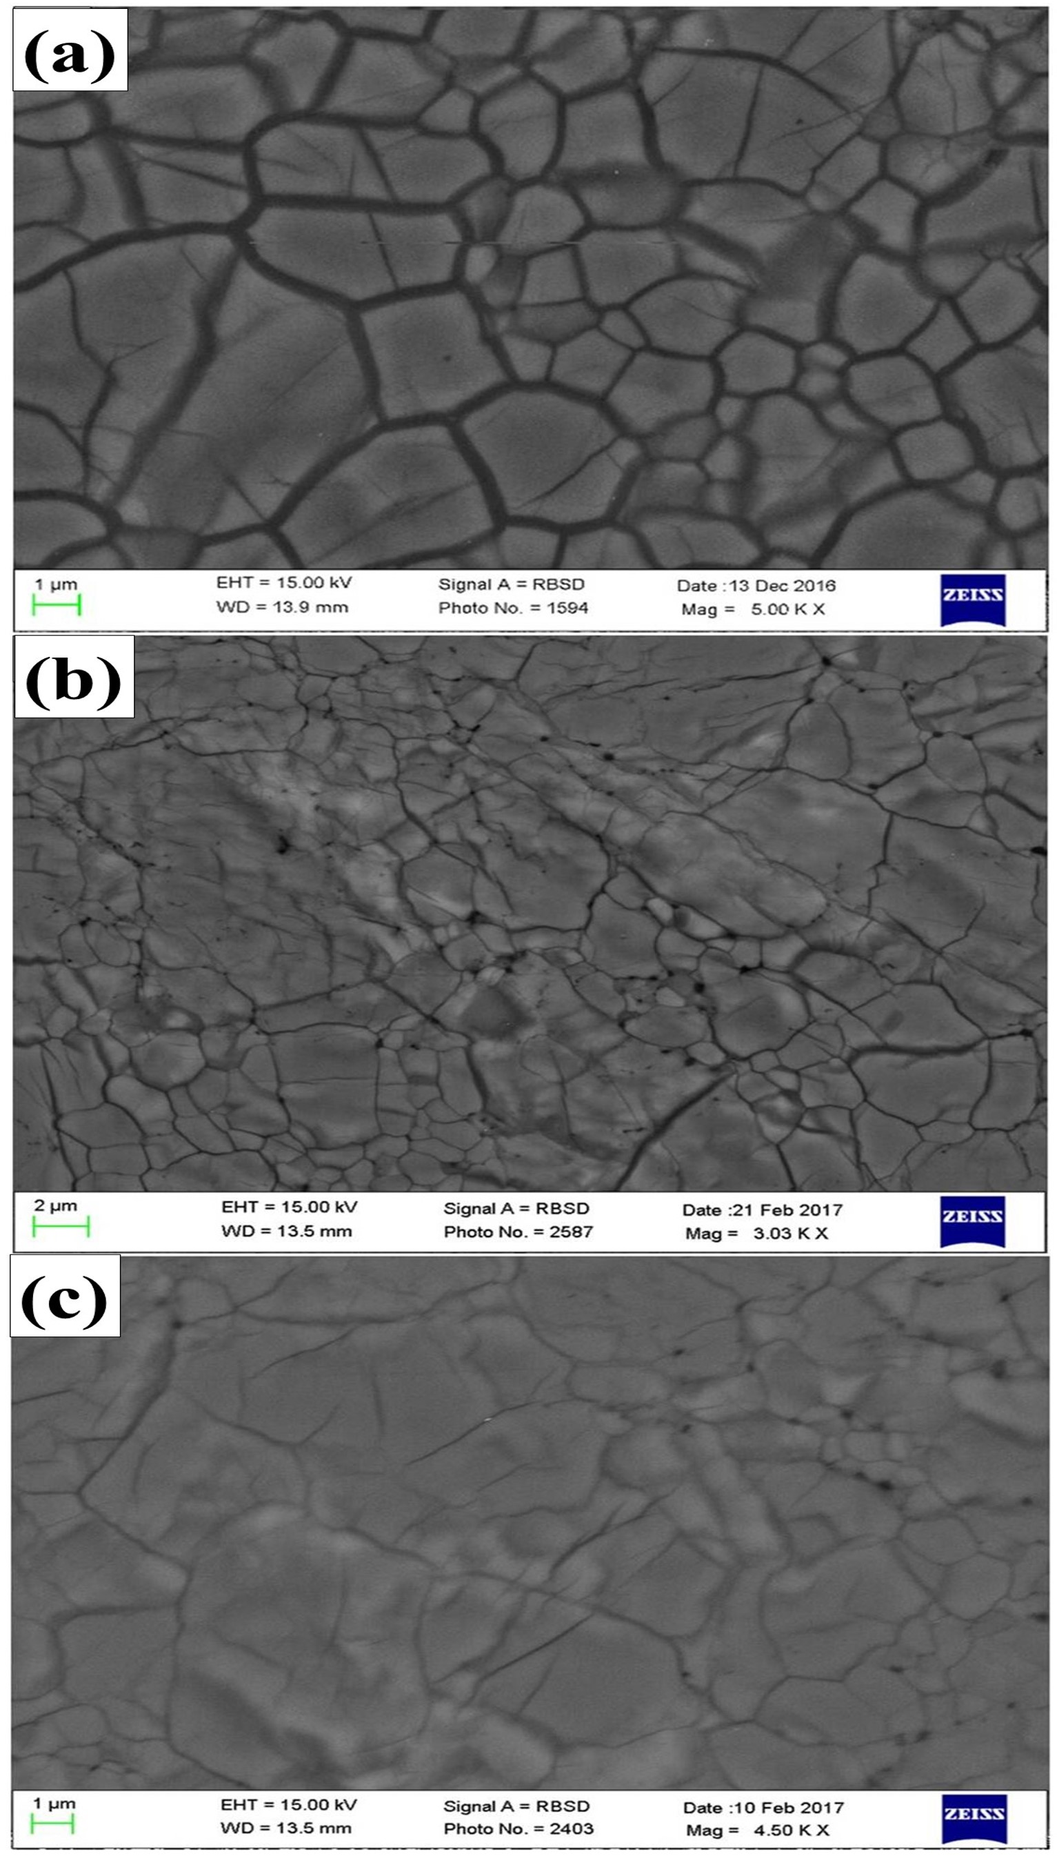
Liu et al.
Rapid decrease of MgAlO_{2.5} component in bridgmanite with pressure
Figure 2 Representative BSE images of En₉₀Brm₁₀ subjected to (a) 27 GPa, (b) 35 and (c) 40 GPa and 2000 ºK.
Liu et al. (2017) Geochem. Persp. Let. 5, 12-18 | doi: 10.7185/geochemlet.1739
© 2017 European Association of Geochemistry
Notes:
Figure 2 Representative BSE images of En₉₀Brm₁₀ subjected to (a) 27 GPa, (b) 35 and (c) 40 GPa and 2000 ºK.

