Slide 1
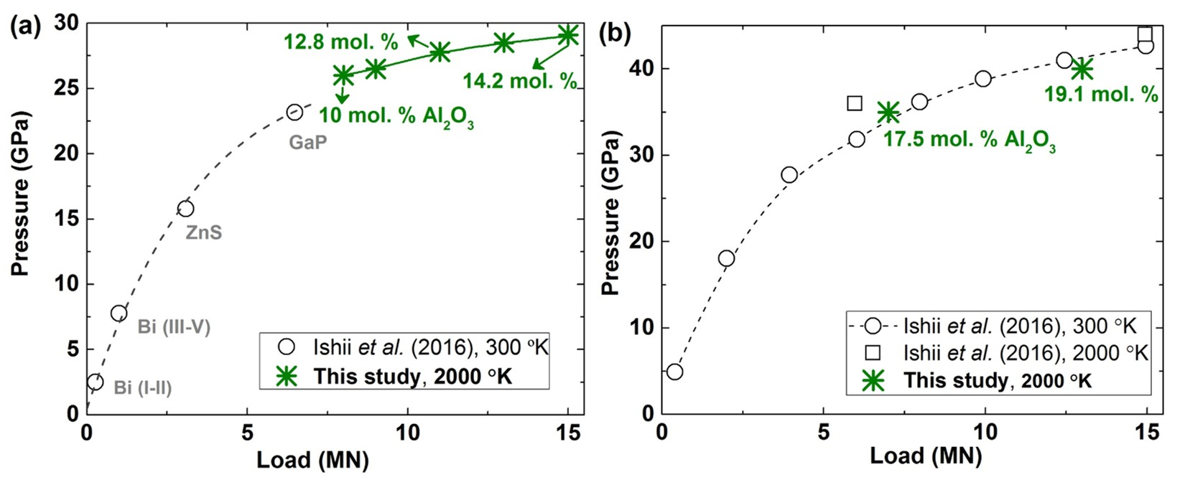
Liu et al.
Rapid decrease of MgAlO_{2.5} component in bridgmanite with pressure
Figure S-2 Pressure calibrations of 7/3 (a) and 5.7/1.5 (b) cell assembly in IRIS-15 at 300 and 2000 ºK, respectively.
Liu et al. (2017) Geochem. Persp. Let. 5, 12-18 | doi: 10.7185/geochemlet.1739
© 2017 European Association of Geochemistry
Notes:
Figure S-2 Pressure calibrations of 7/3 (a) and 5.7/1.5 (b) cell assembly in IRIS-15 at 300 and 2000 ºK, respectively.

