Slide 1
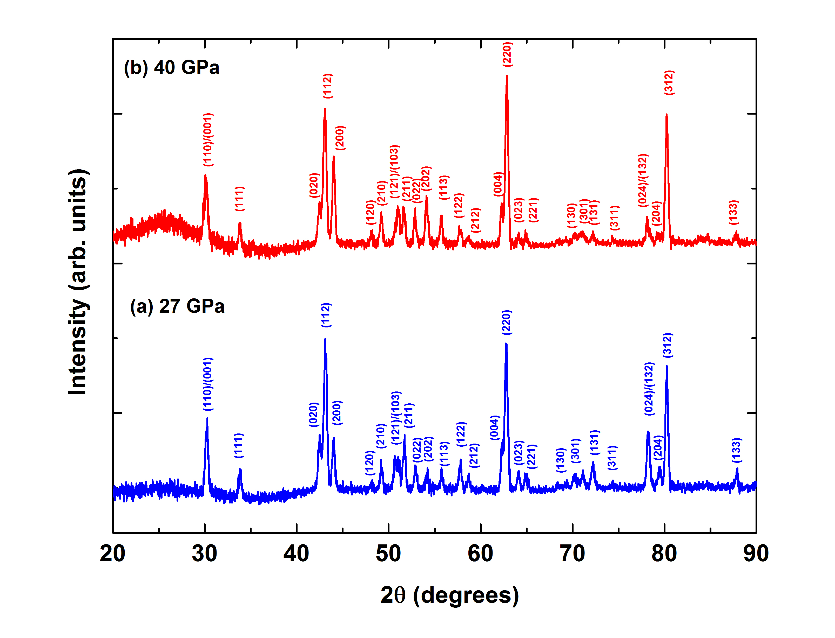
Liu et al.
Rapid decrease of MgAlO_{2.5} component in bridgmanite with pressure
Figure S-3 XRD patterns of the recovered sample for En₉₅Cor₅ composition at 27 (a) and 40 GPa (b) under 2000 ºK, respectively. Number in parentheses represents the index of bridgmanite.
Liu et al. (2017) Geochem. Persp. Let. 5, 12-18 | doi: 10.7185/geochemlet.1739
© 2017 European Association of Geochemistry
Notes:
Figure S-3 XRD patterns of the recovered sample for En₉₅Cor₅ composition at 27 (a) and 40 GPa (b) under 2000 ºK, respectively. Number in parentheses represents the index of bridgmanite.

