Slide 1
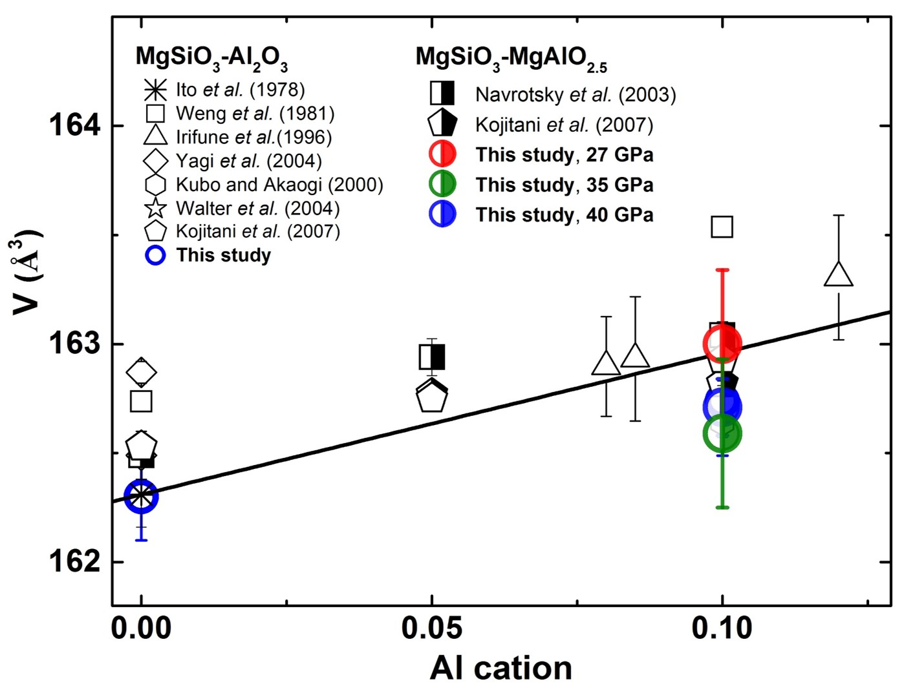
Liu et al.
Rapid decrease of MgAlO_{2.5} component in bridgmanite with pressure
Figure S-4 Unit cell volumes of bridgmanite along the system MgSiO₃–Al₂O₃ and MgSiO₃–MgAlO_{2.5} in the present and previous studies. The solid line presents the linear fitting results on values for bridgmanite along the system MgSiO₃-Al₂O₃ (Liu et al., 2016).
Liu et al. (2017) Geochem. Persp. Let. 5, 12-18 | doi: 10.7185/geochemlet.1739
© 2017 European Association of Geochemistry
Notes:
Figure S-4 Unit cell volumes of bridgmanite along the system MgSiO₃–Al₂O₃ and MgSiO₃–MgAlO_{2.5} in the present and previous studies. The solid line presents the linear fitting results on values for bridgmanite along the system MgSiO₃-Al₂O₃ (Liu et al., 2016).

