Slide 1
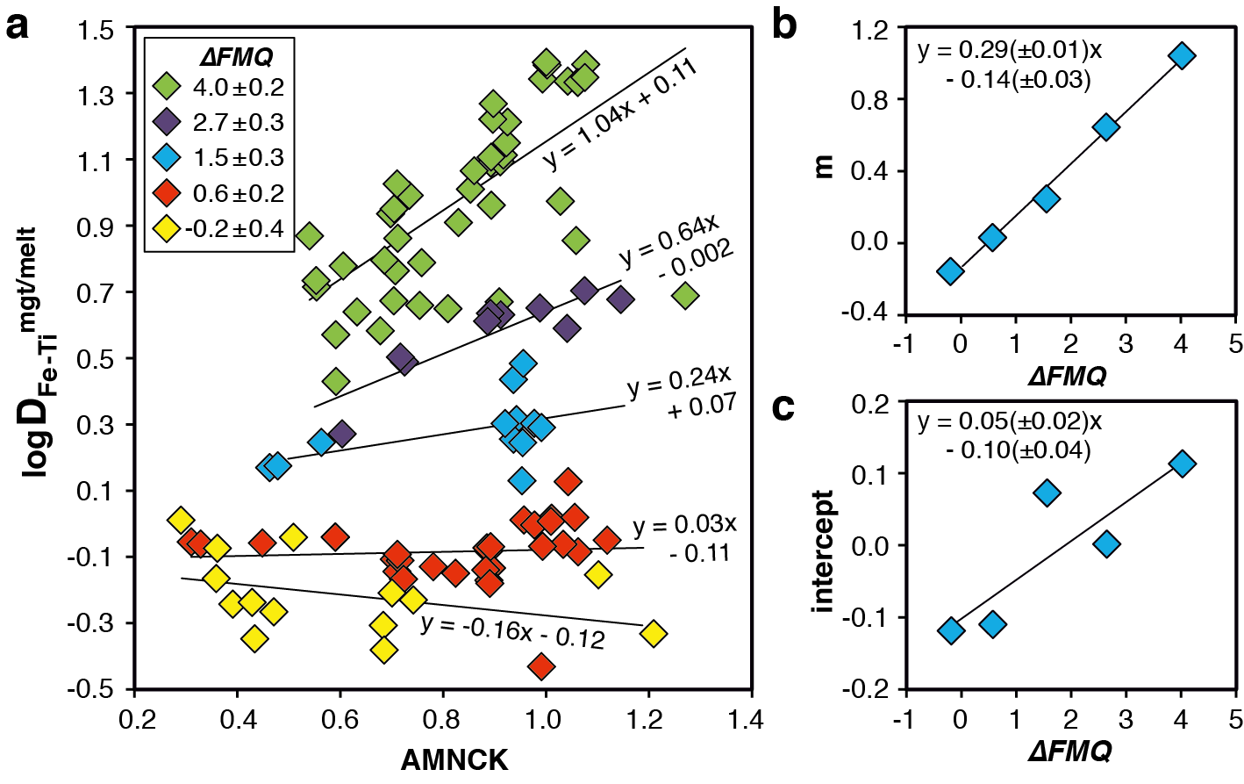
Arató and Audétat
FeTiMM – A new oxybarometer for mafic to felsic magmas
Figure 1 Development of the FeTiMM model. (a) 109 experimental data points (59 ilmenite-saturated; 50 ilmenite-undersaturated) were split into five groups of similar oxygen fugacity, through which linear regressions were fit. D_{Fe–Ti}^{mgt/melt} = (D_{FeOtot}^{mgt/melt})/(D_{TiO2}^{mgt/melt}); AMCNK = molar Al₂O₃/(MgO + CaO + Na₂O + K₂O). (b,c) Variation of the slopes and intercepts of the linear fits in (a) as a function of oxygen fugacity expressed in log unit deviations from the fayalite-magnetite-quartz (FMQ) buffer.
Arató and Audétat (2017) Geochem. Persp. Let. 5, 19-23 | doi: 10.7185/geochemlet.1740
© 2017 European Association of Geochemistry
Notes:
Figure 1 Development of the FeTiMM model. (a) 109 experimental data points (59 ilmenite-saturated; 50 ilmenite-undersaturated) were split into five groups of similar oxygen fugacity, through which linear regressions were fit. D_{Fe–Ti}^{mgt/melt} = (D_{FeOtot}^{mgt/melt})/(D_{TiO2}^{mgt/melt}); AMCNK = molar Al₂O₃/(MgO + CaO + Na₂O + K₂O). (b,c) Variation of the slopes and intercepts of the linear fits in (a) as a function of oxygen fugacity expressed in log unit deviations from the fayalite-magnetite-quartz (FMQ) buffer.

