Slide 1
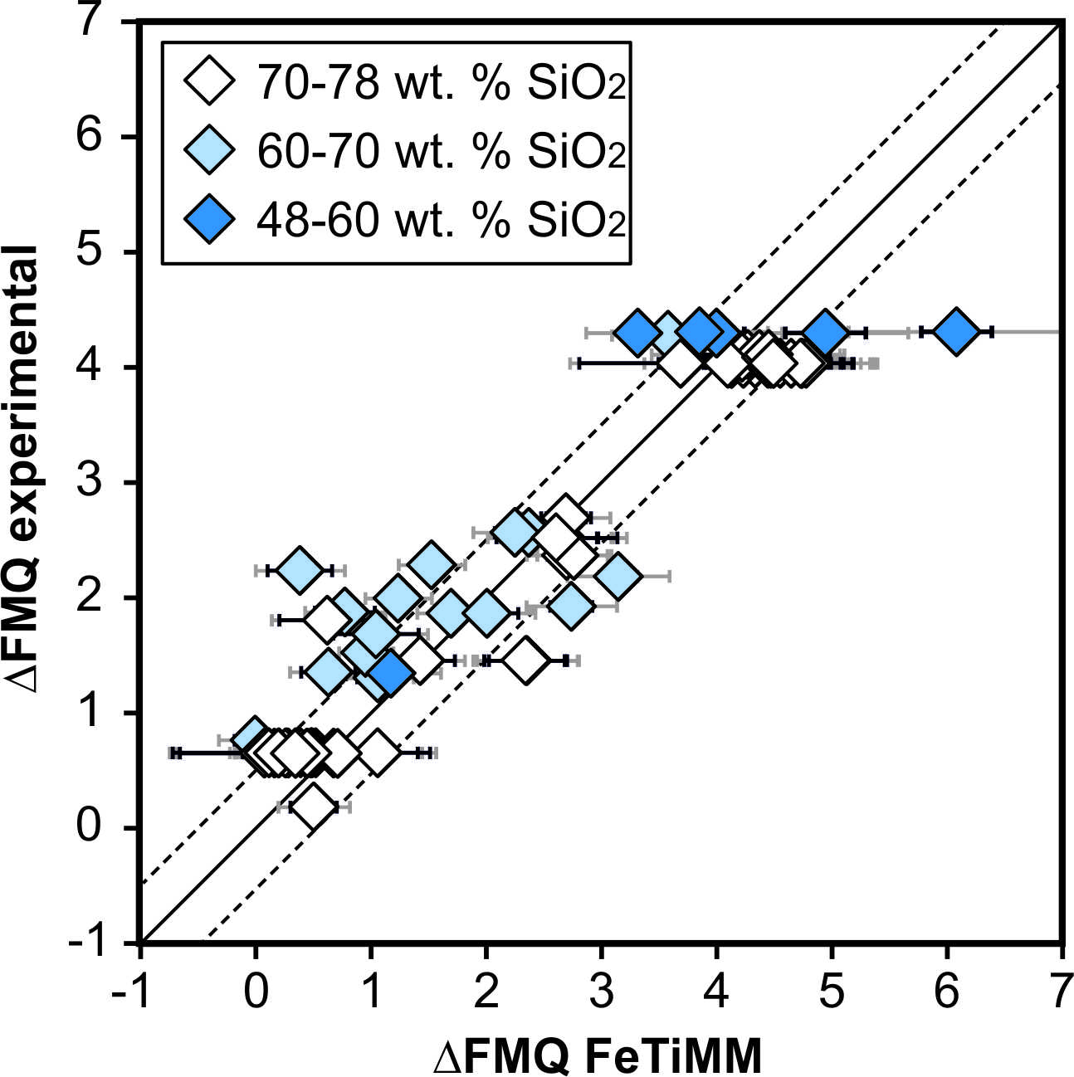
Arató and Audétat
FeTiMM – A new oxybarometer for mafic to felsic magmas
Figure 3 Performance of FeTiMM in ilmenite-undersaturated magmas. Due to the lack of ilmenite, one has to rely on the reported experimentally imposed fO₂ values, which are associated with considerable (but unknown) uncertainty. Correspondingly, error bars in y-axis direction cannot be displayed. See Figure 2 for abbreviations and the meaning of the black and grey error bars in x-axis direction.
Arató and Audétat (2017) Geochem. Persp. Let. 5, 19-23 | doi: 10.7185/geochemlet.1740
© 2017 European Association of Geochemistry
Notes:
Figure 3 Performance of FeTiMM in ilmenite-undersaturated magmas. Due to the lack of ilmenite, one has to rely on the reported experimentally imposed fO₂ values, which are associated with considerable (but unknown) uncertainty. Correspondingly, error bars in y-axis direction cannot be displayed. See Figure 2 for abbreviations and the meaning of the black and grey error bars in x-axis direction.

