Slide 1
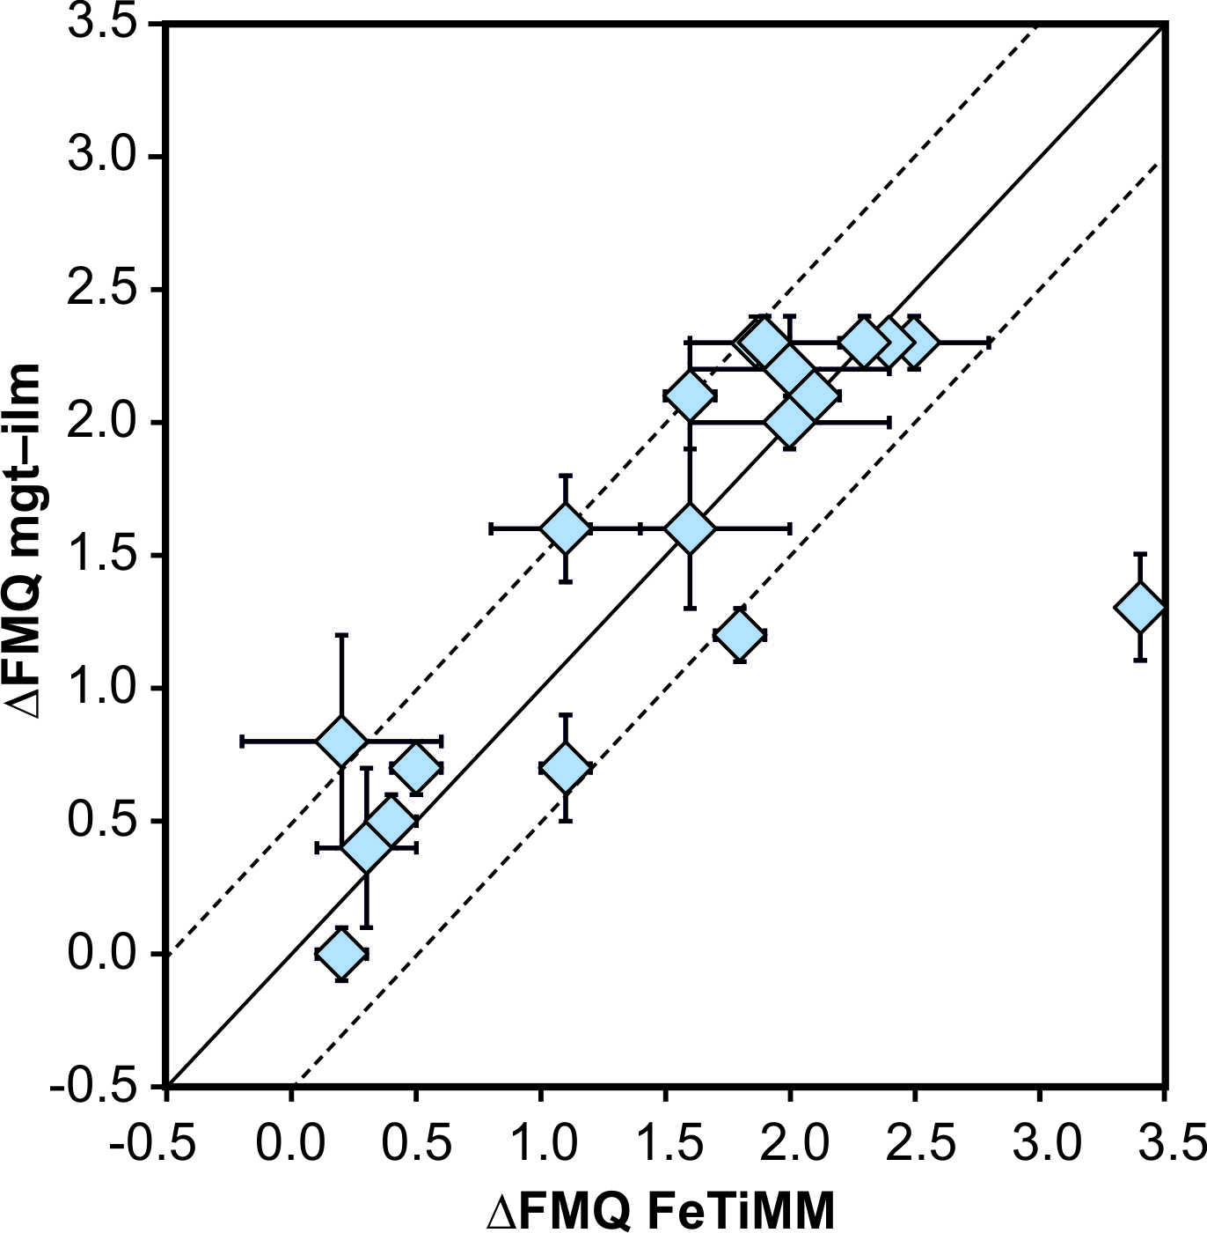
Arató and Audétat
FeTiMM – A new oxybarometer for mafic to felsic magmas
Figure 4 Application of FeTiMM to a set of 19 natural, ilmenite-saturated samples of rhyolitic to dacitic composition (Arató and Audétat, 2017a). Oxygen fugacities (reported in log units relative to the fayalite–magnetite–quartz buffer) obtained via FeTiMM agree within 0.5 log units with those obtained via magnetite–ilmenite oxybarometry (Ghiorso and Evans, 2008) in all but one case. Error bars denote 1σ standard deviation of the fO₂ values obtained from several magnetite–melt pairs.
Arató and Audétat (2017) Geochem. Persp. Let. 5, 19-23 | doi: 10.7185/geochemlet.1740
© 2017 European Association of Geochemistry
Notes:
Figure 4 Application of FeTiMM to a set of 19 natural, ilmenite-saturated samples of rhyolitic to dacitic composition (Arató and Audétat, 2017a). Oxygen fugacities (reported in log units relative to the fayalite–magnetite–quartz buffer) obtained via FeTiMM agree within 0.5 log units with those obtained via magnetite–ilmenite oxybarometry (Ghiorso and Evans, 2008) in all but one case. Error bars denote 1σ standard deviation of the fO₂ values obtained from several magnetite–melt pairs.

