Slide 1
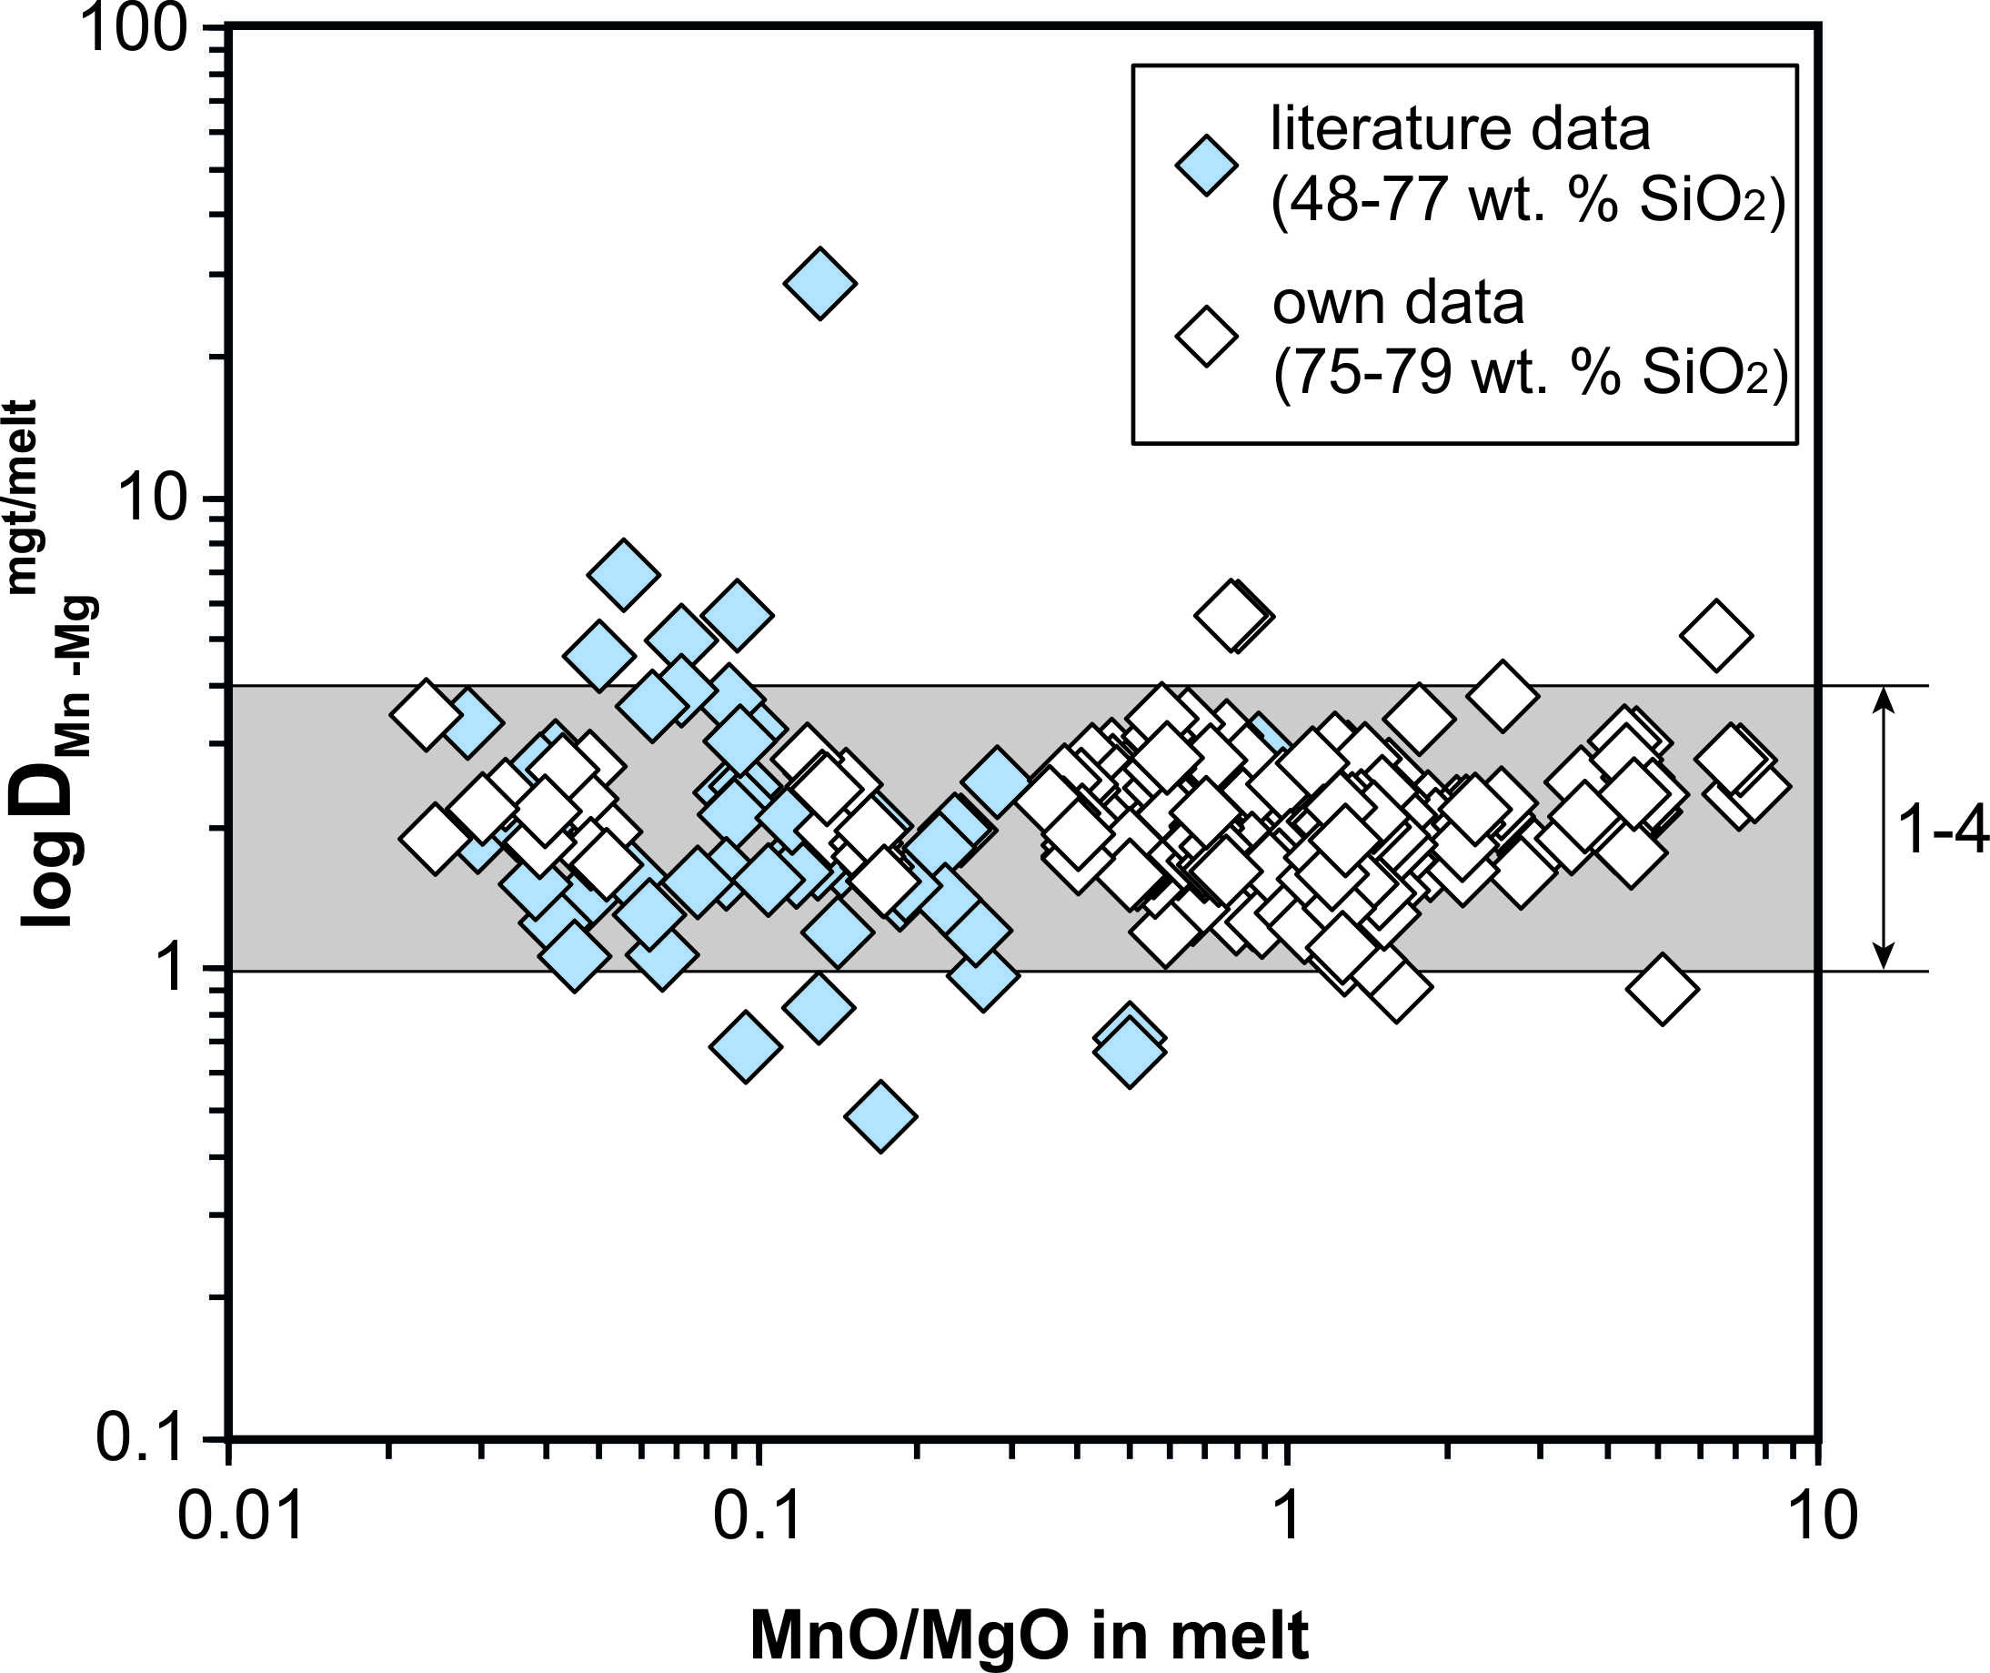
Arató and Audétat
FeTiMM – A new oxybarometer for mafic to felsic magmas
Figure S-2 Variance of the Mn–Mg exchange coefficient between magnetite and silicate melt as a function of the MnO/MgO weight ratio in the silicate melt. D_{Mn–Mg}^{mgt/melt} refers to (D_{MnO}^{mgt/melt})/(D_{MgO}^{mgt/melt}), with MnO and MgO given in weight percent. The data set comprises the 296 magnetite–rhyolite pairs from own experiments, plus the data points shown in Figure 2. The shaded envelope, which encompasses D_{Mn–Mg}^{mgt/melt} values of 1-4, comprises 95 % of all data points.
Arató and Audétat (2017) Geochem. Persp. Let. 5, 19-23 | doi: 10.7185/geochemlet.1740
© 2017 European Association of Geochemistry
Notes:
Figure S-2 Variance of the Mn–Mg exchange coefficient between magnetite and silicate melt as a function of the MnO/MgO weight ratio in the silicate melt. D_{Mn–Mg}^{mgt/melt} refers to (D_{MnO}^{mgt/melt})/(D_{MgO}^{mgt/melt}), with MnO and MgO given in weight percent. The data set comprises the 296 magnetite–rhyolite pairs from own experiments, plus the data points shown in Figure 2. The shaded envelope, which encompasses D_{Mn–Mg}^{mgt/melt} values of 1-4, comprises 95 % of all data points.

