Slide 1
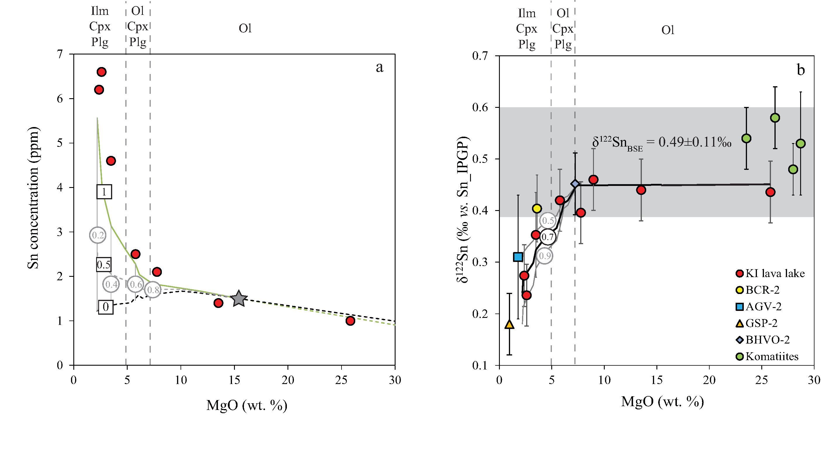
Badullovich et al.
Tin isotopic fractionation during igneous differentiation and Earth’s mantle composition
Figure 1 (a) Model showing Sn concentration for KI samples in the melt against MgO content. Red circles = KI samples. Thick lines represent modelled evolution with differing Sn⁴⁺/∑Sn, listed in black boxes from 1 (green line), 0.5 (dashed grey line) and 0 (dashed black line). Thin grey line represents the fraction of melt remaining (F), listed in grey circles, with the grey star representing the parental melt composition. (b) δ¹²²Sn and Sn against MgO (wt. %) for the KI lava lake samples. The solid lines represent the modelled δ¹²²Sn for ∆¹²²Sn_{mineral-melt} = 0.5 (grey line), 0.7 (black line) and 0.9 (grey line). Geostandard values are taken from Creech et al. (2017). In both cases, the crystallising assemblage is listed at the top of the figure (Ol = olivine, Cpx = clinopyroxene, Plg = plagioclase, Ilm = ilmenite).
Badullovich et al. (2017) Geochem. Persp. Let. 5, 24-28 | doi: 10.7185/geochemlet.1741
© 2017 European Association of Geochemistry
Notes:
Figure 1 (a) Model showing Sn concentration for KI samples in the melt against MgO content. Red circles = KI samples. Thick lines represent modelled evolution with differing Sn⁴⁺/∑Sn, listed in black boxes from 1 (green line), 0.5 (dashed grey line) and 0 (dashed black line). Thin grey line represents the fraction of melt remaining (F), listed in grey circles, with the grey star representing the parental melt composition. (b) δ¹²²Sn and Sn against MgO (wt. %) for the KI lava lake samples. The solid lines represent the modelled δ¹²²Sn for ∆¹²²Sn_{mineral-melt} = 0.5 (grey line), 0.7 (black line) and 0.9 (grey line). Geostandard values are taken from Creech et al. (2017). In both cases, the crystallising assemblage is listed at the top of the figure (Ol = olivine, Cpx = clinopyroxene, Plg = plagioclase, Ilm = ilmenite).

