Slide 1
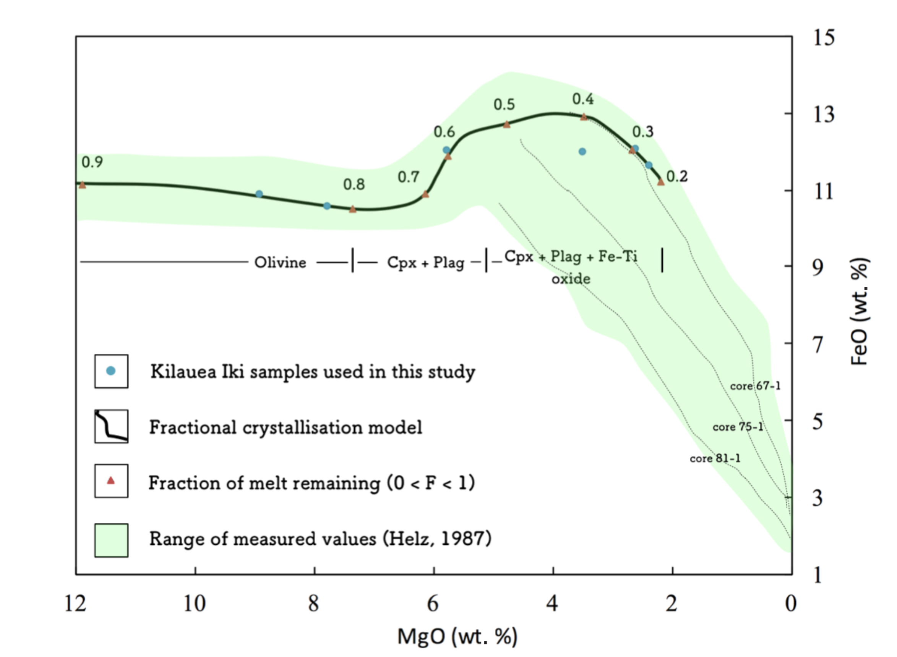
Badullovich et al.
Tin isotopic fractionation during igneous differentiation and Earth’s mantle composition
Figure S-2 Modelled abundances of FeO and MgO (wt. %) in the Kilauea Iki lava lake, overlain with the field (green) of literature data (Helz, 1987) for different eruption dates (1967, 1979 and 1981).
Badullovich et al. (2017) Geochem. Persp. Let. 5, 24-28 | doi: 10.7185/geochemlet.1741
© 2017 European Association of Geochemistry
Notes:
Figure S-2 Modelled abundances of FeO and MgO (wt. %) in the Kilauea Iki lava lake, overlain with the field (green) of literature data (Helz, 1987) for different eruption dates (1967, 1979 and 1981).

