Slide 1
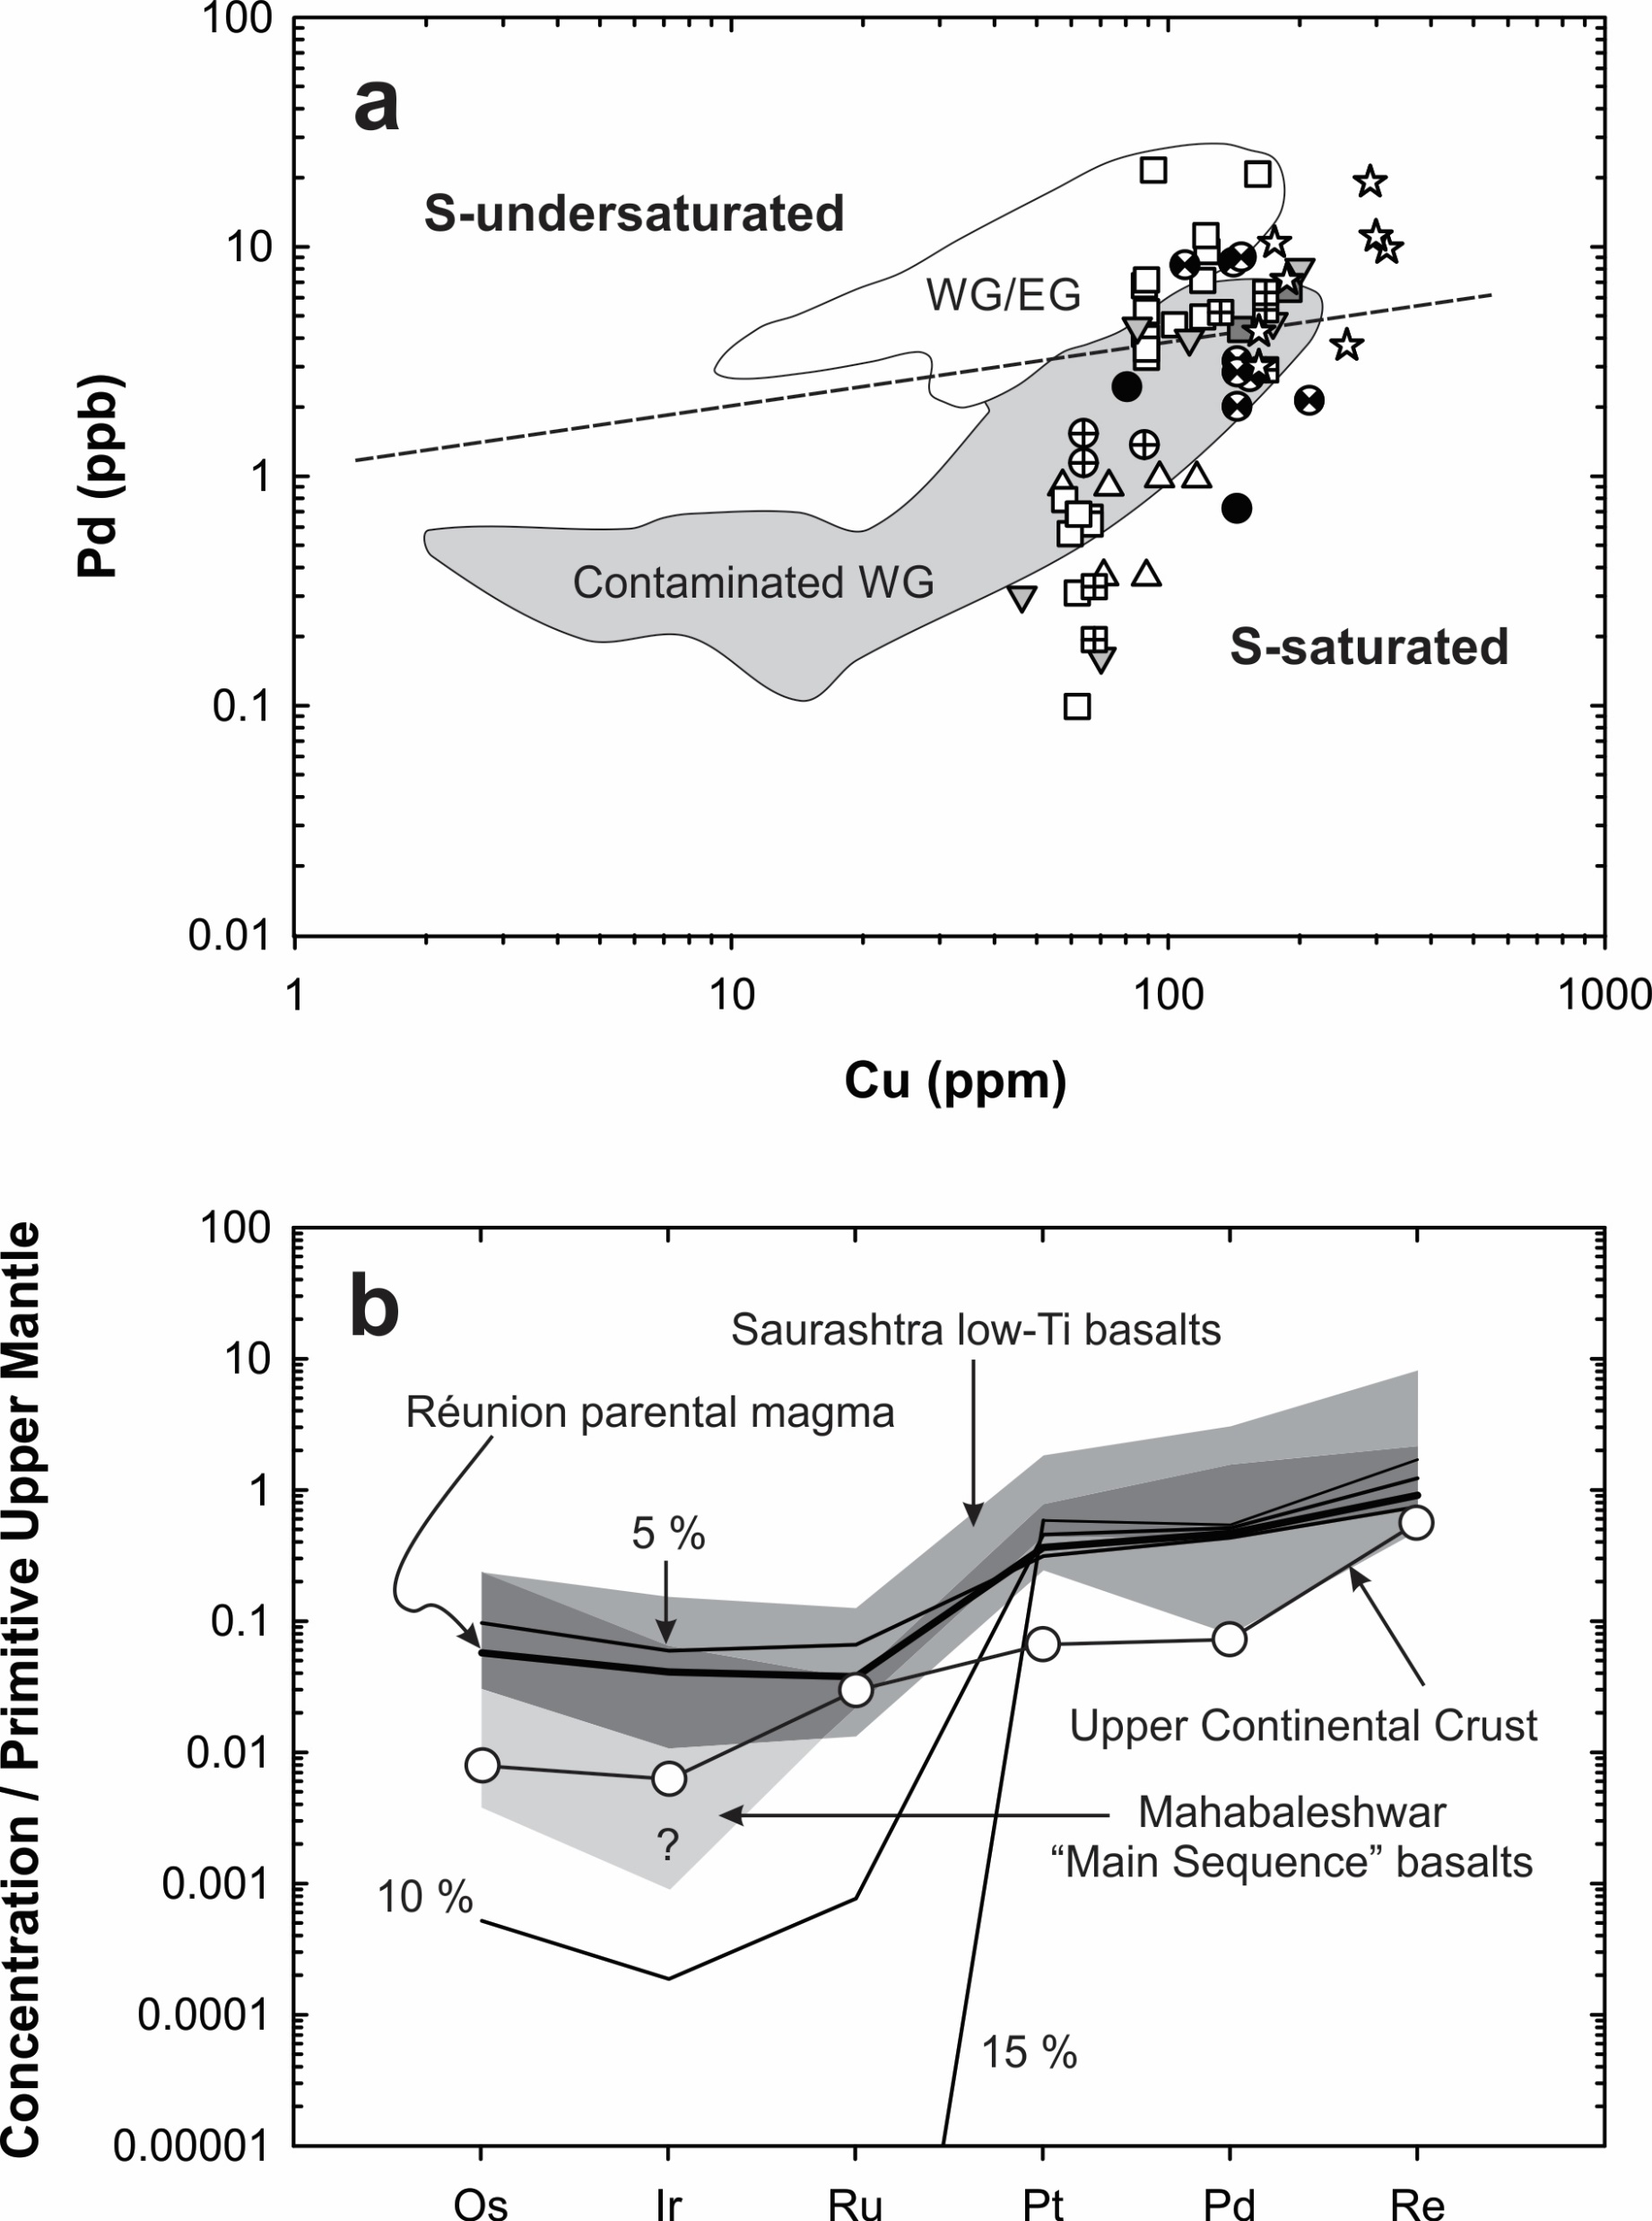
Peters and Day
A geochemical link between plume head and tail volcanism
Figure S-10 (a) Plot of Pd versus Cu to discriminate S-undersaturated and S-saturated lavas (Keays and Lightfoot, 2007). Although many Deccan lava samples lie above the qualitative line denoting the boundary between the S-saturated and S-undersaturated fields, most overlap the field of S-saturated (“contaminated”) West Greenland (WG) lavas (Keays and Lightfoot, 2007) which we take to imply that these lavas are also S-saturated. WG/EG: S-undersaturated (“uncontaminated) West and East Greenland lavas (Keays and Lightfoot, 2007). Symbols as in Figure S-4. (b) Assimilation-fractional crystallisation model …
Peters and Day (2017) Geochem. Persp. Let. 5, 29-34 | doi: 10.7185/geochemlet.1742
© 2017 European Association of Geochemistry
Notes:
Figure S-10 (a) Plot of Pd versus Cu to discriminate S-undersaturated and S-saturated lavas (Keays and Lightfoot, 2007). Although many Deccan lava samples lie above the qualitative line denoting the boundary between the S-saturated and S-undersaturated fields, most overlap the field of S-saturated (“contaminated”) West Greenland (WG) lavas (Keays and Lightfoot, 2007) which we take to imply that these lavas are also S-saturated. WG/EG: S-undersaturated (“uncontaminated) West and East Greenland lavas (Keays and Lightfoot, 2007). Symbols as in Figure S-4. (b) Assimilation-fractional crystallisation model for a hypothesised Deccan parental magma, equal to the calculated Réunion parental HSE composition of Peters et al. (2016), using partition coefficients of Jamais et al. (2008) and Day (2013) and an upper continental crust HSE composition of Peucker-Ehrenbrink and Jahn (2001). Shown for comparison are composition ranges of Mahabaleshwar main sequence basalts (light gray), Saurashtra low Ti basalts (medium gray) and the field in which these ranges overlap (dark gray). Question mark denotes unknown minimum Ir composition after several analyses for which measured Ir contents were less than the Ir contents of associated total analytical blanks.

