Slide 1
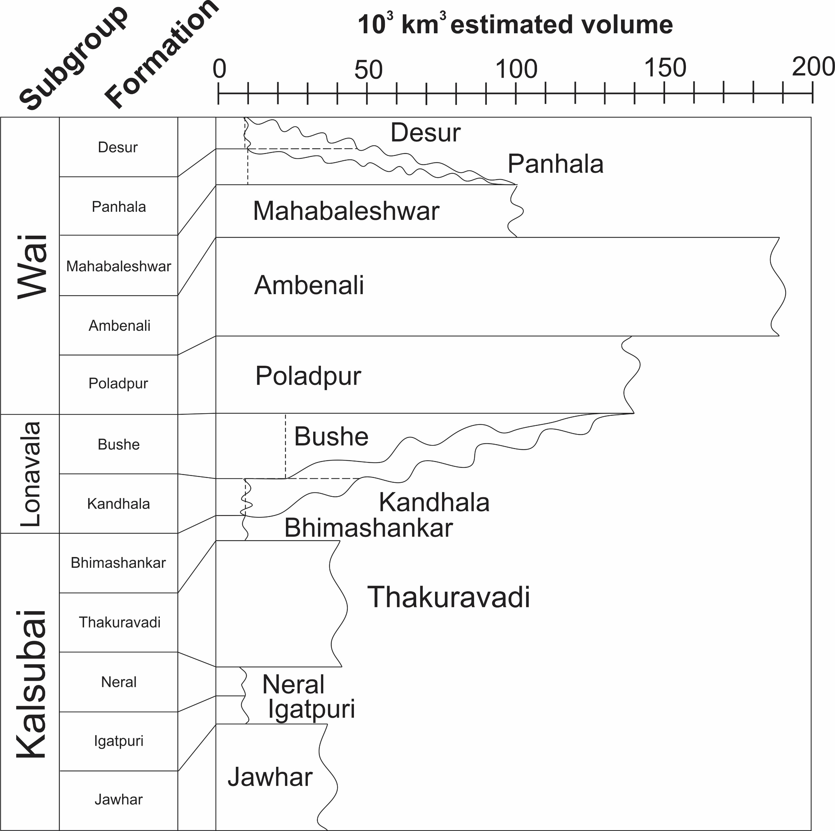
Peters and Day
A geochemical link between plume head and tail volcanism
Figure S-2 Chemostratigraphic subgroups and formations of the Deccan Traps volcanic province (Cox and Hawkesworth, 1985) with relative unit thicknesses (Jay and Widdowson, 2008) represented along the vertical axis (total eruptive thickness of ca. 3 km) and relative unit volumes (Richards et al., 2015) along the horizontal axis of the right-most panel. Dashed lines represent minimum volume estimates (DiMuro et al., 2014) and diagonal wavy lines represent range of possible total volumes up to the volume of the next upward formation with a well constrained estimated volume.
Peters and Day (2017) Geochem. Persp. Let. 5, 29-34 | doi: 10.7185/geochemlet.1742
© 2017 European Association of Geochemistry
Notes:
Figure S-2 Chemostratigraphic subgroups and formations of the Deccan Traps volcanic province (Cox and Hawkesworth, 1985) with relative unit thicknesses (Jay and Widdowson, 2008) represented along the vertical axis (total eruptive thickness of ca. 3 km) and relative unit volumes (Richards et al., 2015) along the horizontal axis of the right-most panel. Dashed lines represent minimum volume estimates (DiMuro et al., 2014) and diagonal wavy lines represent range of possible total volumes up to the volume of the next upward formation with a well constrained estimated volume.

