Slide 1
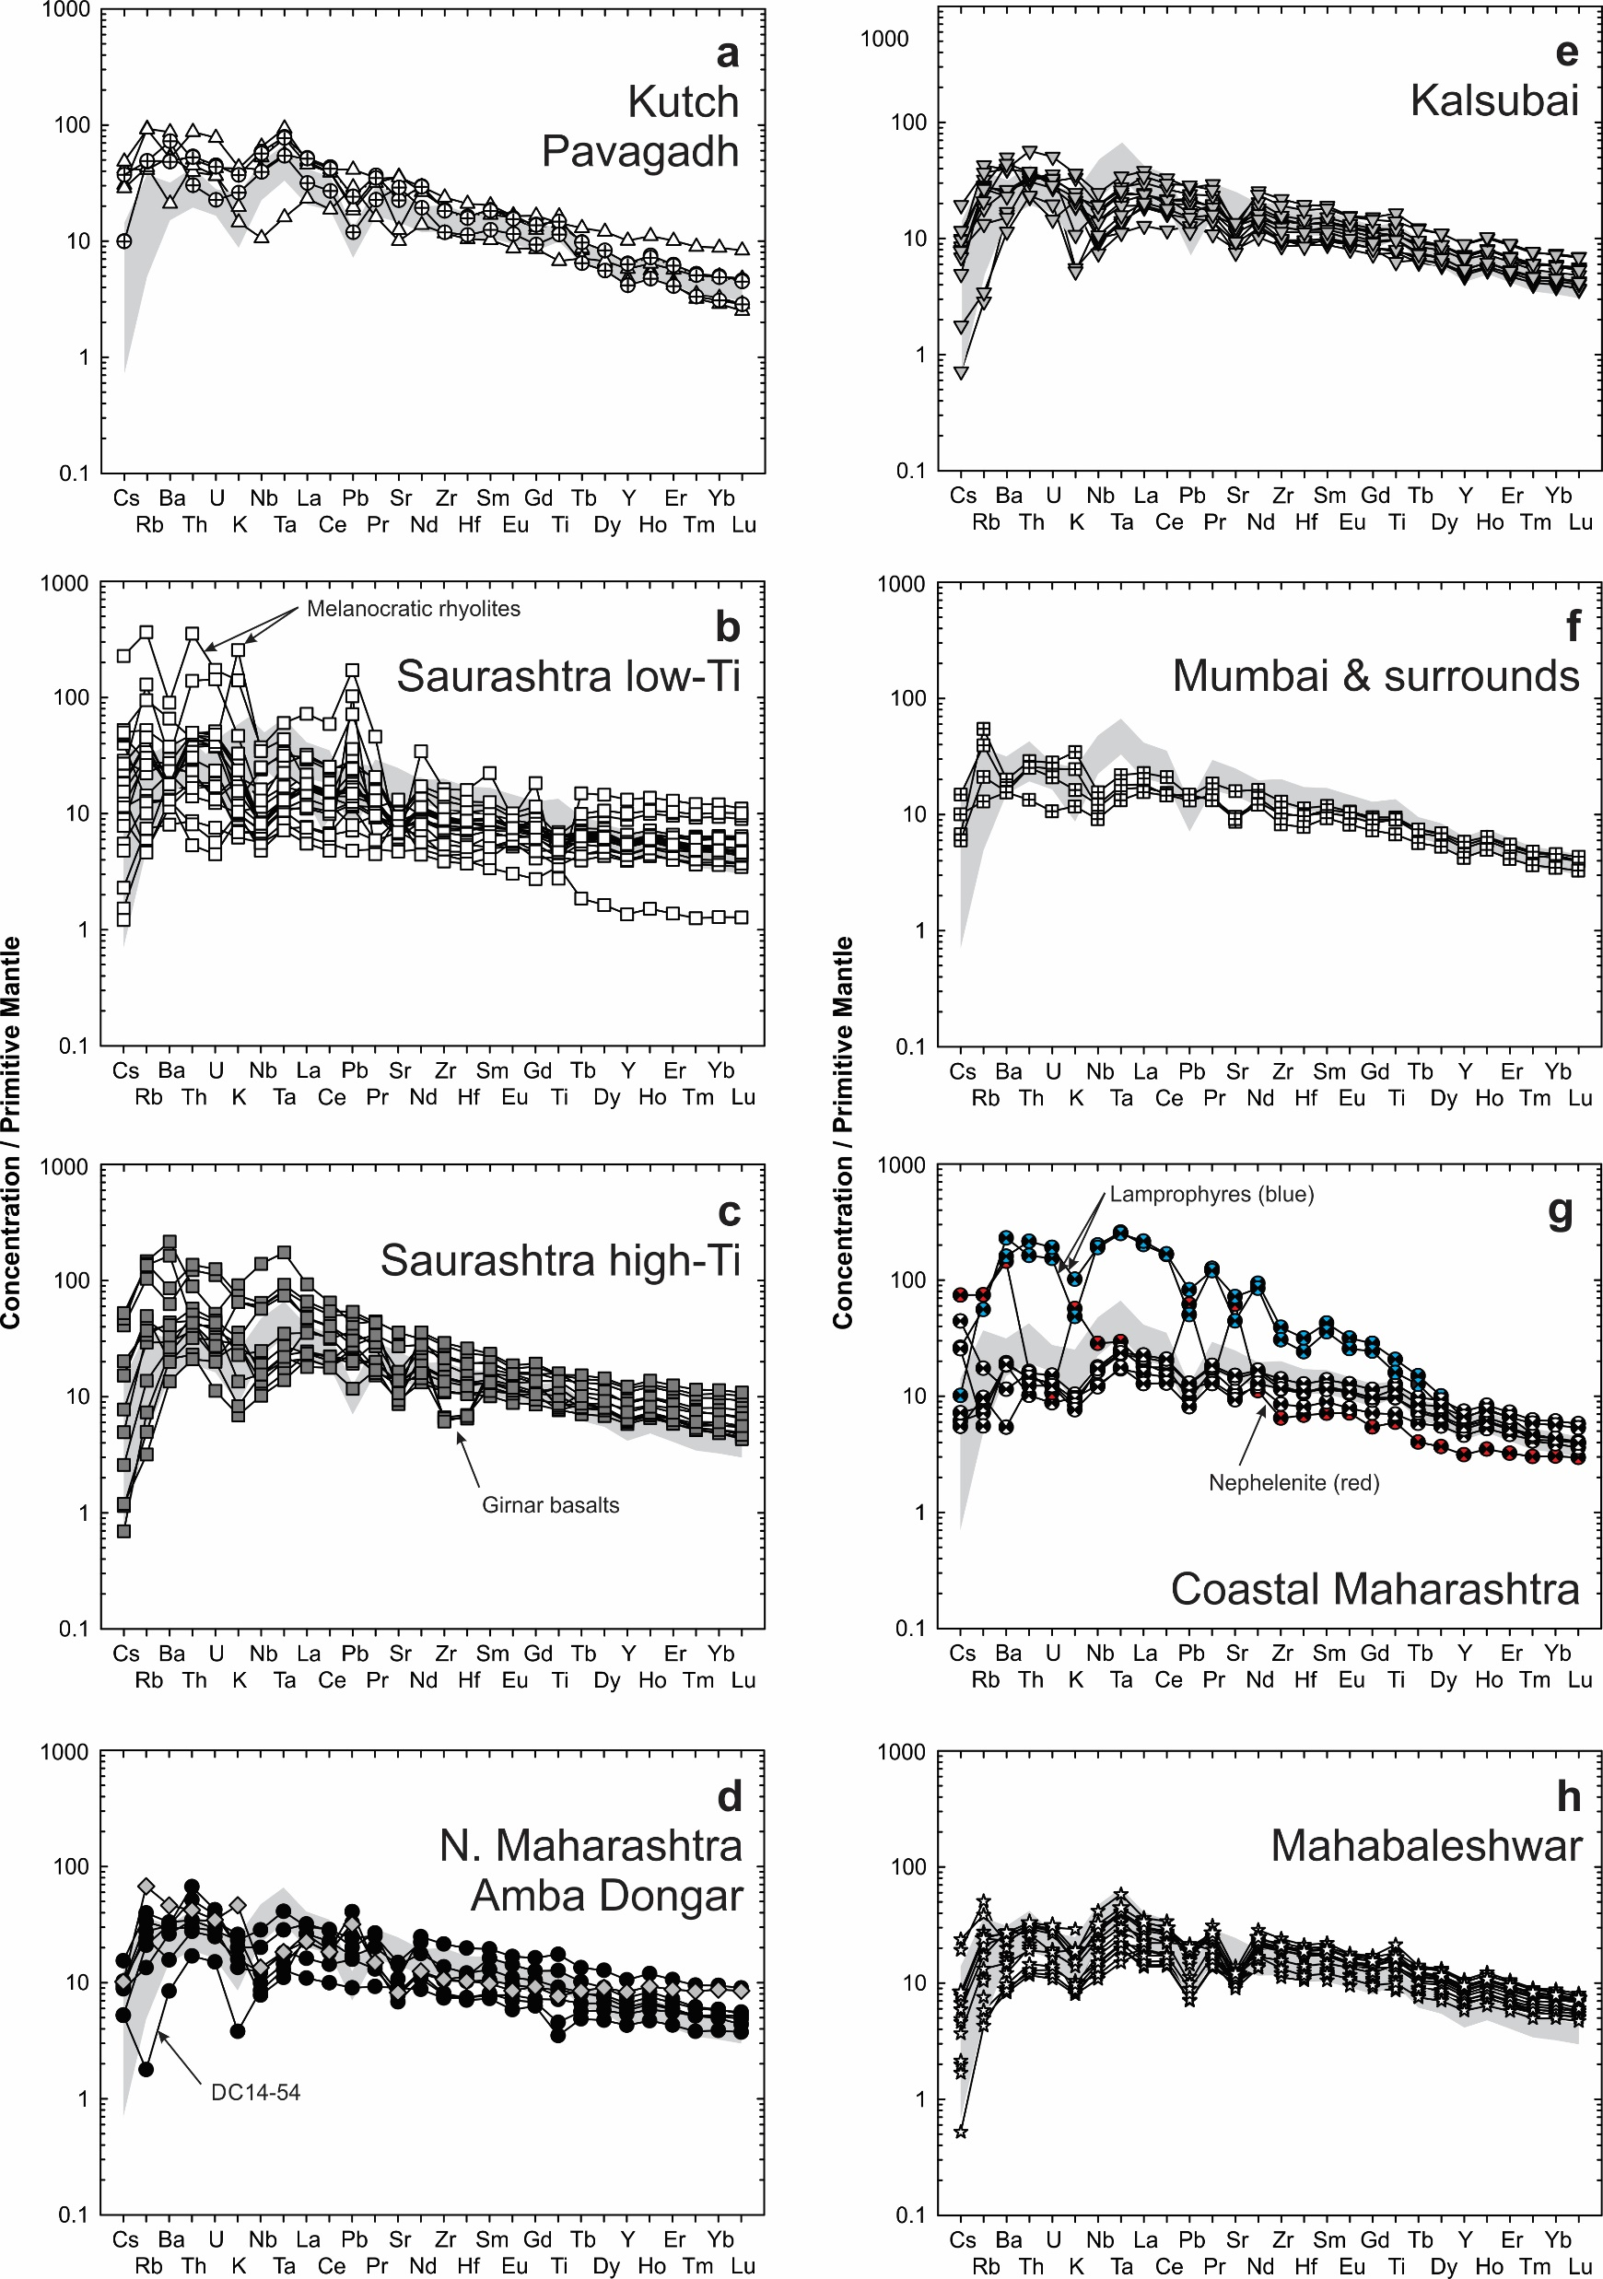
Peters and Day
A geochemical link between plume head and tail volcanism
Figure S-6 Trace element variation diagrams for Deccan lavas, normalised to primitive mantle (McDonough and Sun, 1995). Gray field represent range of Réunion lava compositions (Table S-3; Peters et al., 2016). Symbols as in Figure S-4.
Peters and Day (2017) Geochem. Persp. Let. 5, 29-34 | doi: 10.7185/geochemlet.1742
© 2017 European Association of Geochemistry
Notes:
Figure S-6 Trace element variation diagrams for Deccan lavas, normalised to primitive mantle (McDonough and Sun, 1995). Gray field represent range of Réunion lava compositions (Table S-3; Peters et al., 2016). Symbols as in Figure S-4.

