Slide 1
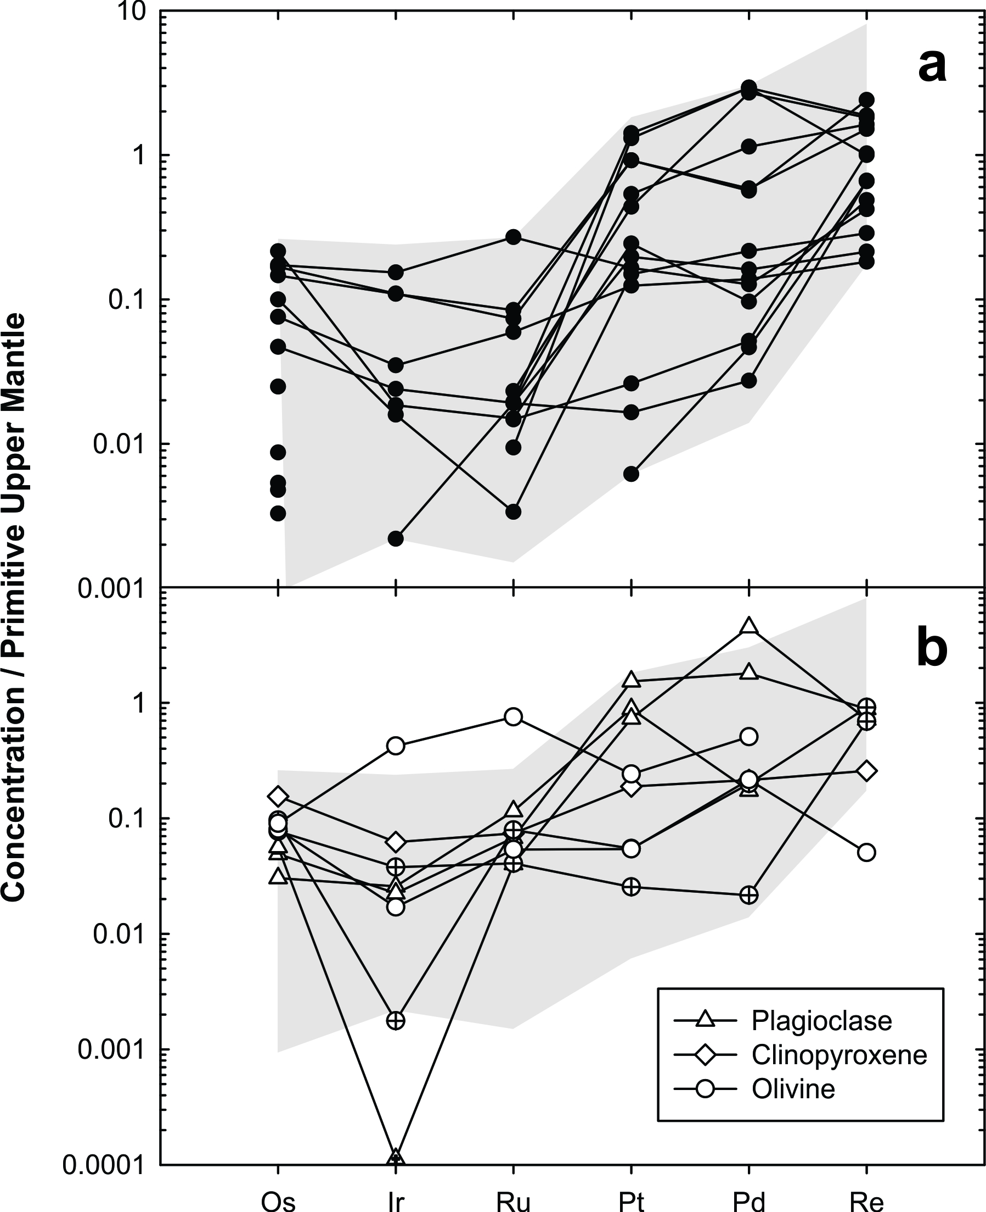
Peters and Day
A geochemical link between plume head and tail volcanism
Figure S-8 (a) PUM-normalised (Becker et al., 2006) HSE patterns for host lavas and (b) mineral separates. Crossed symbols in (b) are recycled powders from crushing in a WC crusher. Gray fields represent range of all measured Deccan samples.
Peters and Day (2017) Geochem. Persp. Let. 5, 29-34 | doi: 10.7185/geochemlet.1742
© 2017 European Association of Geochemistry
Notes:
Figure S-8 (a) PUM-normalised (Becker et al., 2006) HSE patterns for host lavas and (b) mineral separates. Crossed symbols in (b) are recycled powders from crushing in a WC crusher. Gray fields represent range of all measured Deccan samples.

