Slide 1
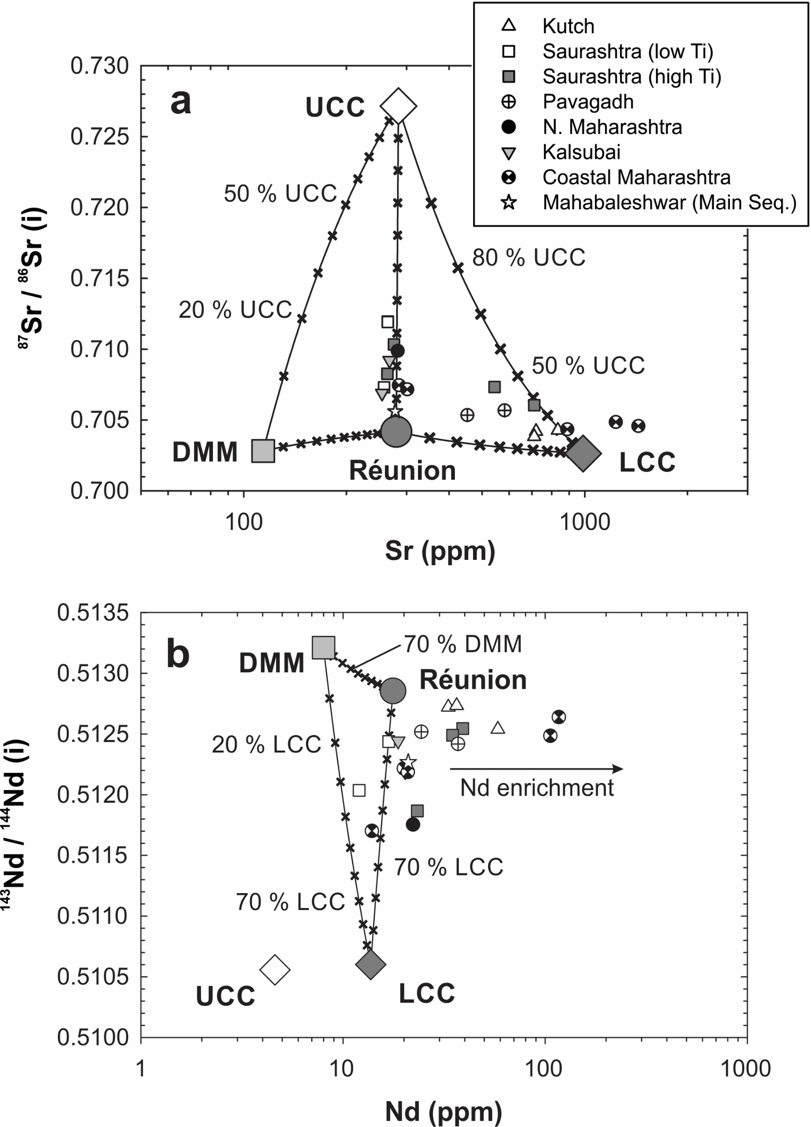
Peters and Day
A geochemical link between plume head and tail volcanism
Figure S-9 (a) Plots of ⁸⁷Sr/⁸⁶Sr versus Sr abundance and (b) ¹⁴³Nd/¹⁴⁴Nd versus Nd abundance. Similar to Figure 2a and Figure 3, inferred compositions of Réunion primary magmas are shown by dark circles. Mantle and crustal reservoirs that may act as assimilants to ascending Deccan primary magmas are shown by other large symbols. Small x symbols demarcate 10 % intervals of mixing. In (b), a number of alkalic and ultra-alkalic rocks show enrichment in Nd that moves them away from the Réunion-LCC join; no known crustal or upper mantle reservoir has Nd greater than about 20 ppm. Data sources are listed in Table S-4.
Peters and Day (2017) Geochem. Persp. Let. 5, 29-34 | doi: 10.7185/geochemlet.1742
© 2017 European Association of Geochemistry
Notes:
Figure S-9 (a) Plots of ⁸⁷Sr/⁸⁶Sr versus Sr abundance and (b) ¹⁴³Nd/¹⁴⁴Nd versus Nd abundance. Similar to Figure 2a and Figure 3, inferred compositions of Réunion primary magmas are shown by dark circles. Mantle and crustal reservoirs that may act as assimilants to ascending Deccan primary magmas are shown by other large symbols. Small x symbols demarcate 10 % intervals of mixing. In (b), a number of alkalic and ultra-alkalic rocks show enrichment in Nd that moves them away from the Réunion-LCC join; no known crustal or upper mantle reservoir has Nd greater than about 20 ppm. Data sources are listed in Table S-4.

