Slide 1
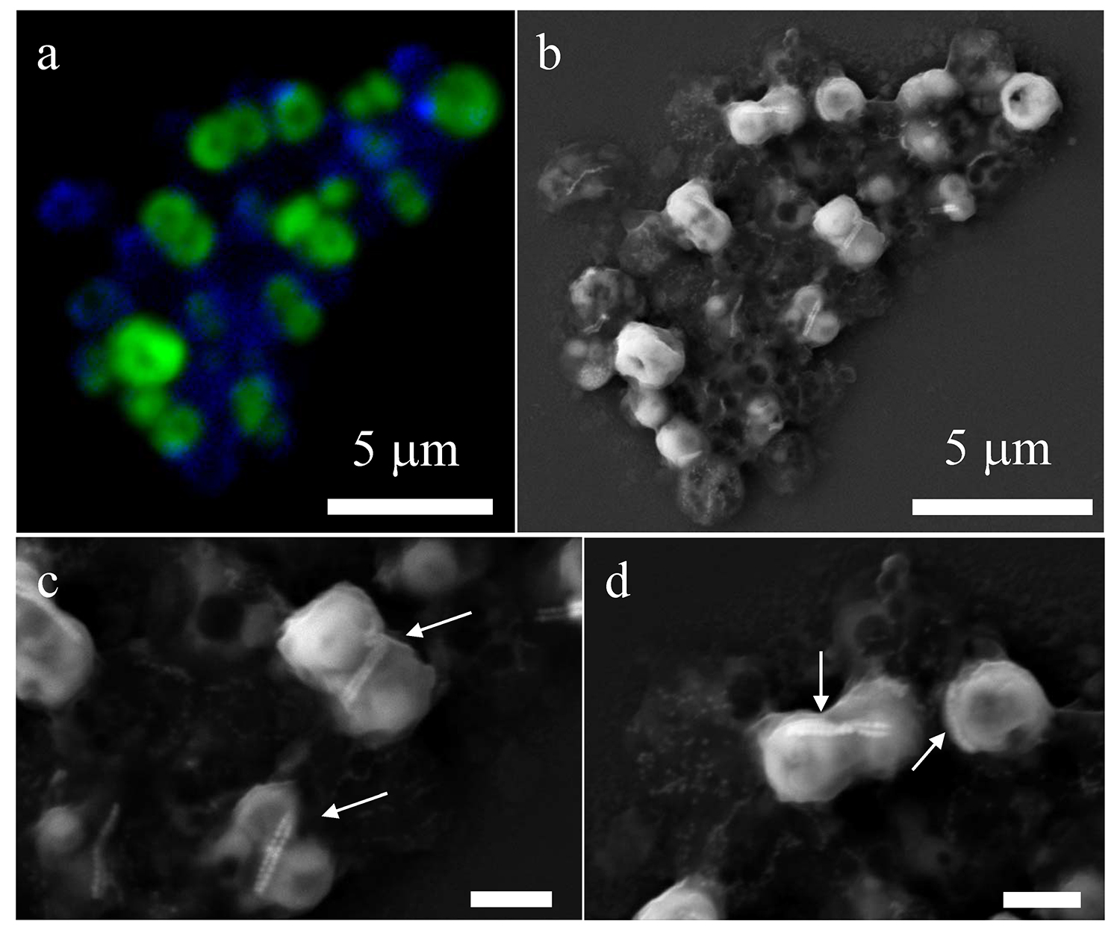
Rivas-Lamelo et al.
Magnetotactic bacteria as a new model for P sequestration in the ferruginous Lake Pavin
Figure 2 Correlative CLSM-SEM microscopy. (a) Overlay of fluorescence maps of DAPI-stained nucleic acid (blue) and polyphosphate (green). (b) SEM image in secondary electron mode of the same area. Brighter cells are filled with polyphosphates. (c) and (d) Close ups of areas seen in (b). Cells filled with polyphosphates contain bright magnetite chains (arrows). Scale bar is 1 μm for (c) and (d).
Rivas-Lamelo et al. (2017) Geochem. Persp. Let. 5, 35-41 | doi: 10.7185/geochemlet.1743
© 2017 European Association of Geochemistry
Notes:
Figure 2 Correlative CLSM-SEM microscopy. (a) Overlay of fluorescence maps of DAPI-stained nucleic acid (blue) and polyphosphate (green). (b) SEM image in secondary electron mode of the same area. Brighter cells are filled with polyphosphates. (c) and (d) Close ups of areas seen in (b). Cells filled with polyphosphates contain bright magnetite chains (arrows). Scale bar is 1 μm for (c) and (d).

