Slide 1
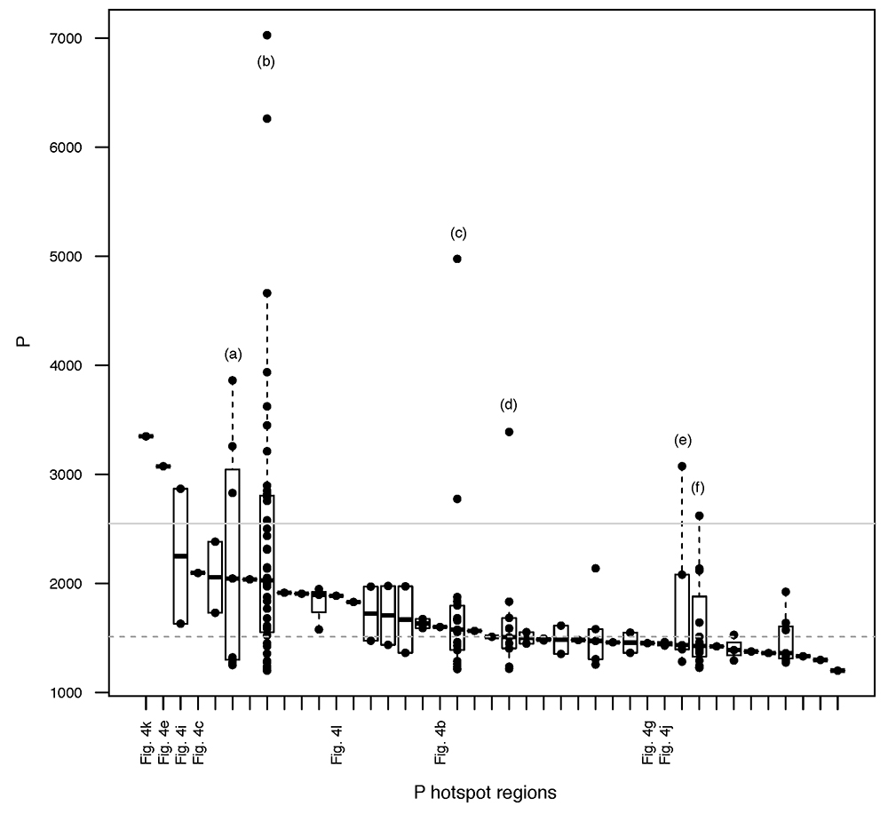
Rivas-Lamelo et al.
Magnetotactic bacteria as a new model for P sequestration in the ferruginous Lake Pavin
Figure S-4 Per pixel P distribution of the 41 hotspots, identified from the fitted μ-XRF intensity map of P. Hotspots (x-axis) were sorted in descending order according to their median, which is indicated by a bold horizontal line inside each box. X-axis labels (Fig 4x, with x = a, b …) refer to polyP-loaded MTB cells shown in Figure 4. For a given distribution, the box boundaries indicate the first and third quartiles. …
Rivas-Lamelo et al. (2017) Geochem. Persp. Let. 5, 35-41 | doi: 10.7185/geochemlet.1743
© 2017 European Association of Geochemistry
Notes:
Figure S-4 Per pixel P distribution of the 41 hotspots, identified from the fitted μ-XRF intensity map of P. Hotspots (x-axis) were sorted in descending order according to their median, which is indicated by a bold horizontal line inside each box. X-axis labels (Fig 4x, with x = a, b …) refer to polyP-loaded MTB cells shown in Figure 4. For a given distribution, the box boundaries indicate the first and third quartiles. The vertical dashed lines that extend from the box encompass the largest/smallest intensities that fall within a distance of 1.5 times the box size from the nearest box hinge. The horizontal gray dashed line at an intensity of 1500 represents the P intensity median of all the hotspots. The hotspots with a high per pixel P content (individual points above the gray horizontal solid line) not related to polyP-loaded MTB cells are described by letters (from a to f); see SEM and EDXS maps of these areas in Figure S-5.

