Slide 1
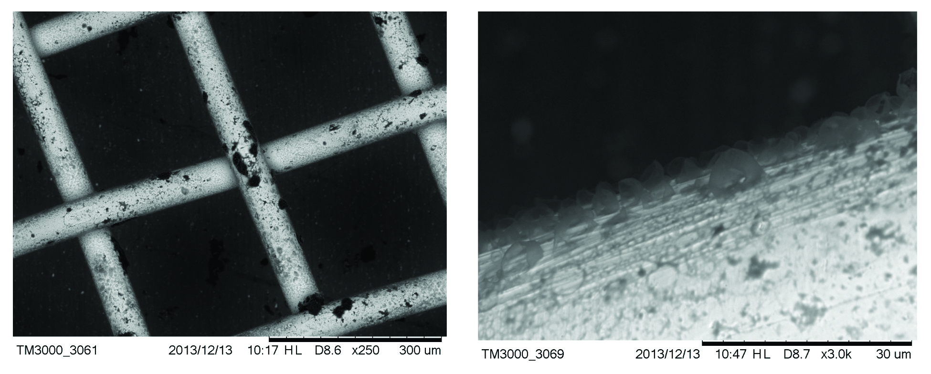
Migdisov et al.
Hydrocarbons as ore fluids
Figure S-3 Examples of back scattered electron images of gold grids from blank experiments (no Zn source).
Migdisov et al. (2017) Geochem. Persp. Let. 5, 47-52 | doi: 10.7185/geochemlet.1745
© 2017 European Association of Geochemistry
Notes:
Figure S-3 Examples of back scattered electron images of gold grids from blank experiments (no Zn source).

