Slide 1
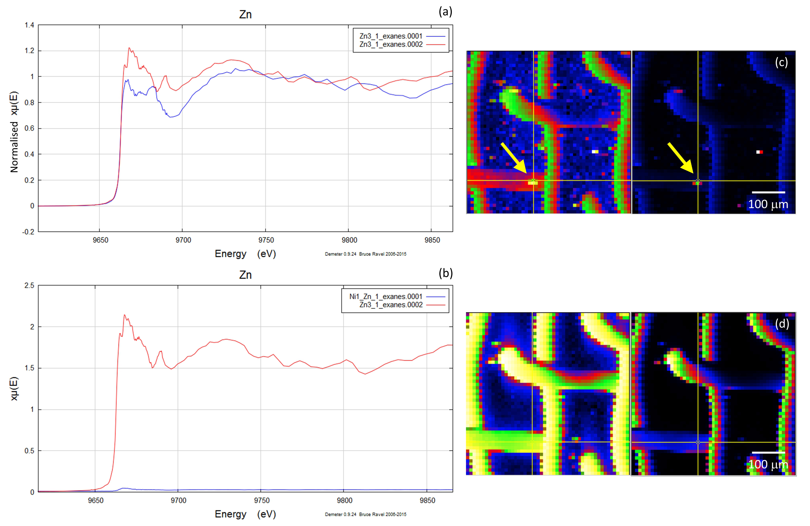
Migdisov et al.
Hydrocarbons as ore fluids
Figure S-5 Group b: (a) Zn K-edge XANES spectra of Zn precipitates, (b) comparison with background Zn (blue), (c) position of Zn hot spot 1 indicated by an arrow, (d) Au distribution of the gold mesh.
Migdisov et al. (2017) Geochem. Persp. Let. 5, 47-52 | doi: 10.7185/geochemlet.1745
© 2017 European Association of Geochemistry
Notes:
Figure S-5 Group b: (a) Zn K-edge XANES spectra of Zn precipitates, (b) comparison with background Zn (blue), (c) position of Zn hot spot 1 indicated by an arrow, (d) Au distribution of the gold mesh.

