Slide 1
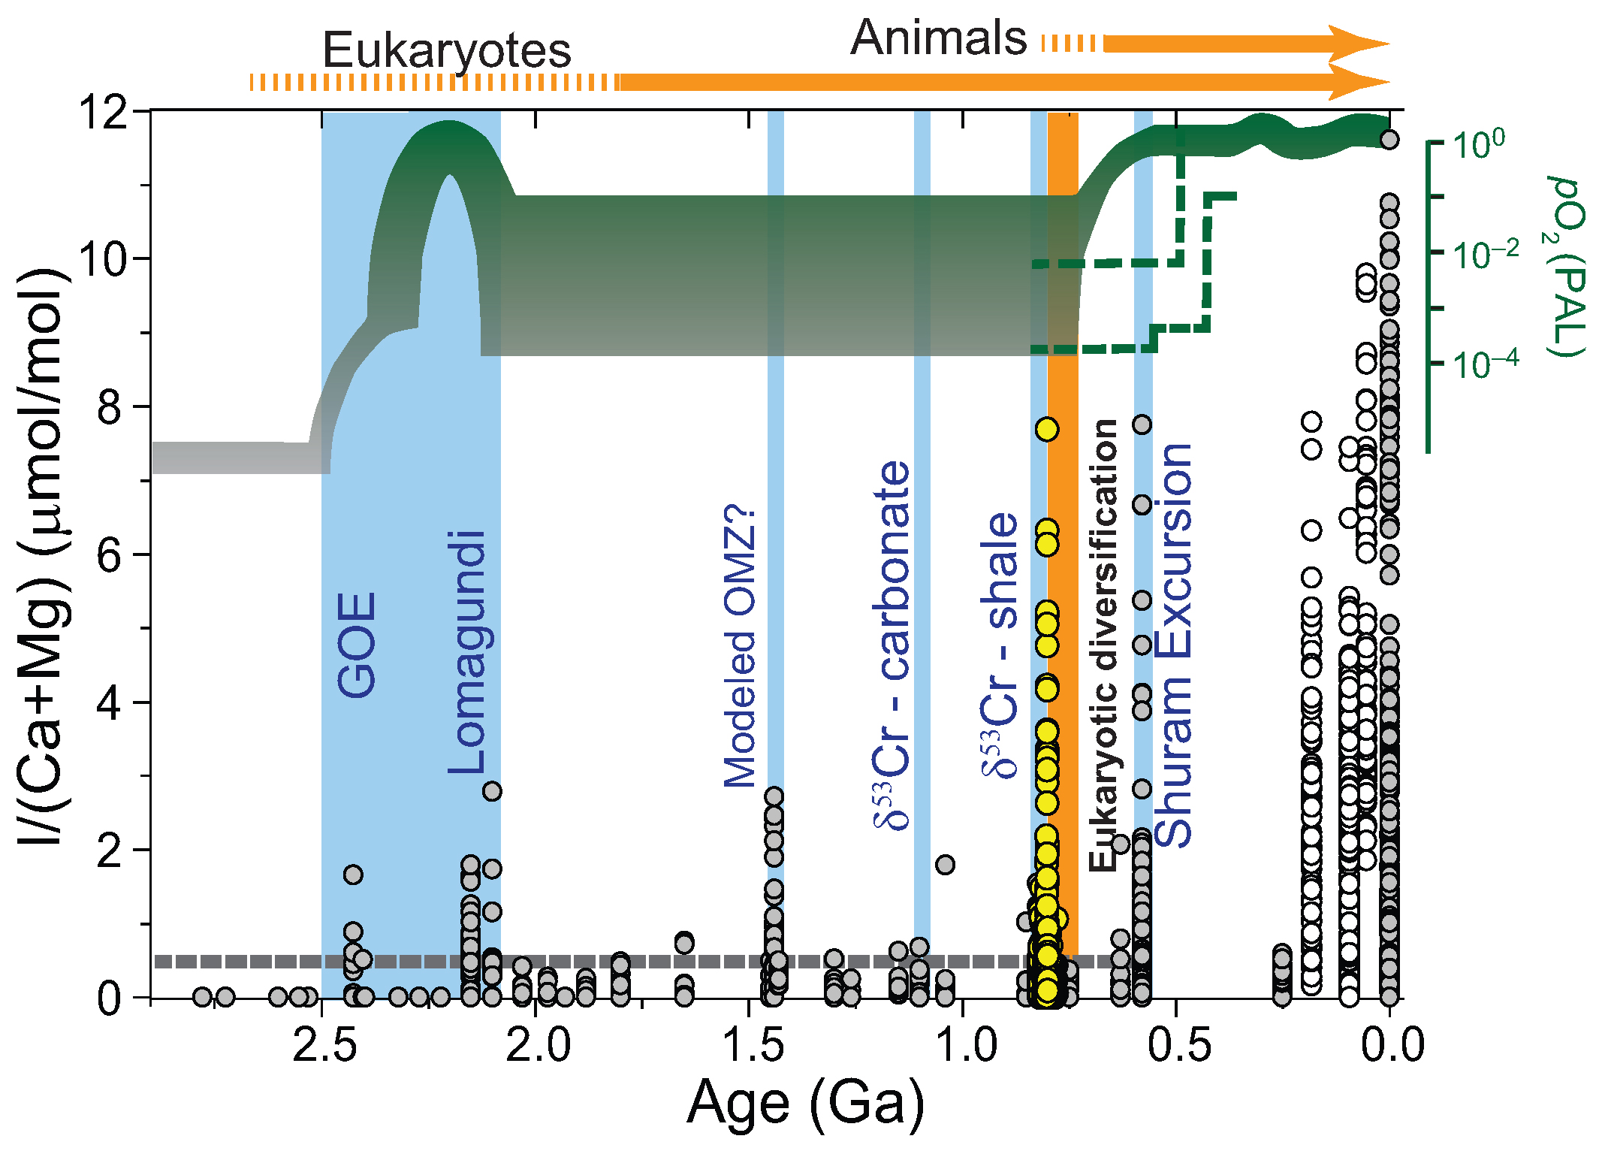
Lu et al.
Iodine proxy evidence for increased ocean oxygenation during the Bitter Springs Anomaly
Figure 1 Secular trend of I/(Ca + Mg). White (I/Ca; limestone) and gray (I/(Ca + Mg); dolostone) dots are from Hardisty et al. (2017). Yellow dots are from this study. Blue bars mark intervals where there are data consistent with possible oxygenation events (Kendall et al., 2009; Planavsky et al., 2014; Gilleaudeau et al., 2016) relative to the long term atmospheric pO₂ curve (green shades from Lyons et al., 2014; green dash line from Sperling et al., 2015) and major evolutionary events (orange) in biosphere. The grey dashed line at 0.5 μmol/mol is the Precambrian I/(Ca + Mg) baseline.
Lu et al. (2017) Geochem. Persp. Let. 5, 53-57 | doi: 10.7185/geochemlet.1746
© 2017 European Association of Geochemistry
Notes:
Figure 1 Secular trend of I/(Ca + Mg). White (I/Ca; limestone) and gray (I/(Ca + Mg); dolostone) dots are from Hardisty et al. (2017). Yellow dots are from this study. Blue bars mark intervals where there are data consistent with possible oxygenation events (Kendall et al., 2009; Planavsky et al., 2014; Gilleaudeau et al., 2016) relative to the long term atmospheric pO₂ curve (green shades from Lyons et al., 2014; green dash line from Sperling et al., 2015) and major evolutionary events (orange) in biosphere. The grey dashed line at 0.5 μmol/mol is the Precambrian I/(Ca + Mg) baseline.

