Slide 1
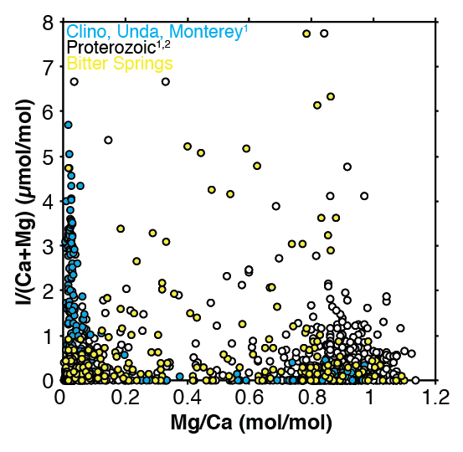
Lu et al.
Iodine proxy evidence for increased ocean oxygenation during the Bitter Springs Anomaly
Figure S-2 I/(Ca + Mg) vs. Mg/Ca. Blue data points for multiple Neogene diagenetic scenarios (Hardisty et al., 2017). White circles for Proterozoic carbonates (Hardisty et al., 2017). Yellow points are from this study.
Lu et al. (2017) Geochem. Persp. Let. 5, 53-57 | doi: 10.7185/geochemlet.1746
© 2017 European Association of Geochemistry
Notes:
Figure S-2 I/(Ca + Mg) vs. Mg/Ca. Blue data points for multiple Neogene diagenetic scenarios (Hardisty et al., 2017). White circles for Proterozoic carbonates (Hardisty et al., 2017). Yellow points are from this study.

