Slide 1
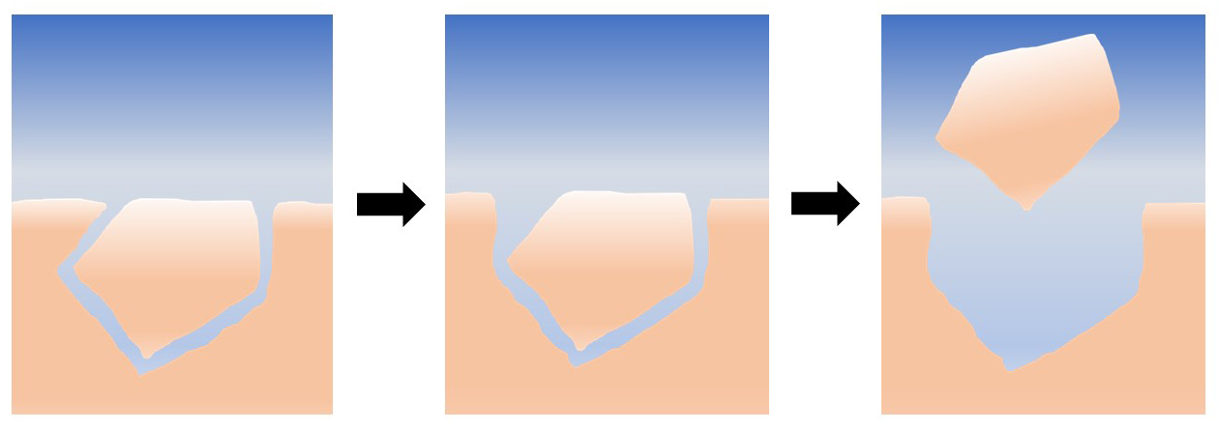
Levenson and Emmanuel
Reply to comment on "Repulsion between calcite crystals and grain detachment during water-rock interaction" by Le Merrer and Colombani, 2017
Figure 1 Schematic representation of the proposed mechanism for grain removal under quiescent conditions. At first, the grains are locked together mechanically; as they dissolve and the grains become unlocked, they are able to leave the surface by intergranular repulsion.
© 2017 The Authors
Published by the European Association of Geochemistry
under Creative Commons License CC BY-NC-ND 4.0
Levenson and Emmanuel (2017) Geochem. Persp. Let. 6, 3-4 | doi: 10.7185/geochemlet.1748
Notes:
Figure 1 Schematic representation of the proposed mechanism for grain removal under quiescent conditions. At first, the grains are locked together mechanically; as they dissolve and the grains become unlocked, they are able to leave the surface by intergranular repulsion.

