Slide 1
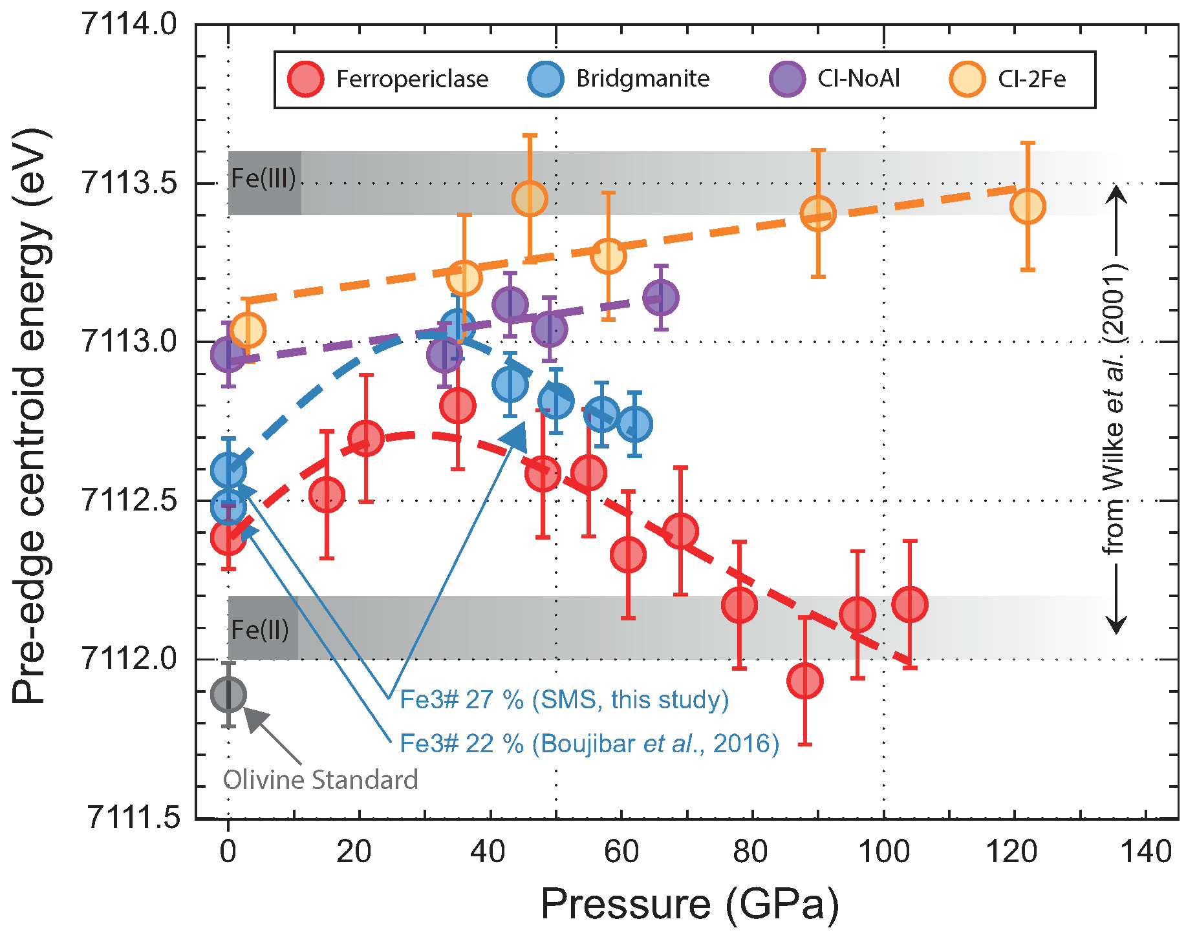
Andrault et al.
Large oxygen excess in the primitive mantle could be the source of the Great Oxygenation Event
Figure 2 Redox state of Fe probed by X-ray absorption spectroscopy. The pre-edge centroid energy (PCE, Fig. S-4) of our samples (orange and purple dots; see Table S-1) are plotted together with our ferropericlase (red dots, dominantly Fe²⁺) and bridgmanite (blue dots, 27 % Fe³⁺) reference compounds. …
© 2018 The Authors
Published by the European Association of Geochemistry
under Creative Commons License CC BY-NC-ND 4.0
Andrault et al. (2018) Geochem. Persp. Let. 6, 5-10 | doi: 10.7185/geochemlet.1801
Notes:
Figure 2 Redox state of Fe probed by X-ray absorption spectroscopy. The pre-edge centroid energy (PCE, Fig. S-4) of our samples (orange and purple dots; see Table S-1) are plotted together with our ferropericlase (red dots, dominantly Fe²⁺) and bridgmanite (blue dots, 27 % Fe³⁺) reference compounds. Horizontal grey stripes correspond to PCE values generally found for Fe²⁺ or Fe³⁺-bearing minerals at ambient P-T conditions (Wilke et al., 2001). PCEs of our samples plot slightly higher than the reference compounds. Also, they increase regularly with pressure, which suggests significant Fe³⁺ contents and excludes a decrease of their bulk #Fe³⁺ up to more than 120 GPa.

