Slide 1
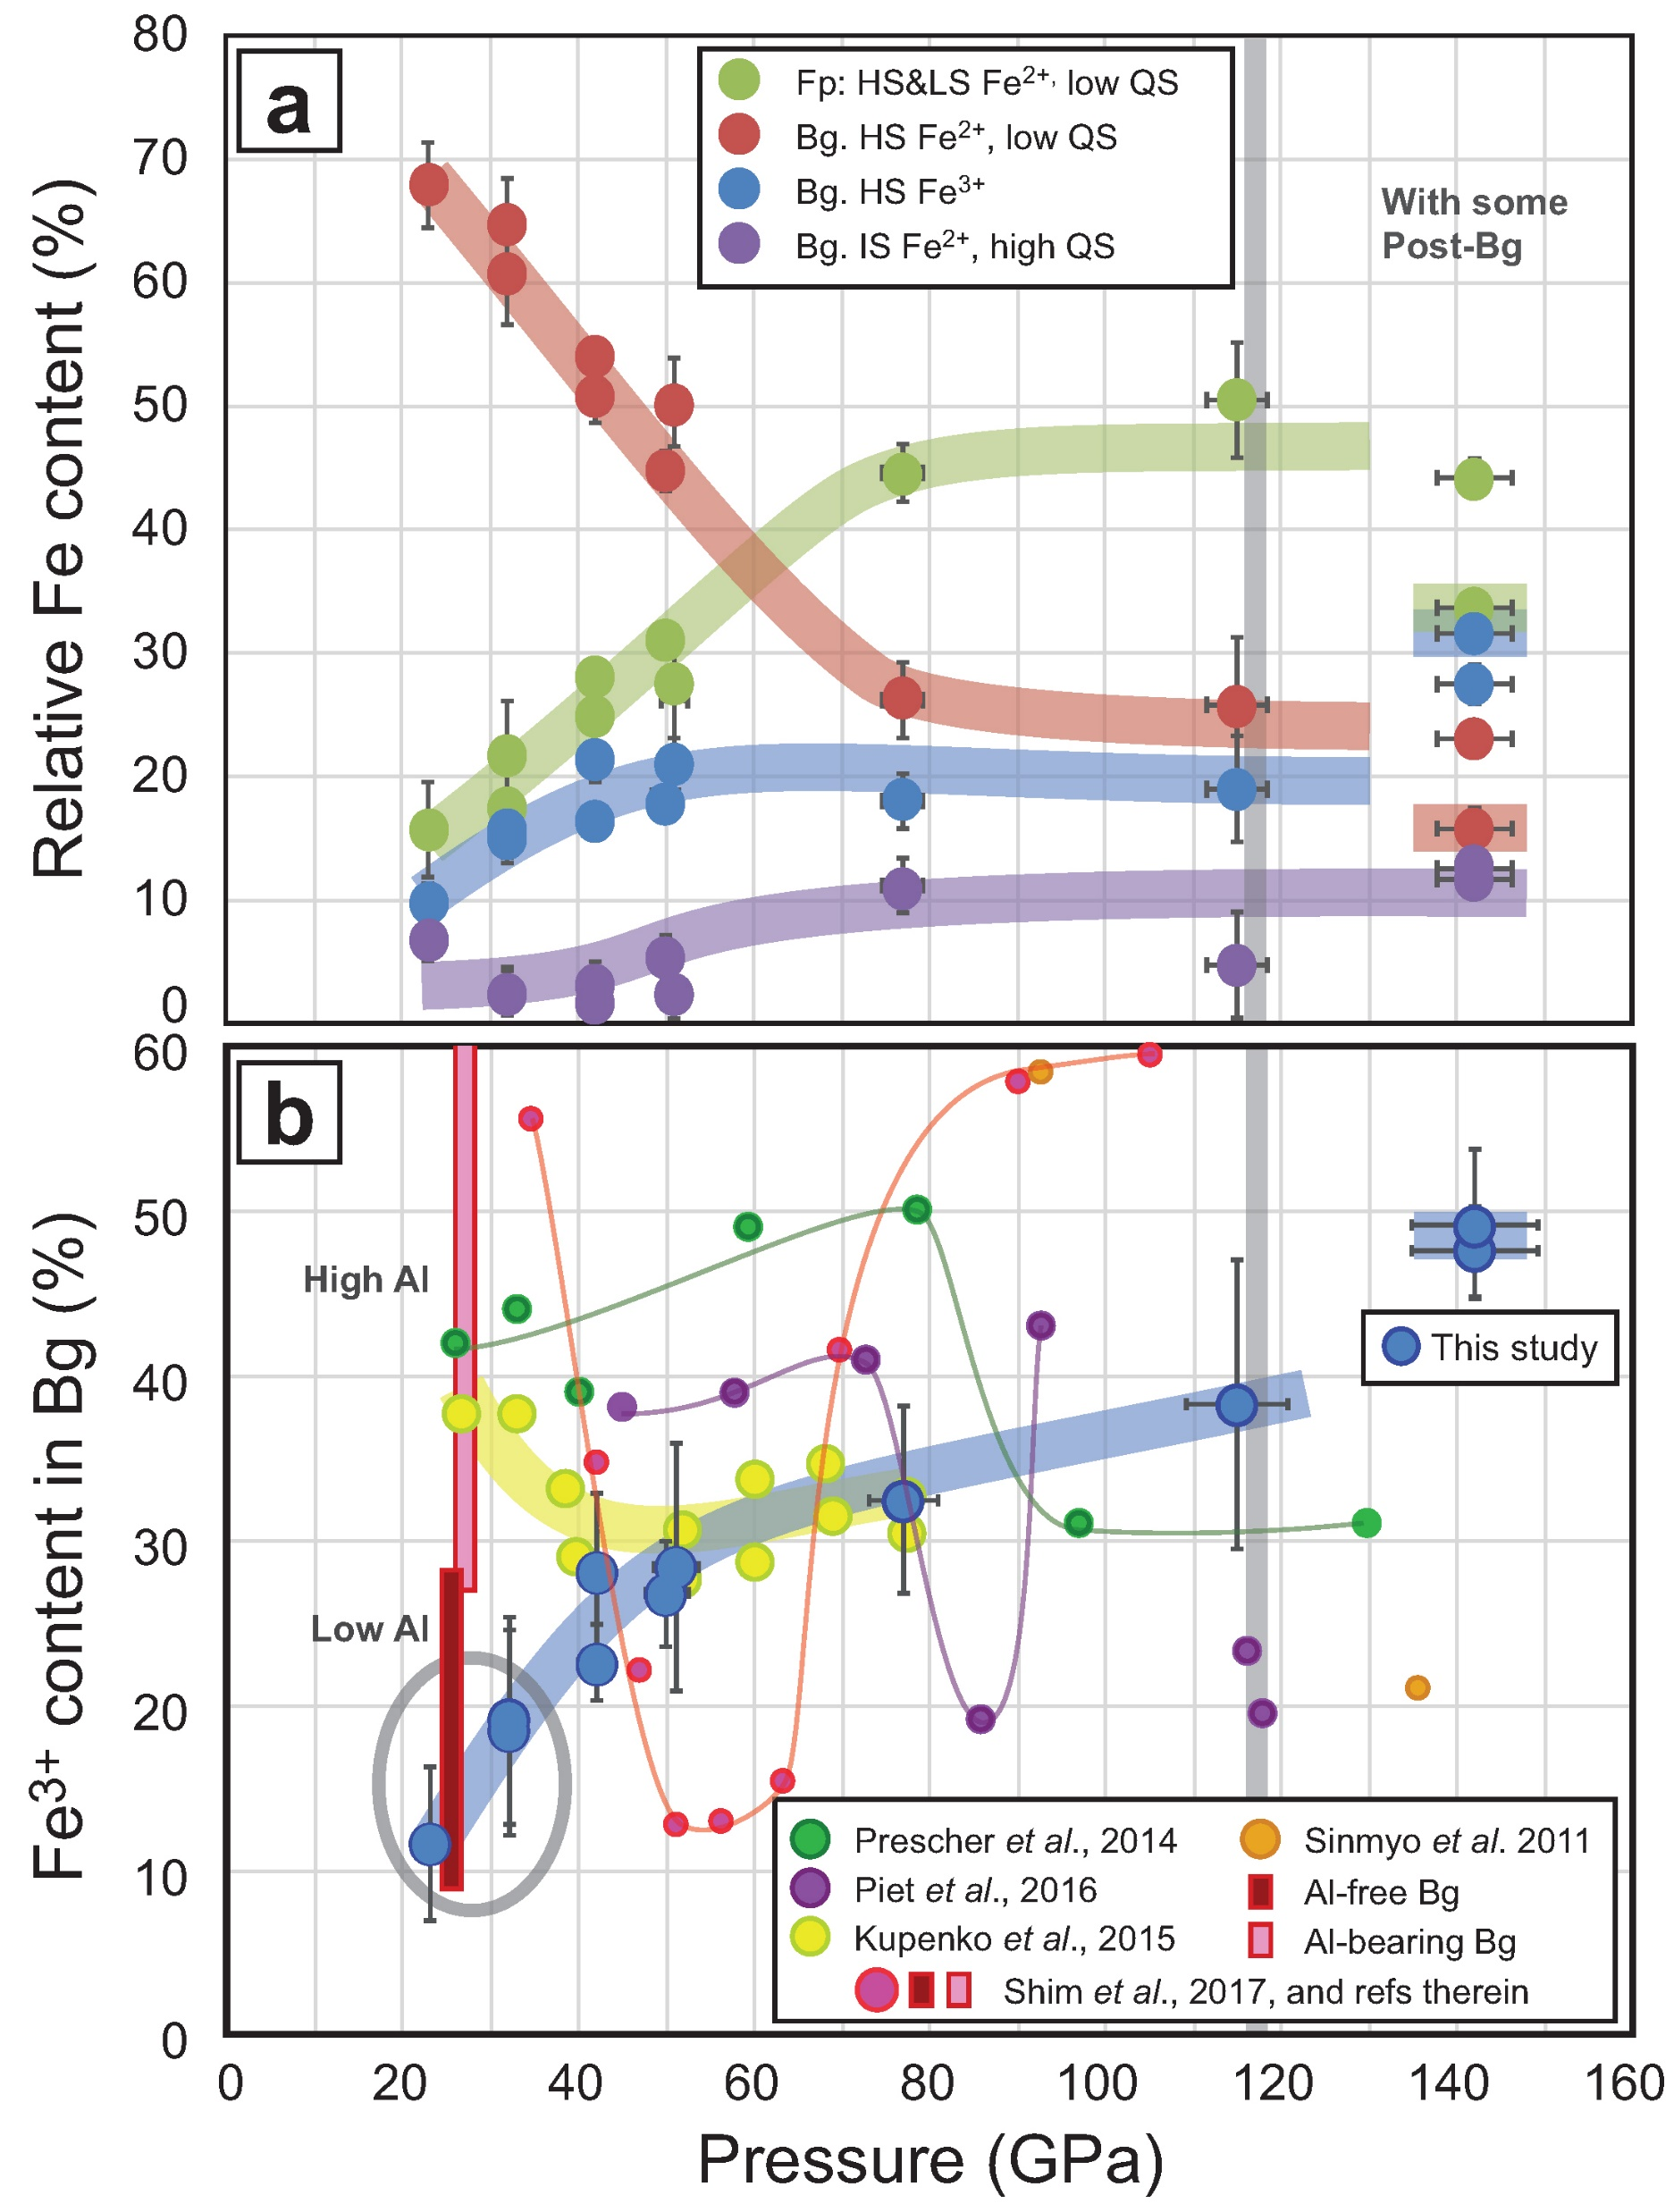
Andrault et al.
Large oxygen excess in the primitive mantle could be the source of the Great Oxygenation Event
Figure 3 The mantle #Fe³⁺ refined from SMS measurements. (a) Major Fe contributions found in our sample are high spin and low spin Fe²⁺ in Fp (Kantor et al., 2009) (both added to each other, green dots), high spin Fe²⁺ with low QS (red), intermediate spin Fe²⁺ (purple) and high spin Fe³⁺ (blue) in Bg (Kupenko et al., 2015). …
© 2018 The Authors
Published by the European Association of Geochemistry
under Creative Commons License CC BY-NC-ND 4.0
Andrault et al. (2018) Geochem. Persp. Let. 6, 5-10 | doi: 10.7185/geochemlet.1801
Notes:
Figure 3 The mantle #Fe³⁺ refined from SMS measurements. (a) Major Fe contributions found in our sample are high spin and low spin Fe²⁺ in Fp (Kantor et al., 2009) (both added to each other, green dots), high spin Fe²⁺ with low QS (red), intermediate spin Fe²⁺ (purple) and high spin Fe³⁺ (blue) in Bg (Kupenko et al., 2015). Above ~40 GPa, corresponding to mantle depths greater than ~1000 km, the #Fe³⁺ in the bulk sample is almost constant at ~20 %. In the pressure field of post-Bg (~142 GPa), we performed two syntheses at ~2500 K (dot with a coloured trend superimposed) and ~3500 K. (b) When focusing on Bg properties, we observe a continuous increase of its #Fe³⁺ with pressure. At low pressure, our two samples plot in the field of previous Al-free (low Al) Bg compounds (see Shim et al., 2017 and references therein). It could be associated with the remaining presence of Al-bearing garnet in our samples. On the other hand, Kupenko et al. (2015) found higher #Fe³⁺ in Bg in this pressure range (yellow dots). Above ~40 GPa, our data set produces a smooth trend which lies between the previous findings (Sinmyo et al., 2011; Prescher et al., 2014; Kupenko et al., 2015; Piet et al., 2016; Shim et al., 2017).

