Slide 1
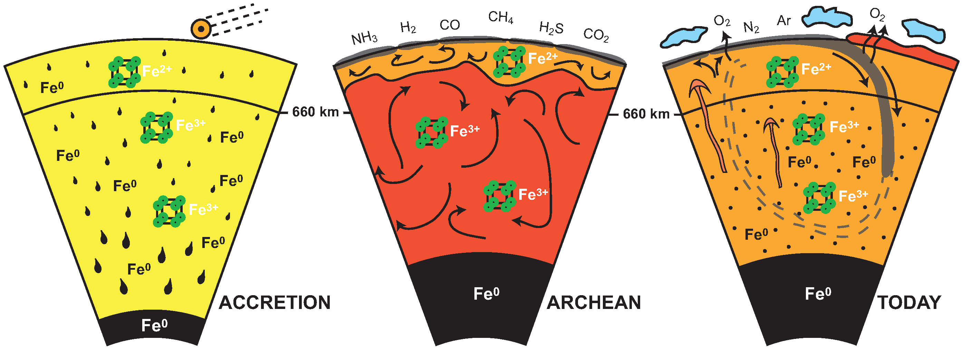
Andrault et al.
Large oxygen excess in the primitive mantle could be the source of the Great Oxygenation Event
Figure 4 Change in the redox state of the deep mantle. During the Earth's accretion (left), the descending iron droplets equilibrated chemically in a partially molten mantle, which contained a major amount of Bg below the 660 km discontinuity. After loss of the Fe⁰, the lower mantle was left with a #Fe³⁺ of ~20 % (Fig. 3a) …
© 2018 The Authors
Published by the European Association of Geochemistry
under Creative Commons License CC BY-NC-ND 4.0
Andrault et al. (2018) Geochem. Persp. Let. 6, 5-10 | doi: 10.7185/geochemlet.1801
Notes:
Figure 4 Change in the redox state of the deep mantle. During the Earth's accretion (left), the descending iron droplets equilibrated chemically in a partially molten mantle, which contained a major amount of Bg below the 660 km discontinuity. After loss of the Fe⁰, the lower mantle was left with a #Fe³⁺ of ~20 % (Fig. 3a). During the Archean (centre), the oxidised deep mantle remained relatively isolated from the Earth’s surface with a tectonic regime characterised by almost no subduction. At that time, the atmosphere was anoxic. The progressive transition to modern plate tectonics around the Archean to Proterozoic Transition greatly enhanced mantle mixing (right). Subduction became the dominant mechanism, which associated to global mantle convection brought deeper material and then fresh lavas to the Earth’s surface. Large amounts of oxygen were potentially degassed, due to the increase in volcanic fluxes and other sub-surface exchange processes. In this scheme, “Fe²⁺” and “Fe³⁺” indicate mantle fractions where the Fe³⁺/ΣFe ratios are 2–3 % and ~20 %, respectively. Yellow, orange and red colours indicate the Earth’s envelopes of Oxygen/ΣCations ratios that are lower (due to a Fe⁰ excess), similar and higher (due to a Fe³⁺ excess), respectively, than the current mantle value.

