Slide 1
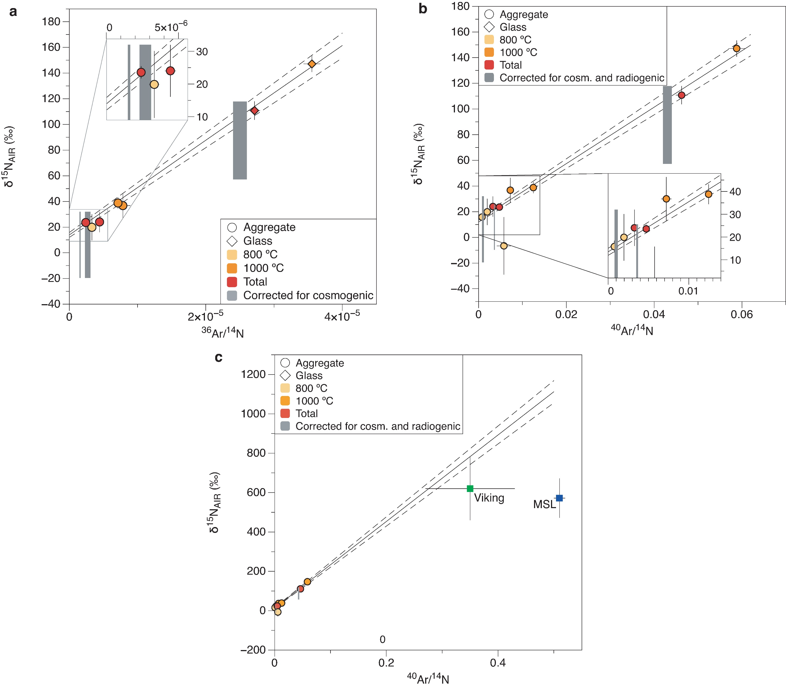
Avice et al.
Noble gases and nitrogen in Tissint reveal the composition of the Mars atmosphere
Figure 1 N-Ar isotope plots. (a) δ¹⁵N vs. ³⁶Ar/¹⁴N mixing diagram. The line corresponds to the relationship between an end-member with low δ¹⁵N and ³⁶Ar/¹⁴N values and the Mars atmosphere with elevated isotope and elemental ratios and was computed using Isoplot software (courtesy of K. Ludwig, Berkeley Geochronology Center)…
© 2018 The Authors
Published by the European Association of Geochemistry
under Creative Commons License CC BY-NC-ND 4.0
Avice et al. (2018) Geochem. Persp. Let. 6, 11-16 | doi: 10.7185/geochemlet.1802
Notes:
Figure 1 N-Ar isotope plots. (a) δ¹⁵N vs. ³⁶Ar/¹⁴N mixing diagram. The line corresponds to the relationship between an end-member with low δ¹⁵N and ³⁶Ar/¹⁴N values and the Mars atmosphere with elevated isotope and elemental ratios and was computed using Isoplot software (courtesy of K. Ludwig, Berkeley Geochronology Center). Dashed lines correspond to 1σ error envelope. (b) Same as (a) but with the ⁴⁰Ar/¹⁴N ratio. (c) Expanded view of (b) showing results from Viking (Owen et al., 1977) and MSL (Wong et al., 2013). Tissint data are compatible with the ⁴⁰Ar/¹⁴N ratio defined by Viking. Errors correspond to 1σ.

