Slide 1
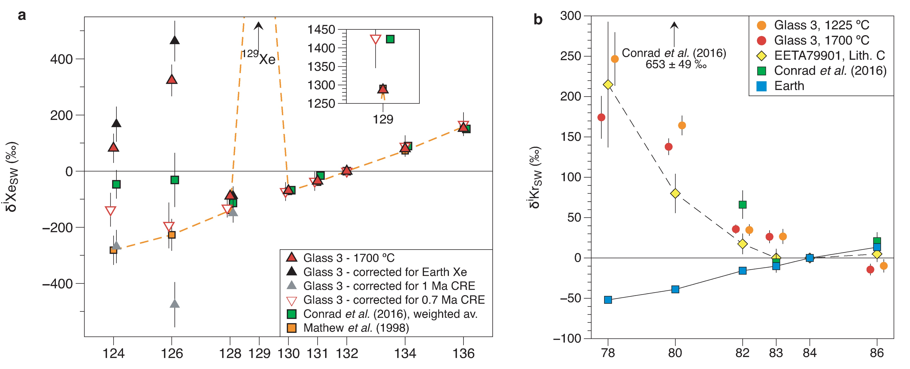
Avice et al.
Noble gases and nitrogen in Tissint reveal the composition of the Mars atmosphere
Figure 3 Isotope composition of Xe and Kr in Tissint. (a) Isotope spectrum of Xe released from sample Glass 3. The isotopic compositions of Xe measured by MSL (Conrad et al., 2016) and in other Martian meteorites (Mathew et al., 1998) are also displayed. All data …
© 2018 The Authors
Published by the European Association of Geochemistry
under Creative Commons License CC BY-NC-ND 4.0
Avice et al. (2018) Geochem. Persp. Let. 6, 11-16 | doi: 10.7185/geochemlet.1802
Notes:
Figure 3 Isotope composition of Xe and Kr in Tissint. (a) Isotope spectrum of Xe released from sample Glass 3. The isotopic compositions of Xe measured by MSL (Conrad et al., 2016) and in other Martian meteorites (Mathew et al., 1998) are also displayed. All data are normalised to ¹³²Xe and to SW-Xe (Meshik et al., 2014) and expressed in delta notation: δ^{i}Xe = 1000 * [(^{i}Xe/¹³²Xe)/( ^{i}Xe/¹³²Xe)_{SW-Xe} - 1]. ¹²⁹Xe excesses relative to SW-Xe are shown in the top-right sub-panel. Xe isotope spectra corrected for terrestrial Xe, for 1 Myr and 0.7 Myr of cosmic-ray exposure are also shown. (b) Isotope spectra of Kr extracted from sample glass compared to results obtained on lithology C (glass) of the EETA79001 meteorite (Swindle et al., 1986) and in situ by MSL (Conrad et al., 2016). Terrestrial Kr (Ozima and Podosek, 2002) is shown for comparison. Data are expressed in delta notation relative to solar-wind Kr (Meshik et al., 2014). Errors correspond to 1σ.

