Slide 1
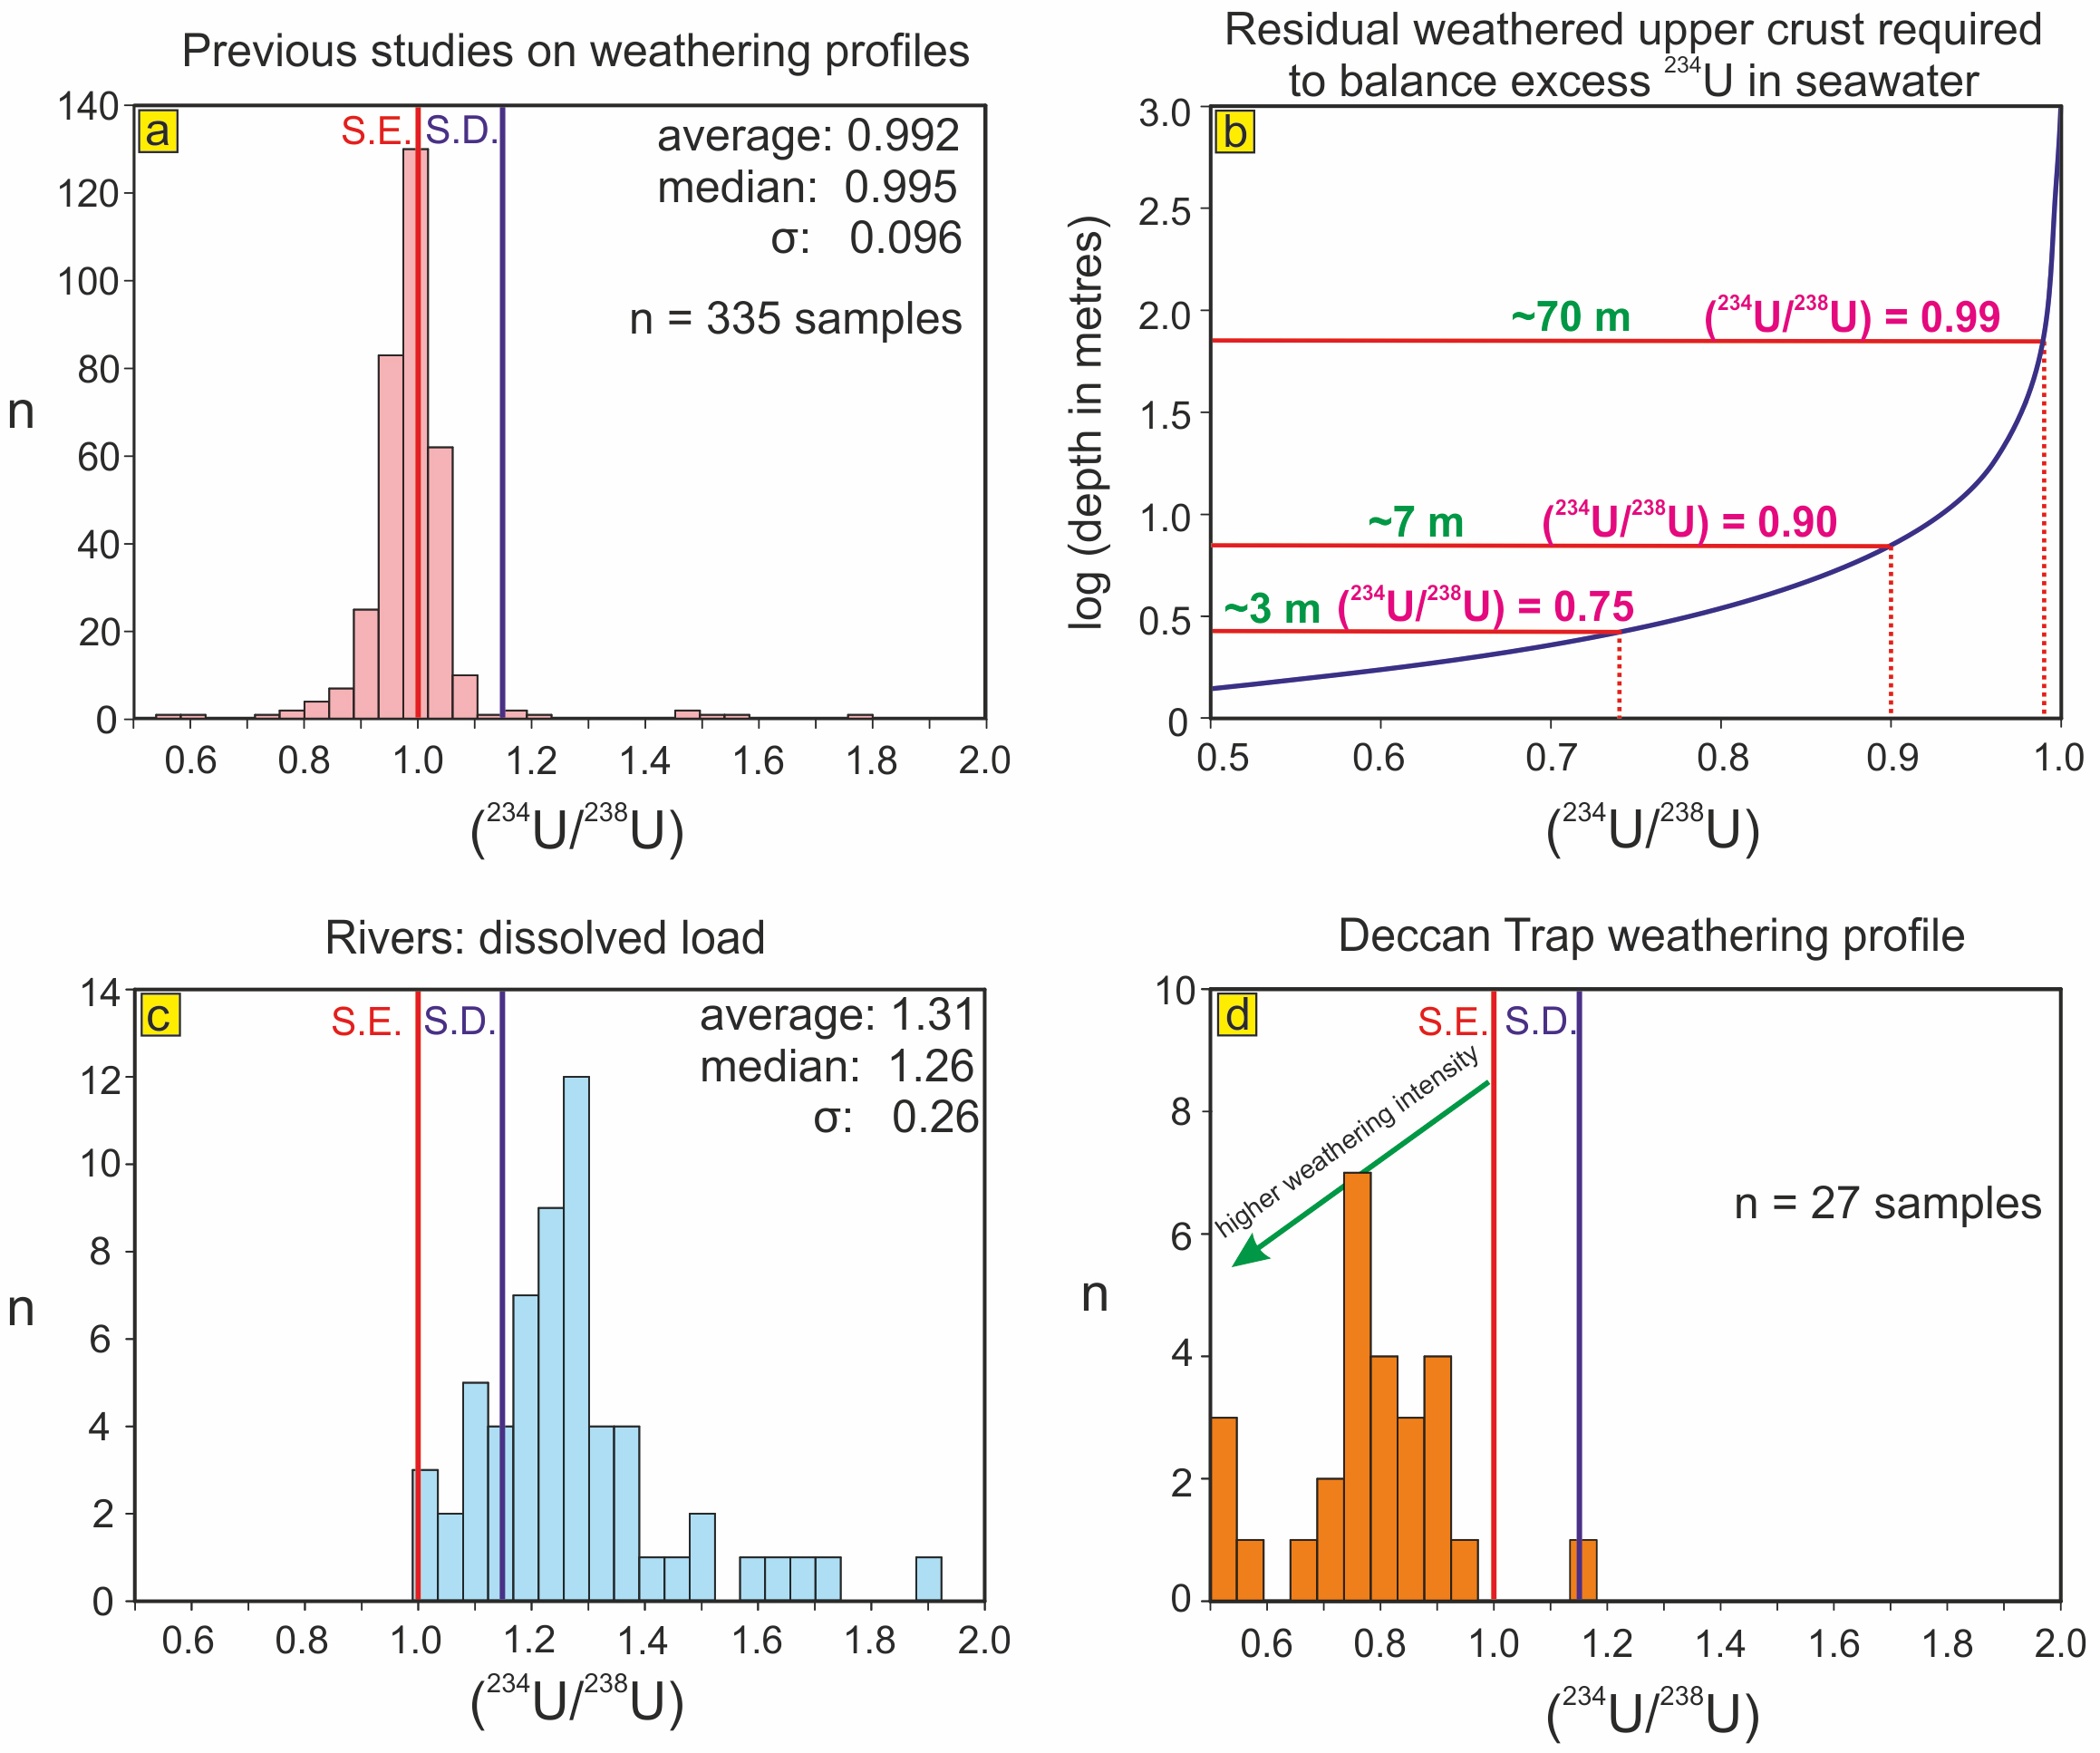
Suhr et al.
Th/U and U series systematics of saprolite: importance for the oceanic ²³⁴U excess
Figure 1 Histograms of (²³⁴U/²³⁸U). (a) Previously published data for weathering profiles. (b) Results of a simple mass balance calculation accounting for the observed ²³⁴U excess in seawater in terms of weathering depth for various values of (²³⁴U/²³⁸U) in the residual weathered material. (c) Dissolved load in major rivers. (d) Weathering…
© 2018 The Authors
Published by the European Association of Geochemistry
under Creative Commons License CC BY-NC-ND 4.0
Suhr et al. (2018) Geochem. Persp. Let. 6, 17-22 | doi: 10.7185/geochemlet.1803
Notes:
Figure 1 Histograms of (²³⁴U/²³⁸U). (a) Previously published data for weathering profiles. (b) Results of a simple mass balance calculation accounting for the observed ²³⁴U excess in seawater in terms of weathering depth for various values of (²³⁴U/²³⁸U) in the residual weathered material. (c) Dissolved load in major rivers. (d) Weathering profile of this study. S.E. = secular equilibrium; S.D. = seawater dissolved (²³⁴U/²³⁸U). The average, median and standard deviation (σ) of each respective data set are illustrated in (a,c). Data for (a,c) are compiled in Table S-1.

