Slide 1
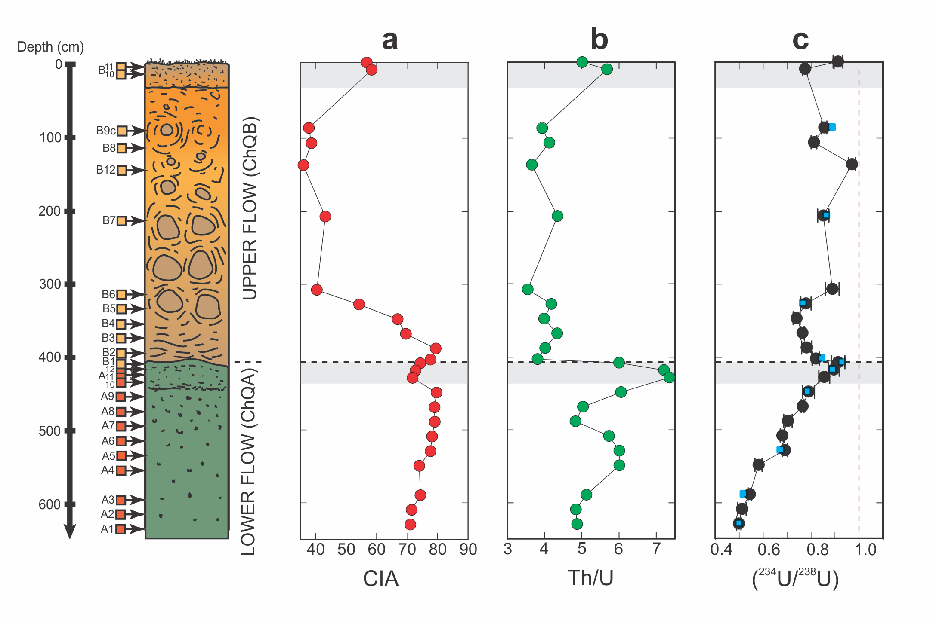
Suhr et al.
Th/U and U series systematics of saprolite: importance for the oceanic ²³⁴U excess
Figure 2 Vertical profile of volcanic flows and weathering characteristics. (a) CIA. (b) Th/U ratio. (c) (²³⁴U/²³⁸U), dashed purple line illustrates secular equilibrium, black dots = Q-ICP-MS data, blue squares = MC-ICP-MS data to test the accuracy of Q-ICP-MS data. Note that…
© 2018 The Authors
Published by the European Association of Geochemistry
under Creative Commons License CC BY-NC-ND 4.0
Suhr et al. (2018) Geochem. Persp. Let. 6, 17-22 | doi: 10.7185/geochemlet.1803
Notes:
Figure 2 Vertical profile of volcanic flows and weathering characteristics. (a) CIA. (b) Th/U ratio. (c) (²³⁴U/²³⁸U), dashed purple line illustrates secular equilibrium, black dots = Q-ICP-MS data, blue squares = MC-ICP-MS data to test the accuracy of Q-ICP-MS data. Note that errors bars of MC-ICP-MS data are smaller than symbols; the contact between the two flows is shown on each plot as a horizontal dashed line. The modern soil surface and palaeo-flow surface are denoted by the horizontal shaded horizons.

