Slide 1
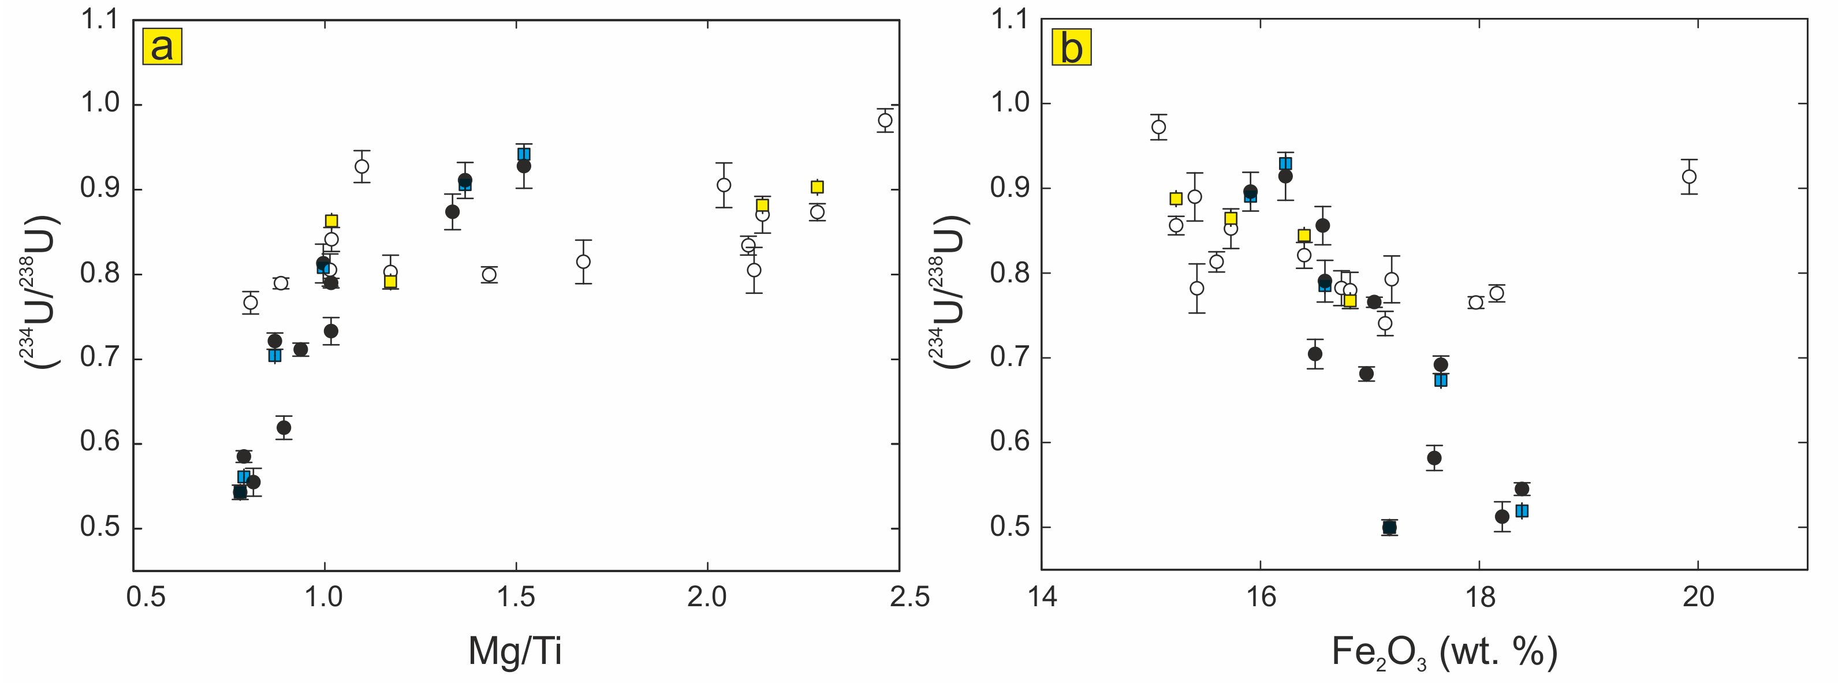
Suhr et al.
Th/U and U series systematics of saprolite: importance for the oceanic ²³⁴U excess
Figure 3 Bi-variate diagrams. (a) (²³⁴U/²³⁸U) vs. Mg/Ti. (b) (²³⁴U/²³⁸U) vs. Fe₂O_{3.} The decreasing Mg/Ti ratios correlate with (²³⁴U/²³⁸U), whereas Fe₂O₃ anti-correlates.
© 2018 The Authors
Published by the European Association of Geochemistry
under Creative Commons License CC BY-NC-ND 4.0
Suhr et al. (2018) Geochem. Persp. Let. 6, 17-22 | doi: 10.7185/geochemlet.1803
Notes:
Figure 3 Bi-variate diagrams. (a) (²³⁴U/²³⁸U) vs. Mg/Ti. (b) (²³⁴U/²³⁸U) vs. Fe₂O_{3.} The decreasing Mg/Ti ratios correlate with (²³⁴U/²³⁸U), whereas Fe₂O₃ anti-correlates.

