Slide 1
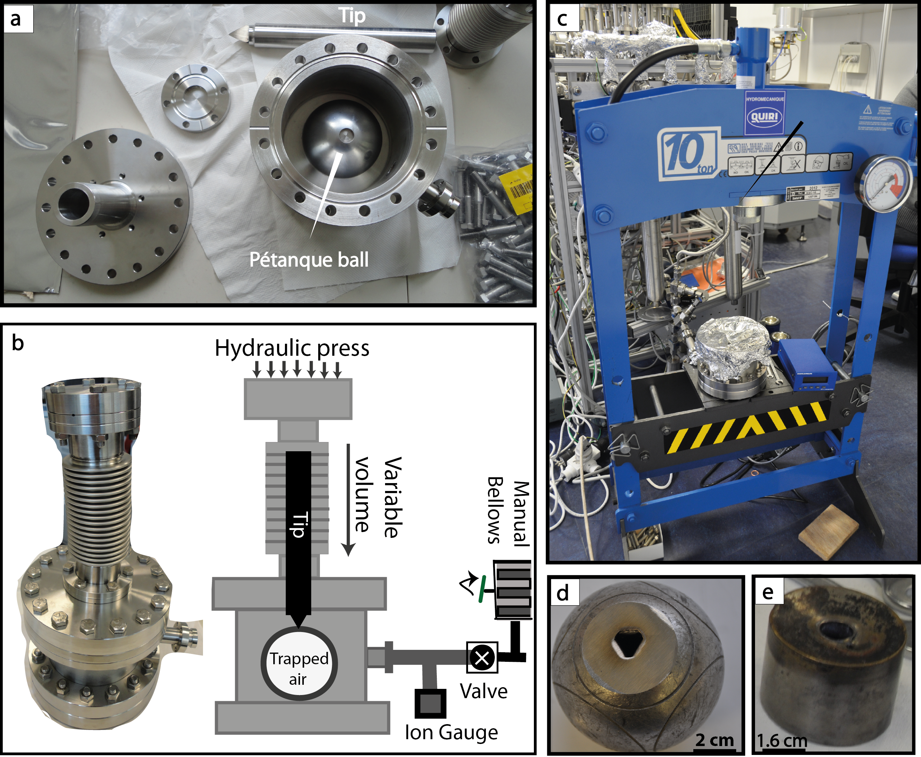
Boucher et al.
Atmospheric helium isotopic ratio from 1910 to 2016 recorded in stainless steel containers
Figure 1 (a) Stainless steel chamber. (b) Sectional view of the chamber. (c) Hydraulic press KSC-10. (d) Pétanque ball pierced. (e) Carburettor float.
© 2018 The Authors
Published by the European Association of Geochemistry
under Creative Commons License CC BY-NC-ND 4.0
Boucher et al. (2018) Geochem. Persp. Let. 6, 23-27 | doi: 10.7185/geochemlet.1804
Notes:
Figure 1 (a) Stainless steel chamber. (b) Sectional view of the chamber. (c) Hydraulic press KSC-10. (d) Pétanque ball pierced. (e) Carburettor float.

