Slide 1
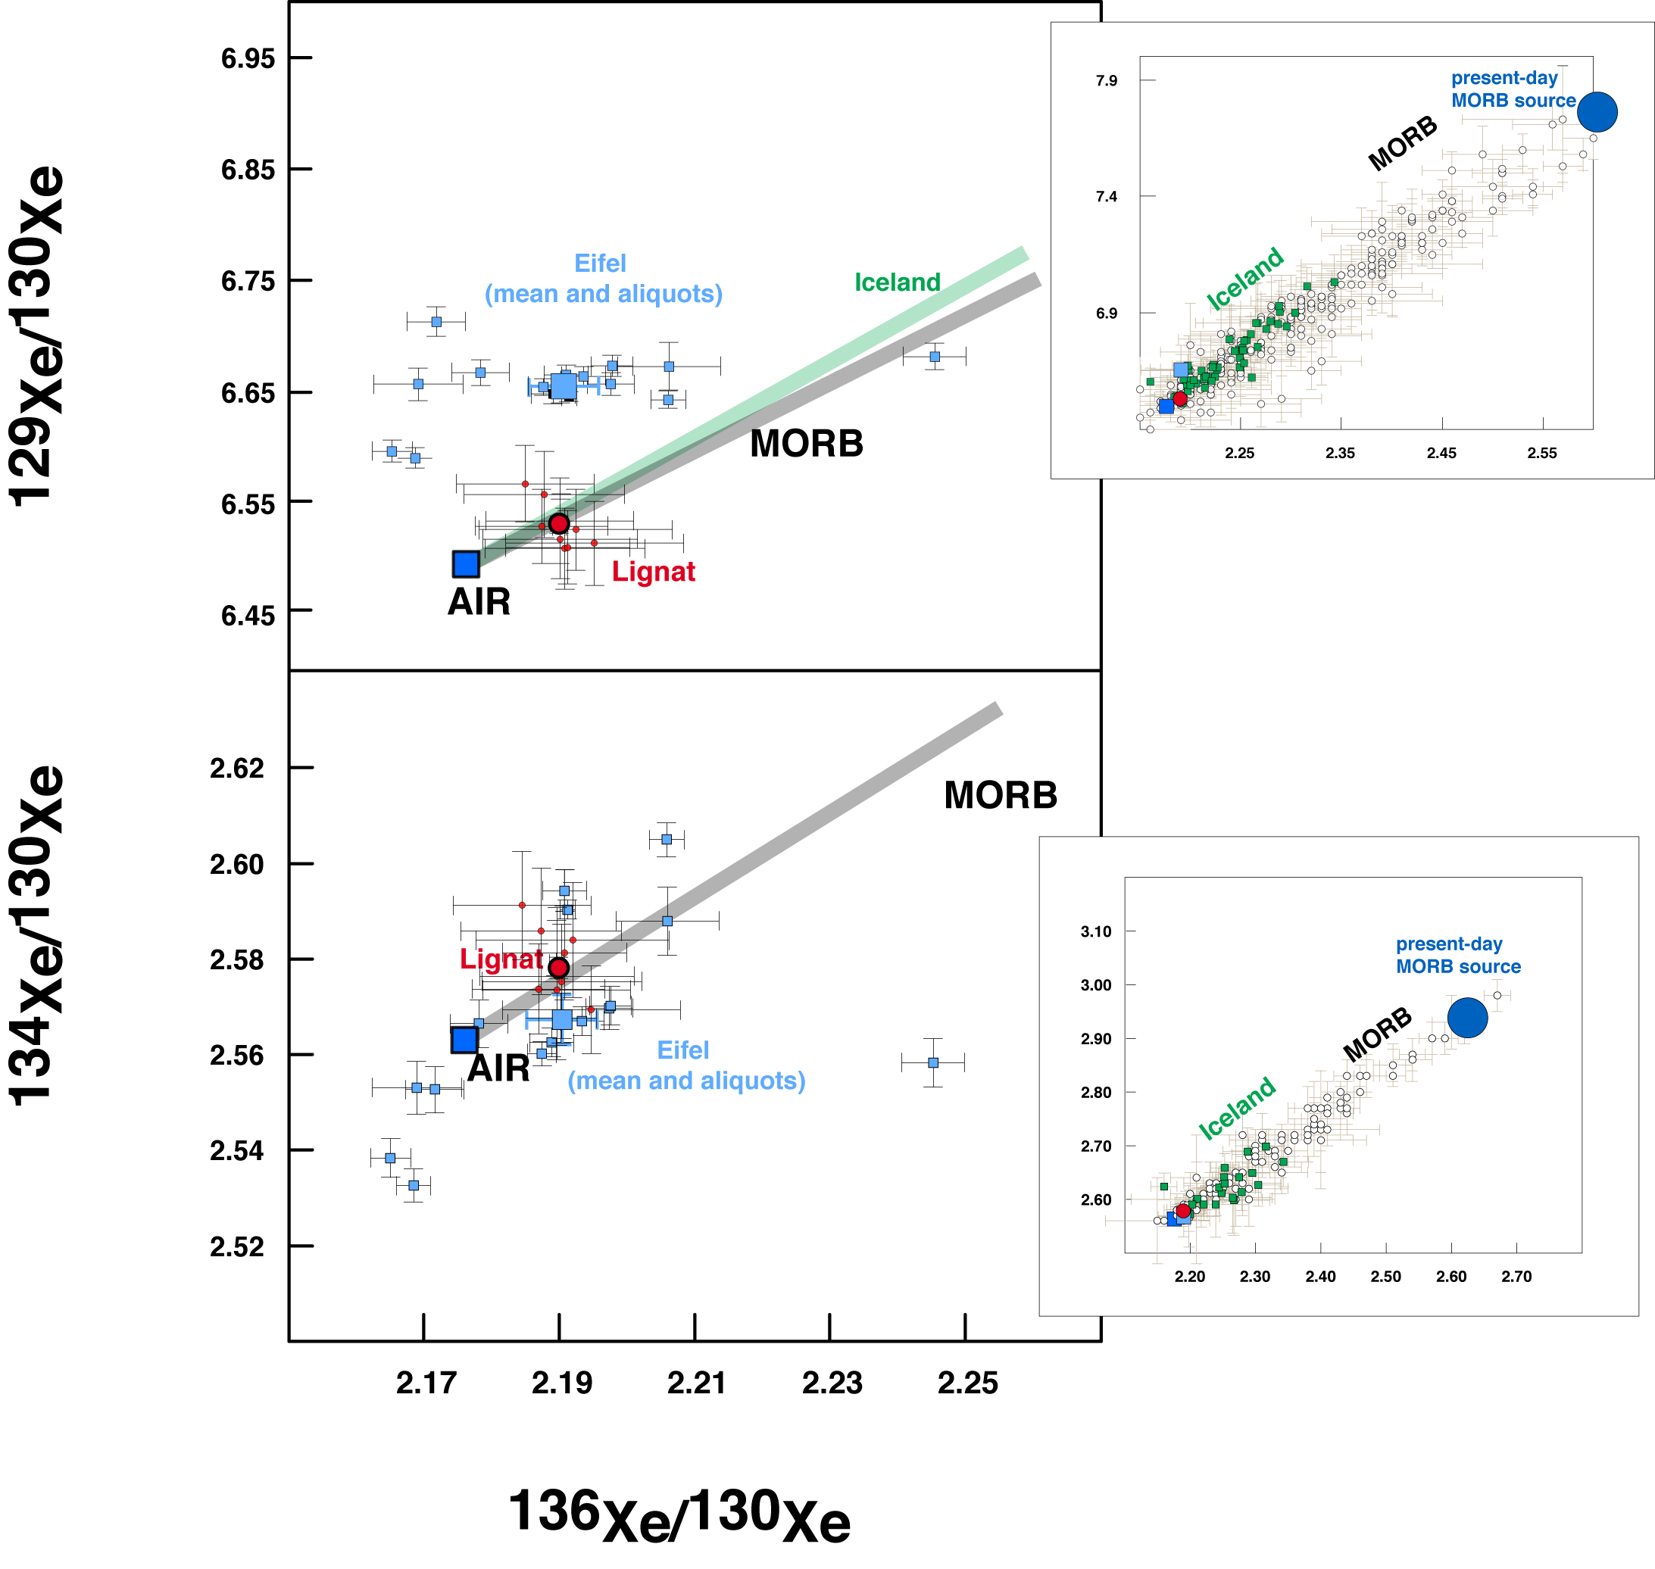
Moreira et al.
The xenon isotopic signature of the mantle beneath Massif Central
Figure 2 Xenon isotopes in the Lignat gas (aliquots: small red dots; mean: large red dot), compared to MORB (Kunz et al., 1998; Parai et al., 2012; Tucker et al., 2012) and Iceland basalts (Mukhopadhyay, 2012). The Eifel gas is shown for comparison (small blue squares: aliquots, large blue square: mean) (Caracausi et al., 2016). The inserts represent the global scale of variation in mantle-derived samples.
© 2018 The Authors
Published by the European Association of Geochemistry
under Creative Commons License CC BY-NC-ND 4.0
Moreira et al. (2018) Geochem. Persp. Let. 6, 28-32 | doi: 10.7185/geochemlet.1805
Notes:
Figure 2 Xenon isotopes in the Lignat gas (aliquots: small red dots; mean: large red dot), compared to MORB (Kunz et al., 1998; Parai et al., 2012; Tucker et al., 2012) and Iceland basalts (Mukhopadhyay, 2012). The Eifel gas is shown for comparison (small blue squares: aliquots, large blue square: mean) (Caracausi et al., 2016). The inserts represent the global scale of variation in mantle-derived samples.

