Slide 1
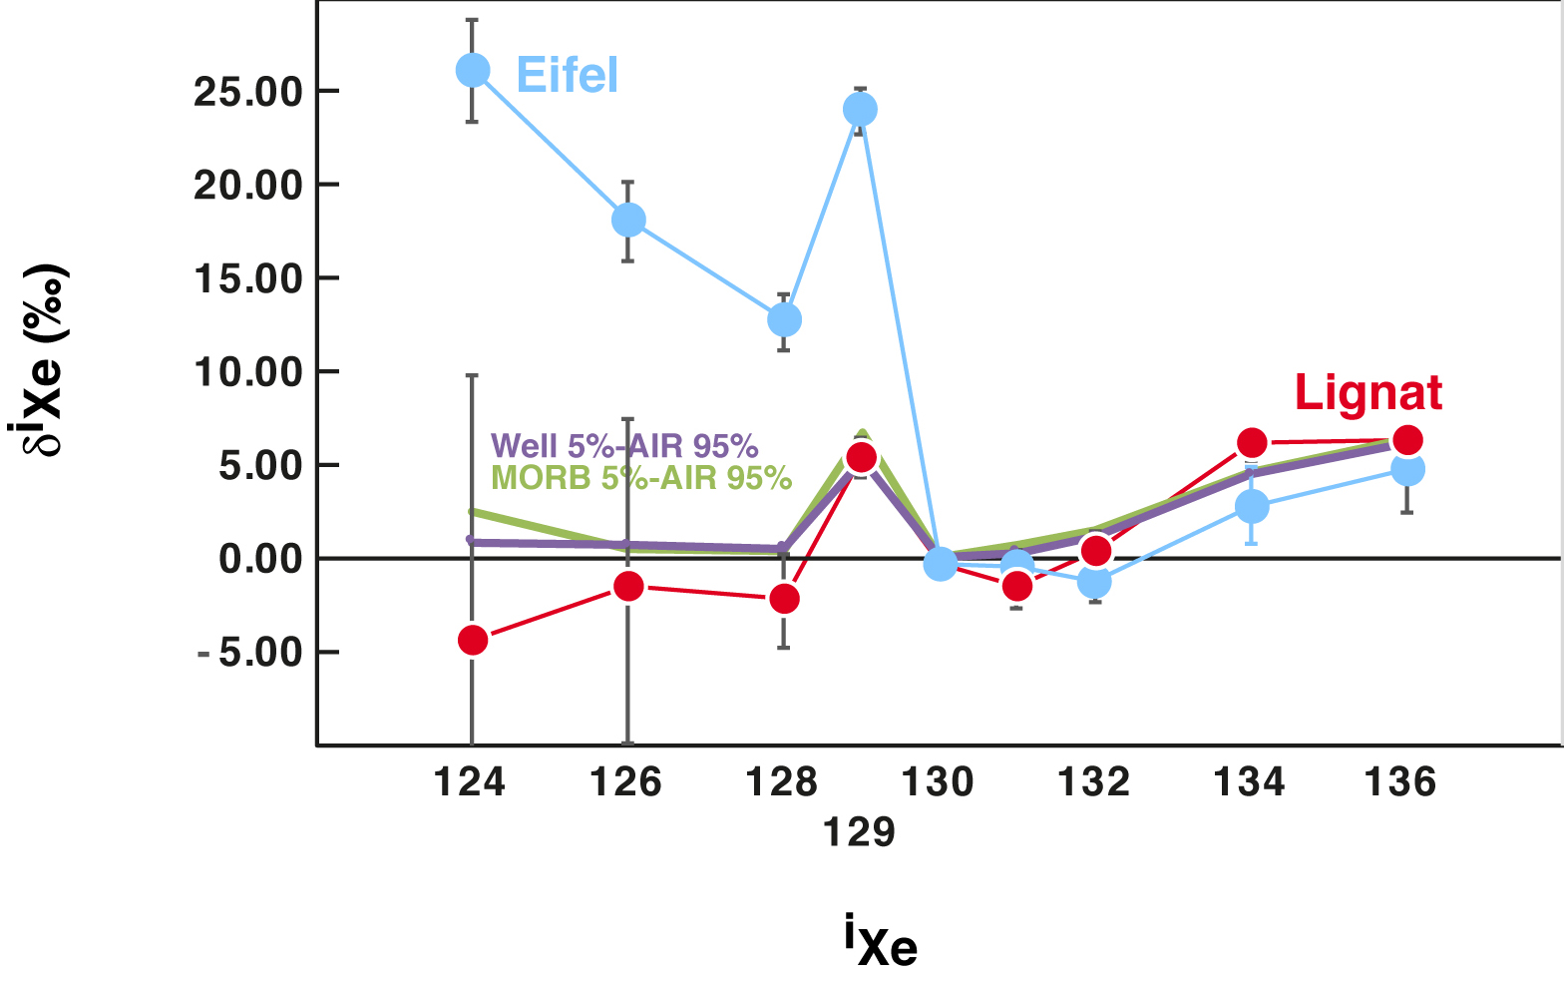
Moreira et al.
The xenon isotopic signature of the mantle beneath Massif Central
Figure 3 Xenon isotopic ratios in the Lignat gas expressed in ‰ deviation relative to the atmospheric composition. Assuming the xenon composition reflects mixing between air and MORB (or CO₂-well gas; Holland and Ballentine, 2006), one can estimate the proportion of atmospheric xenon. Using the ¹³⁶Xe/¹³⁰Xe ratio, 95 % of the ¹³⁰Xe in the Lignat source is sourced from…
© 2018 The Authors
Published by the European Association of Geochemistry
under Creative Commons License CC BY-NC-ND 4.0
Moreira et al. (2018) Geochem. Persp. Let. 6, 28-32 | doi: 10.7185/geochemlet.1805
Notes:
Figure 3 Xenon isotopic ratios in the Lignat gas expressed in ‰ deviation relative to the atmospheric composition. Assuming the xenon composition reflects mixing between air and MORB (or CO₂-well gas; Holland and Ballentine, 2006), one can estimate the proportion of atmospheric xenon. Using the ¹³⁶Xe/¹³⁰Xe ratio, 95 % of the ¹³⁰Xe in the Lignat source is sourced from the air. The other isotopic ratios can be estimated using this mixing proportion. Two patterns are given for the result of this mixing: violet using CO₂-well gas and green using the mean MORB-source ratios (Table S-2). The Lignat gas satisfies a simple binary mixture between air and MORB. Although the Eifel gas (blue circles) shows the same pattern for fissiogenic isotopes, it exhibits notable excesses in light Xe isotopes that are unaccounted for by the MORB-AIR mixing model.

