Slide 1
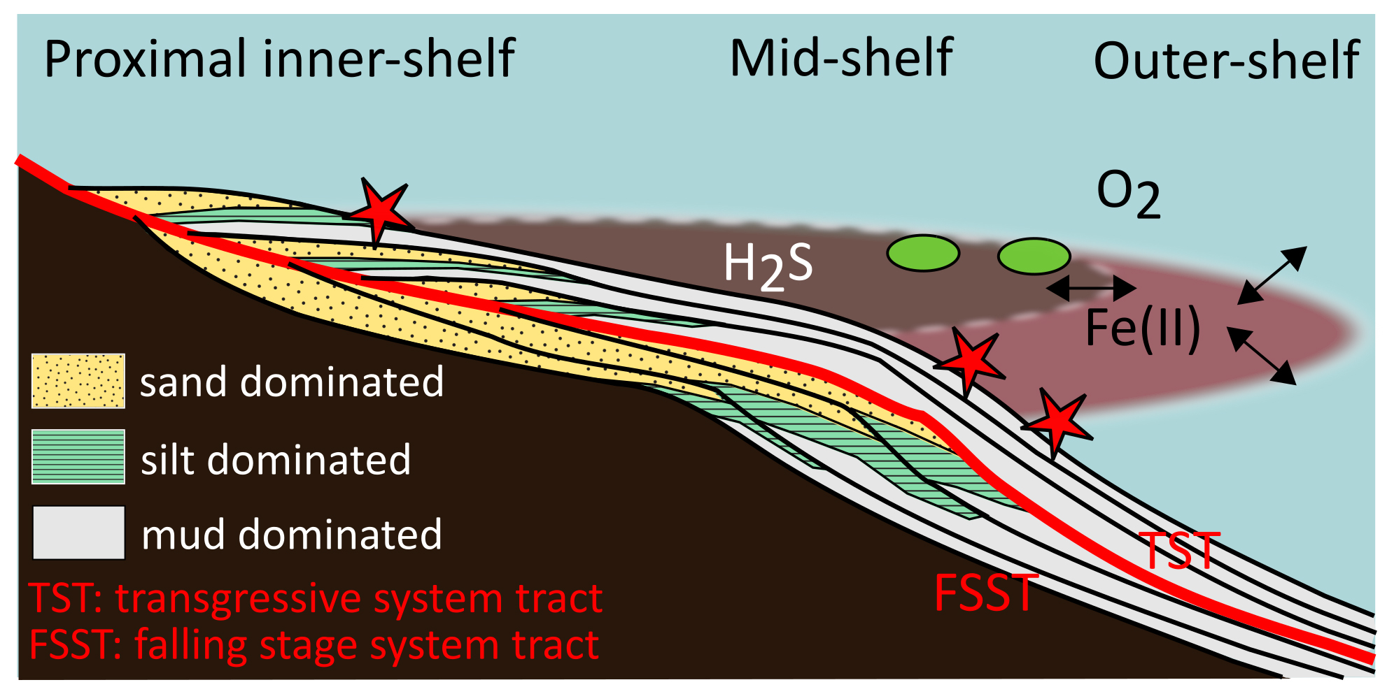
Guilbaud et al.
Oxygen minimum zones in the early Cambrian ocean
Figure 4 Redox architecture reconstruction, with oxic conditions above and below anoxic settings. Ferruginous conditions dominate in the OMZ, but euxinia develops in zones of increased organic carbon delivery. Metazoan body fossils recovery is shown by the red stars. Evidence for phototrophic GSB (green ovals) in mid-shelf settings corroborates geochemical and palaeontological redox indicators.
© 2018 The Authors
Published by the European Association of Geochemistry
under Creative Commons License CC BY 4.0
Guilbaud et al. (2018) Geochem. Persp. Let. 6, 33-38 | doi: 10.7185/geochemlet.1806
Notes:
Figure 4 Redox architecture reconstruction, with oxic conditions above and below anoxic settings. Ferruginous conditions dominate in the OMZ, but euxinia develops in zones of increased organic carbon delivery. Metazoan body fossils recovery is shown by the red stars. Evidence for phototrophic GSB (green ovals) in mid-shelf settings corroborates geochemical and palaeontological redox indicators.

