Slide 1
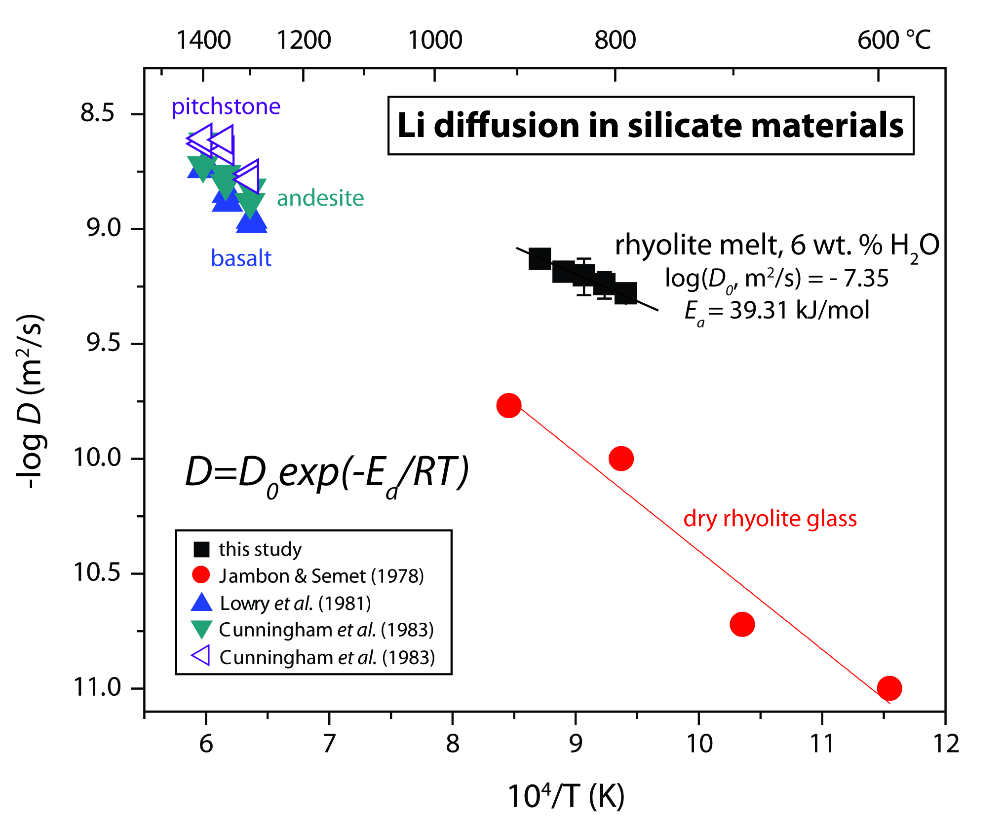
Holycross et al.
Diffusive fractionation of Li isotopes in wet, highly silicic melts
Figure 1 Arrhenius plot showing temperature dependence of Li diffusion in silicate materials. Lithium diffusion in wet rhyolite melt is significantly faster than in dry obsidian glass due to the decrease in viscosity from glass to liquid and from the addition of 6 wt. % dissolved H₂O to the melt.
© 2018 The Authors
Published by the European Association of Geochemistry
under Creative Commons License CC BY 4.0
Holycross et al. (2018) Geochem. Persp. Let. 6, 39-42 | doi: 10.7185/geochemlet.1807
Notes:
Figure 1 Arrhenius plot showing temperature dependence of Li diffusion in silicate materials. Lithium diffusion in wet rhyolite melt is significantly faster than in dry obsidian glass due to the decrease in viscosity from glass to liquid and from the addition of 6 wt. % dissolved H₂O to the melt.

