Slide 1
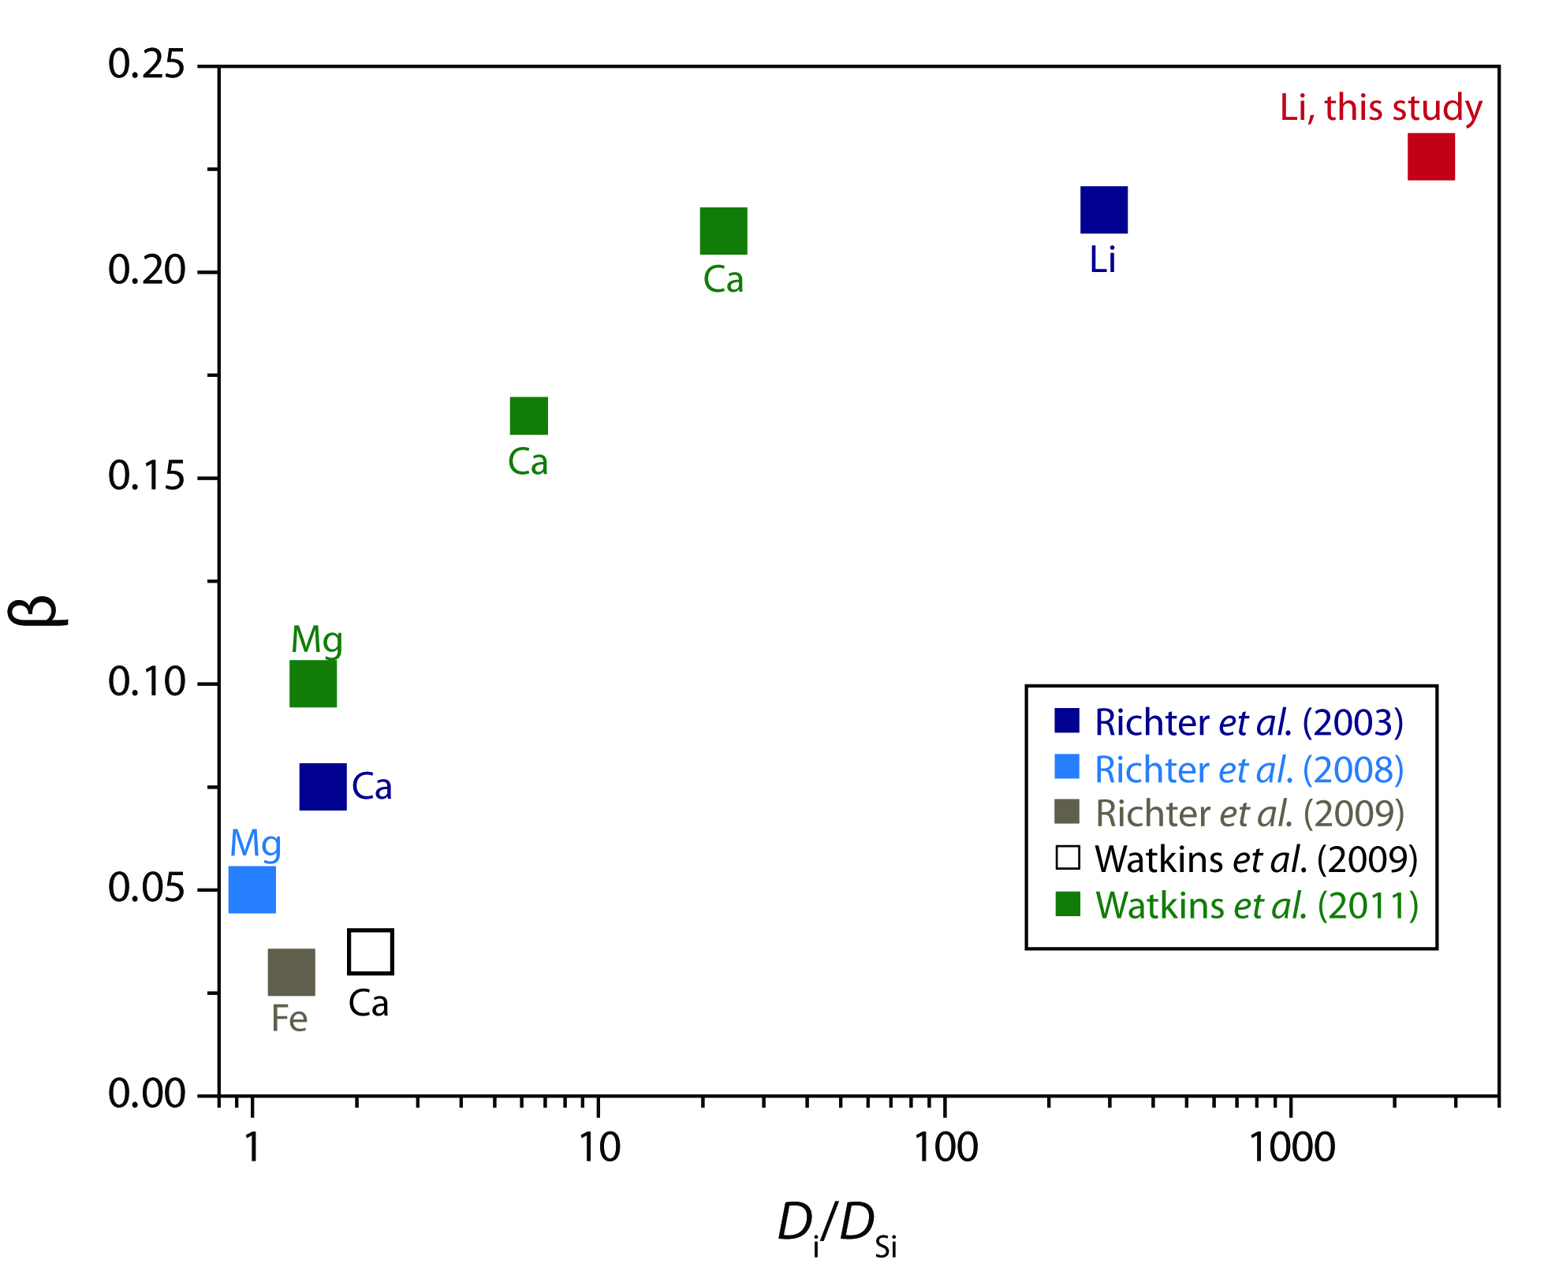
Holycross et al.
Diffusive fractionation of Li isotopes in wet, highly silicic melts
Figure 3 The reported β factors for isotopes of an element i vary with its Si-normalised diffusivity, D_{i}/D_{Si}. Data point in red is for rhyolitic melt containing 6 wt. % H₂O at 810 ºC. Silicon is an extremely slow diffuser in rhyolite while Li is extremely fast. This suggests diffusion of Li may be decoupled from the melt network and exhibit a greater mass discrimination. Figure after Watkins et al. (2017).
© 2018 The Authors
Published by the European Association of Geochemistry
under Creative Commons License CC BY 4.0
Holycross et al. (2018) Geochem. Persp. Let. 6, 39-42 | doi: 10.7185/geochemlet.1807
Notes:
Figure 3 The reported β factors for isotopes of an element i vary with its Si-normalised diffusivity, D_{i}/D_{Si}. Data point in red is for rhyolitic melt containing 6 wt. % H₂O at 810 ºC. Silicon is an extremely slow diffuser in rhyolite while Li is extremely fast. This suggests diffusion of Li may be decoupled from the melt network and exhibit a greater mass discrimination. Figure after Watkins et al. (2017).

