Slide 1
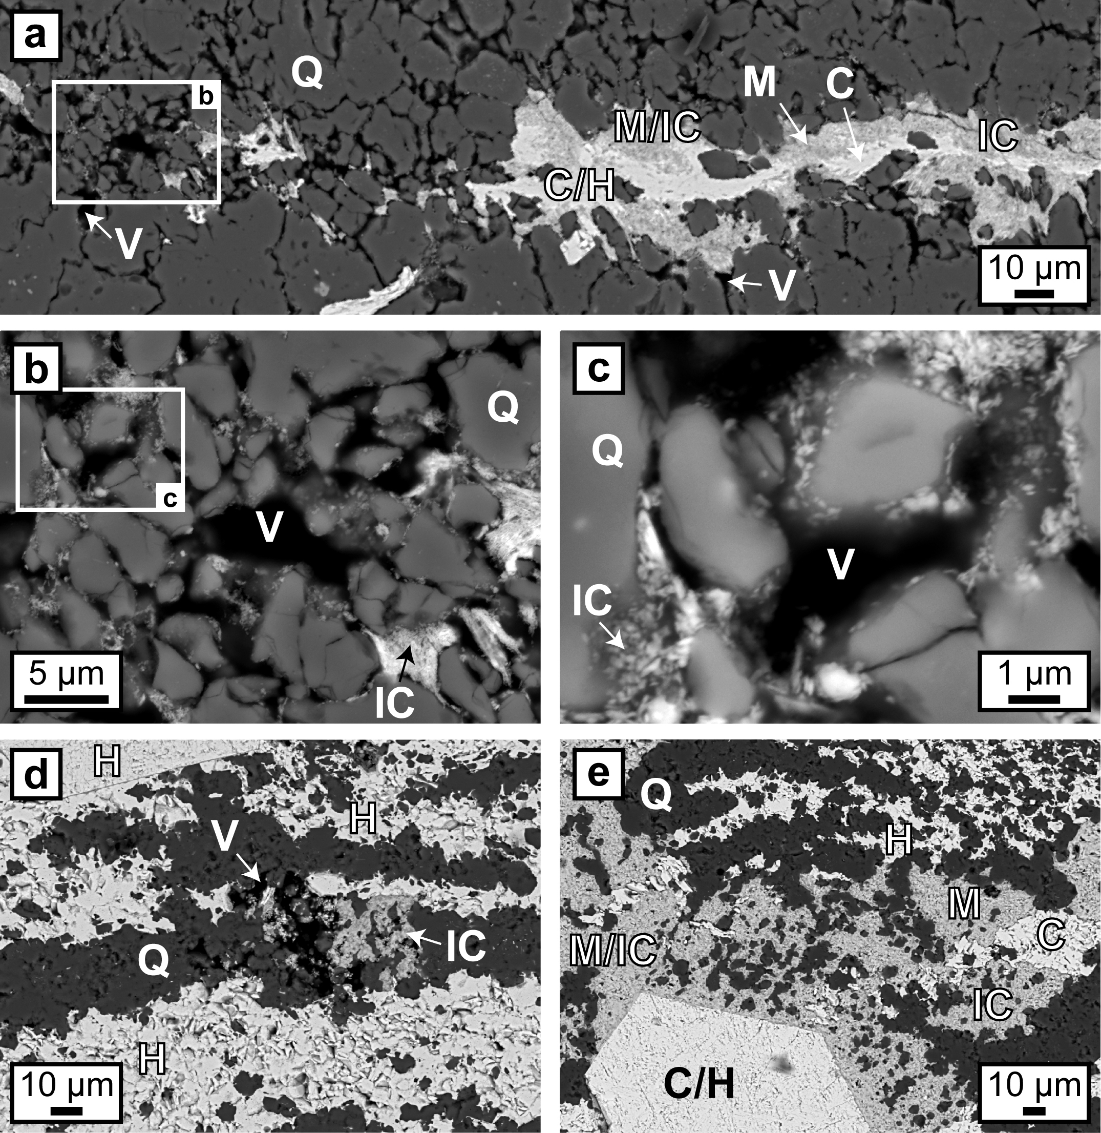
Egglseder et al.
Colloidal origin of microbands in banded iron formations
Figure 3 (a–e) BSE images of BIF laminae illustrating the lateral change from porous chert to hematite microbands with irregular boundaries. (a–c) The porosity is (partly) filled with hematite particles encapsulating quartz grains. (d–e) Hematite forms more larger crystals inside these particle agglomerations, as evident by core/mantle structures resulting in new microbands of hematite. C: core, H: hematite, M: mantle, IC: iron oxide colloids/particles, Q: quartz, V: void.
© 2018 The Authors
Published by the European Association of Geochemistry
under Creative Commons License CC BY-NC-ND 4.0
Egglseder et al. (2018) Geochem. Persp. Let. 6, 43-49 | doi: 10.7185/geochemlet.1808
Notes:
Figure 3 (a–e) BSE images of BIF laminae illustrating the lateral change from porous chert to hematite microbands with irregular boundaries. (a–c) The porosity is (partly) filled with hematite particles encapsulating quartz grains. (d–e) Hematite forms more larger crystals inside these particle agglomerations, as evident by core/mantle structures resulting in new microbands of hematite. C: core, H: hematite, M: mantle, IC: iron oxide colloids/particles, Q: quartz, V: void.

