Slide 1
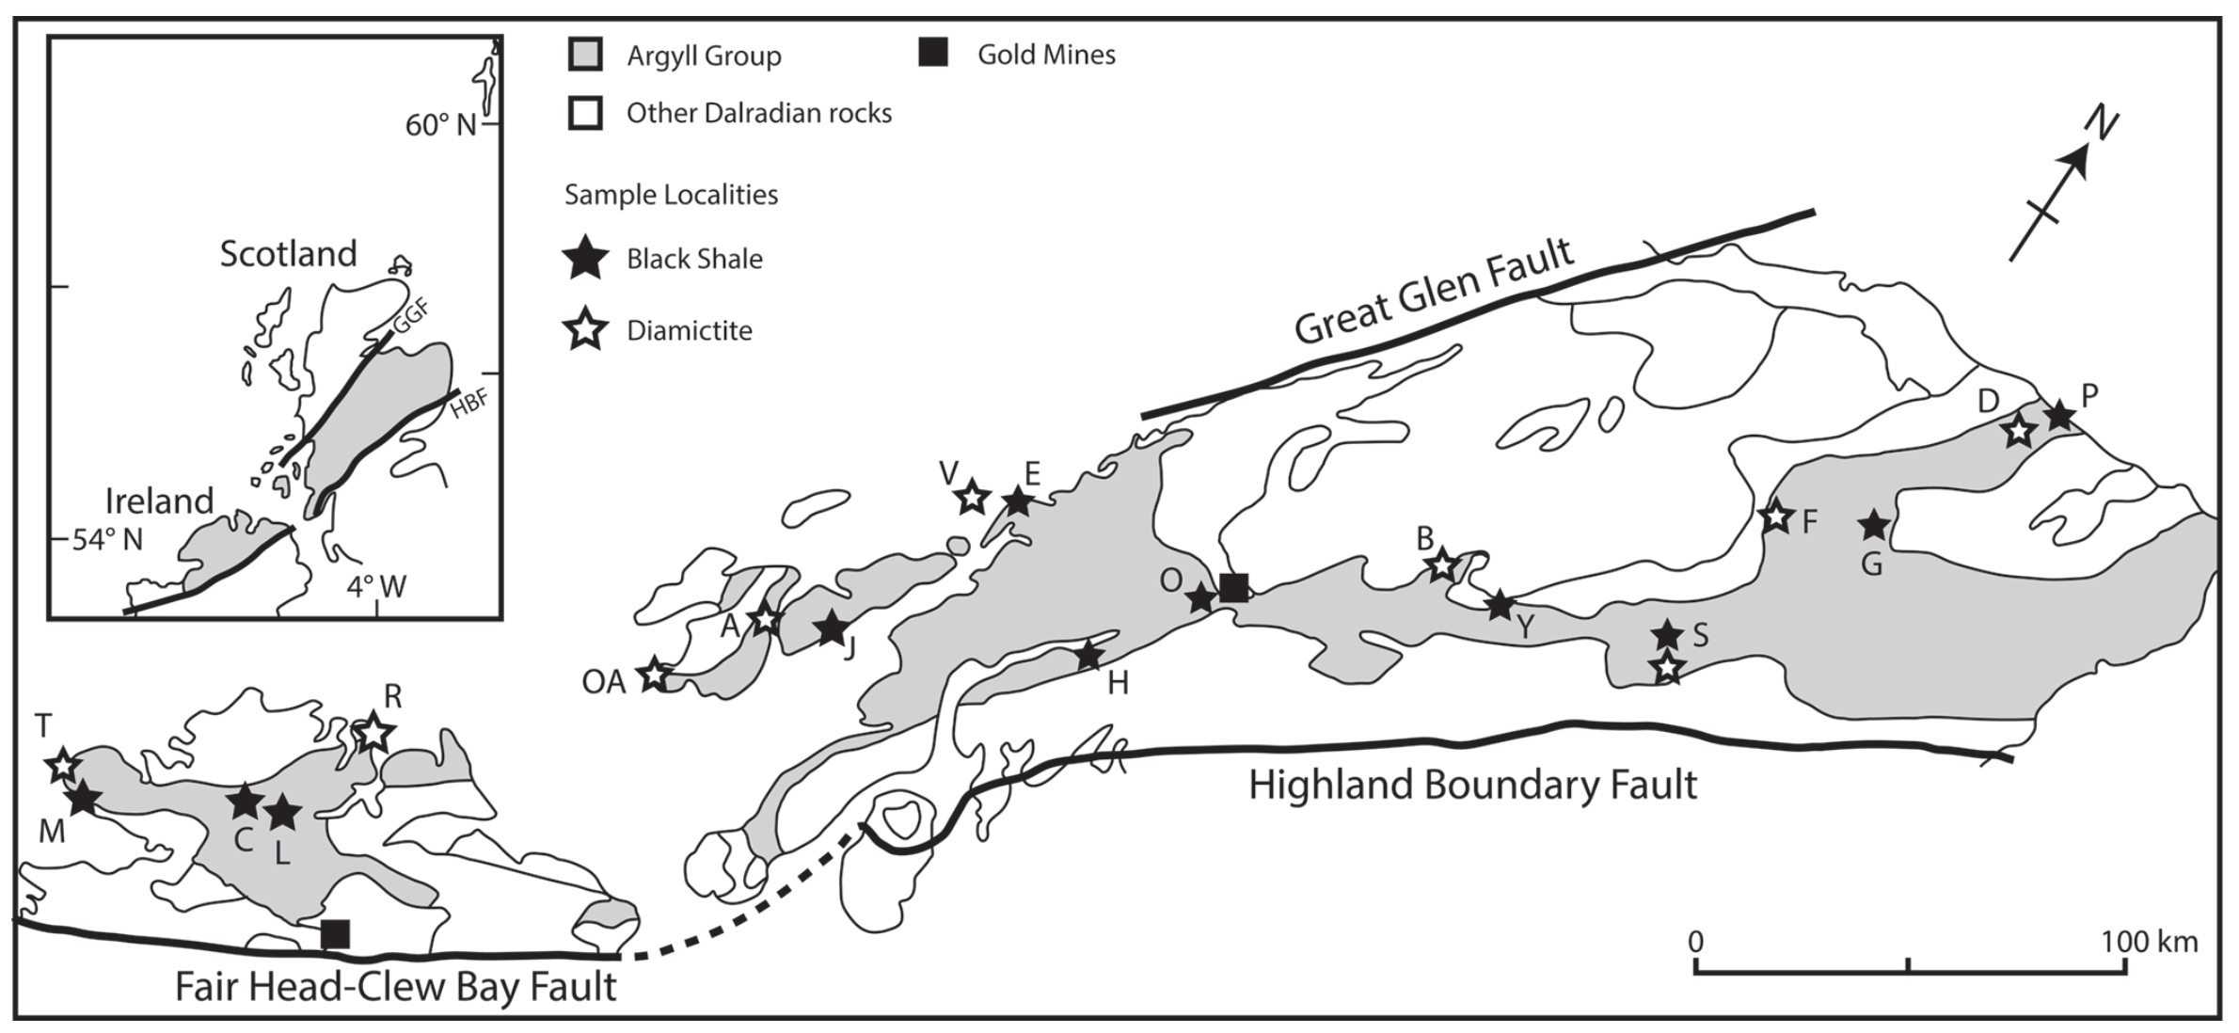
Parnell et al.
Geochemistry and metallogeny of Neoproterozoic pyrite in oxic and anoxic sediments
Figure 1 Sample map (after Prave et al., 2009). A, Port Askaig; B, Balmore; C, Cullion; D, Fordyce; E, Easdale; F, Meikle Fergie Burn; G, Glenbuchat; H, Strachur; J, Jura Forest; K, Kerrera; L, Bellanamore; M, Muckross; O, Strath Orchy; OA, Mull of Oa; P, Portsoy; R, Croaghan Hill; S, Glen Shee; T, Kiltyfannad/Glencolumbkille; V, Garvellachs; Y, Aberfeldy-Foss.
© 2018 The Authors
Published by the European Association of Geochemistry
under Creative Commons License CC BY 4.0
Parnell et al. (2018) Geochem. Persp. Let. 7, 12-16 | doi: 10.7185/geochemlet.1812
Notes:
Figure 1 Sample map (after Prave et al., 2009). A, Port Askaig; B, Balmore; C, Cullion; D, Fordyce; E, Easdale; F, Meikle Fergie Burn; G, Glenbuchat; H, Strachur; J, Jura Forest; K, Kerrera; L, Bellanamore; M, Muckross; O, Strath Orchy; OA, Mull of Oa; P, Portsoy; R, Croaghan Hill; S, Glen Shee; T, Kiltyfannad/Glencolumbkille; V, Garvellachs; Y, Aberfeldy-Foss.

