Slide 1
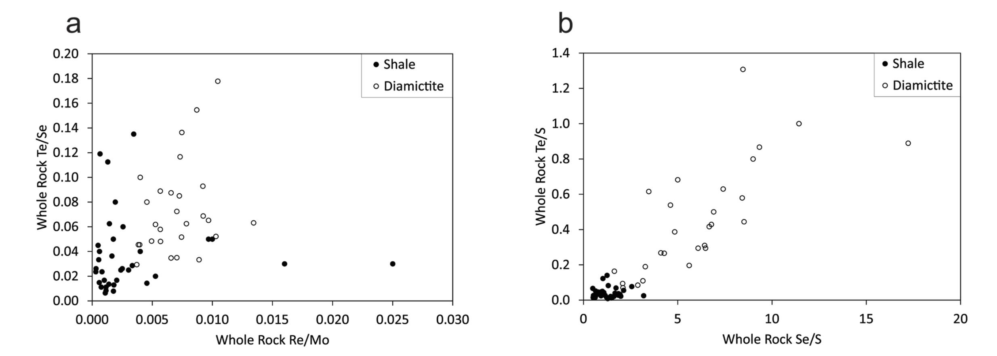
Parnell et al.
Geochemistry and metallogeny of Neoproterozoic pyrite in oxic and anoxic sediments
Figure 2 Cross-plots of (a) Re/Mo ratio against Te/Se ratio for whole rock samples of diamictites and shales, showing a broad correlation. Both parameters increase with oxygenation of the environment. Samples below detection limit (0.001 ppm) for Re plotted at 50 % of limit. (b) Te/S against Se/S for whole rock samples of diamictites and shales.
© 2018 The Authors
Published by the European Association of Geochemistry
under Creative Commons License CC BY 4.0
Parnell et al. (2018) Geochem. Persp. Let. 7, 12-16 | doi: 10.7185/geochemlet.1812
Notes:
Figure 2 Cross-plots of (a) Re/Mo ratio against Te/Se ratio for whole rock samples of diamictites and shales, showing a broad correlation. Both parameters increase with oxygenation of the environment. Samples below detection limit (0.001 ppm) for Re plotted at 50 % of limit. (b) Te/S against Se/S for whole rock samples of diamictites and shales.

