Slide 1
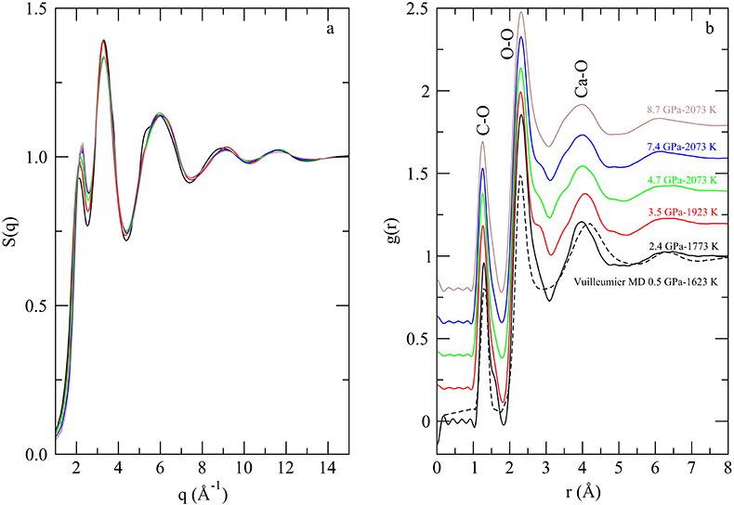
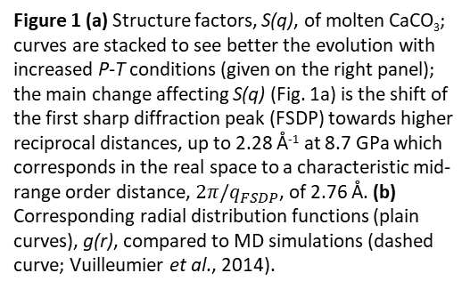
Hudspeth et al.
Properties of molten CaCO₃ at high pressure
Figure 1 (a) Structure factors, S(q), of molten CaCO₃; curves are stacked to see better the evolution with increased P-T conditions (given on the right panel); the main change affecting S(q) (Fig. 1a) is the shift of the first sharp diffraction peak (FSDP) towards higher reciprocal distances, up to 2.28 Å⁻¹ at 8.7 GPa which corresponds in the real space to a characteristic mid-range order distance, $2π/q_{FSDP}$, of 2.76 Å. (b) Corresponding radial distribution functions (plain curves), g(r), compared to MD simulations (dashed curve; Vuilleumier et al., 2014).
© 2018 The Authors
Published by the European Association of Geochemistry
under Creative Commons License CC BY-NC-ND 4.0
Hudspeth et al. (2018) Geochem. Persp. Let. 7, 17-21 | doi: 10.7185/geochemlet.1813
Notes:
Figure 1 (a) Structure factors, S(q), of molten CaCO₃; curves are stacked to see better the evolution with increased P-T conditions (given on the right panel); the main change affecting S(q) (Fig. 1a) is the shift of the first sharp diffraction peak (FSDP) towards higher reciprocal distances, up to 2.28 Å⁻¹ at 8.7 GPa which corresponds in the real space to a characteristic mid-range order distance, $2π/q_{FSDP}$, of 2.76 Å. (b) Corresponding radial distribution functions (plain curves), g(r), compared to MD simulations (dashed curve; Vuilleumier et al., 2014).

