Slide 1
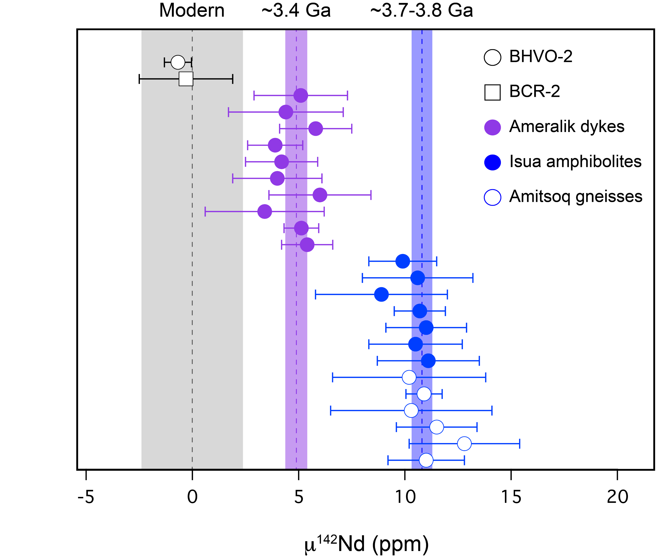
Saji et al.
Hadean geodynamics inferred from time-varying ¹⁴²Nd/¹⁴⁴Nd in the early Earth rock record
Figure 1 The µ¹⁴²Nd composition relative to JNdi-1 for terrestrial rock standards and rocks from Isua Supracrustal Belt. Error bars for each sample indicate the internal errors (2 SE). The grey band for modern samples is the 2 SD external reproducibility (Saji et al., 2016). The light purple band represents the …
© 2018 The Authors
Published by the European Association of Geochemistry
under Creative Commons License CC BY-NC-ND 4.0
Saji et al. (2018) Geochem. Persp. Let. 7, 43-48 | doi: 10.7185/geochemlet.1818
Notes:
Figure 1 The µ¹⁴²Nd composition relative to JNdi-1 for terrestrial rock standards and rocks from Isua Supracrustal Belt. Error bars for each sample indicate the internal errors (2 SE). The grey band for modern samples is the 2 SD external reproducibility (Saji et al., 2016). The light purple band represents the weighted mean and 2σ uncertainty (MSWD = 0.9) of the Palaeoarchean (~3.4 Ga) samples whereas the light blue band represents the weighted mean and 2σ uncertainty (MSWD = 0.5) of the Eoarchean (3.7-3.8 Ga) samples.

