Slide 1
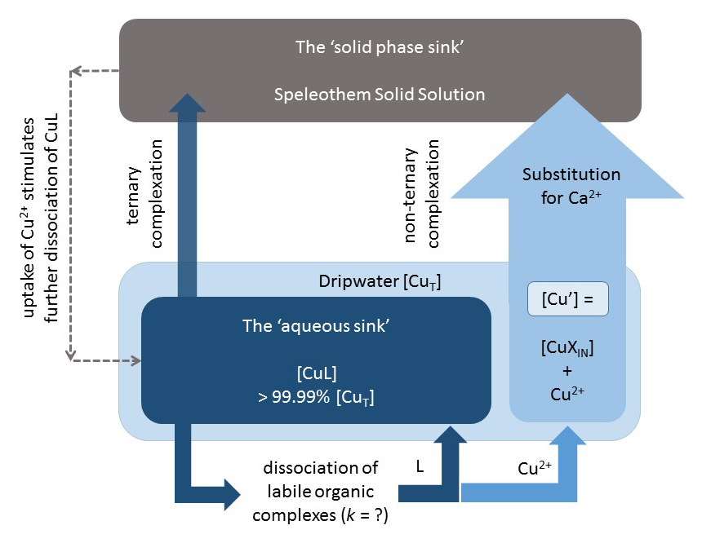
Hartland and Zitoun
Transition metal availability to speleothems controlled by organic binding ligands
Figure 3 Conceptual diagram illustrating the influence of Cu ligands on the incorporation of Cu in speleothems.
© 2018 The Authors
Published by the European Association of Geochemistry
under Creative Commons License CC BY-NC-ND 4.0
Hartland and Zitoun (2018) Geochem. Persp. Let. 8, 22-25 | doi: 10.7185/geochemlet.1824
Notes:
Figure 3 Conceptual diagram illustrating the influence of Cu ligands on the incorporation of Cu in speleothems.

