Slide 1
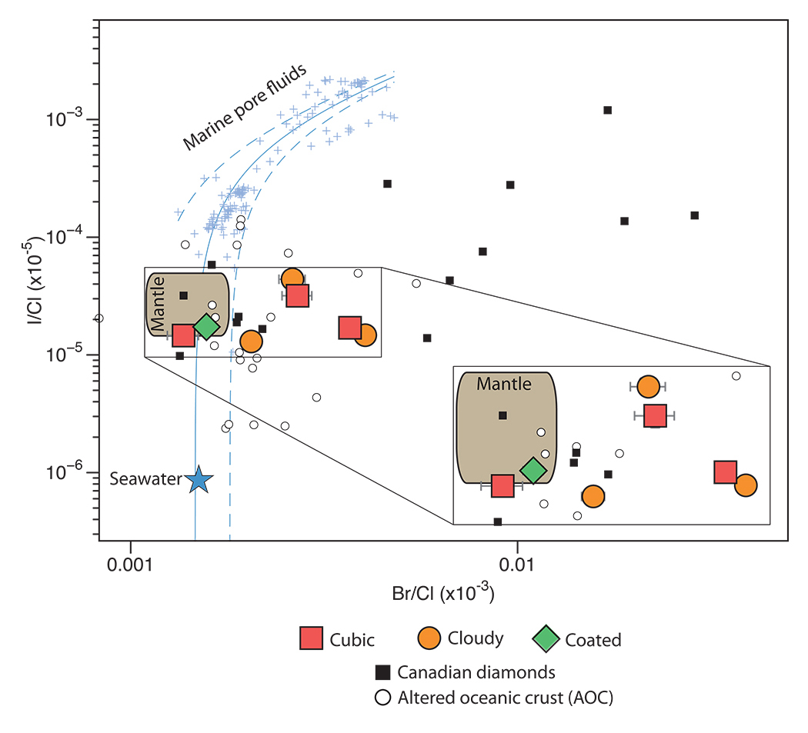
Broadley et al.
Plume-lithosphere interaction, and the formation of fibrous diamonds
Figure 1 Log-log plot of I/Cl vs. Br/Cl (mol/mol) for the Nyurbinskaya diamonds. Seawater, average mantle, marine pore fluids, altered oceanic crust fluids (AOC) and Canadian diamonds are shown for reference (Johnson et al., 2000; Muramatsu et al., 2007 and references therein; Kendrick et al., 2012; Chavrit et al., 2016). Nyurbinskaya diamonds…
© 2018 The Authors
Published by the European Association of Geochemistry
under Creative Commons License CC BY-NC-ND 4.0
Broadley et al. (2018) Geochem. Persp. Let. 8, 26-30 | doi: 10.7185/geochemlet.1825
Notes:
Figure 1 Log-log plot of I/Cl vs. Br/Cl (mol/mol) for the Nyurbinskaya diamonds. Seawater, average mantle, marine pore fluids, altered oceanic crust fluids (AOC) and Canadian diamonds are shown for reference (Johnson et al., 2000; Muramatsu et al., 2007 and references therein; Kendrick et al., 2012; Chavrit et al., 2016). Nyurbinskaya diamonds range from mantle values towards enriched Br/Cl, similar to AOC and Canadian diamonds suggesting there has been an input of Br-rich fluids to the Siberian lithosphere. Uncertainties are 1σ when shown and are often smaller than symbol size.

